Slide 1

How Scientists Use Evidence
Physical & Chemical Changes
OBSERVE
What do I actually see, measure, or record?
• Bubbles formed
• 22°C → 31°C
• White solid appeared
• Color changed
• Solid became liquid
INTERPRET
What could those observations mean?
An observation becomes useful evidence only when we interpret it in context.
CONCLUDE
What explanation is best supported by ALL the evidence?
Avoid jumping from one clue directly to a conclusion.
OBSERVE → EVIDENCE → INTERPRET → CONCLUDE
STEM Scholars Hub - Middle School STEM • Physical & Chemical Changes • SC.8.P.9.2

Slide 2
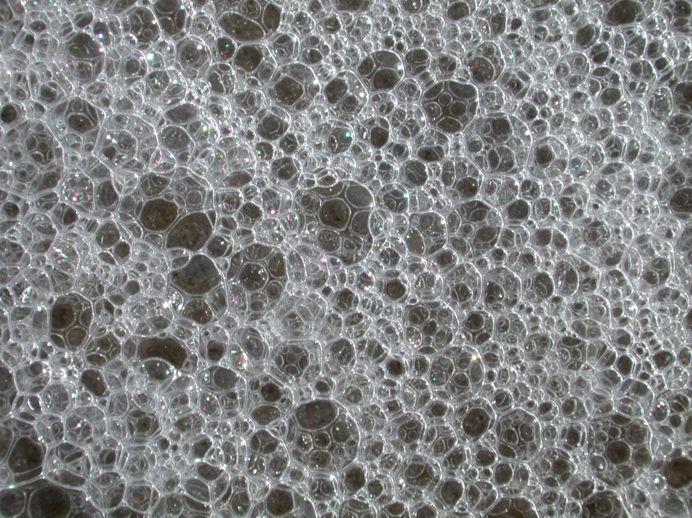

Slide 3
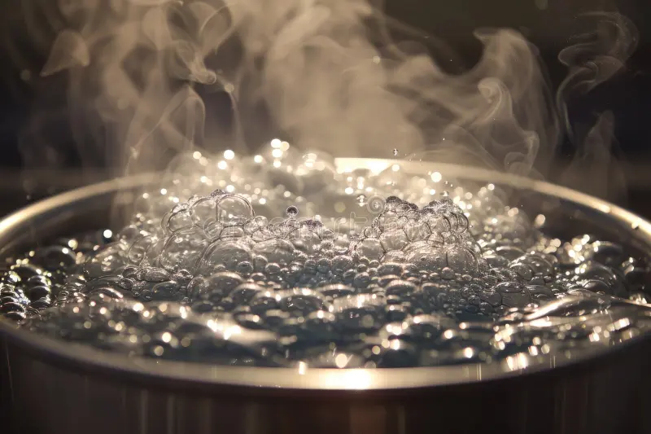

Slide 4
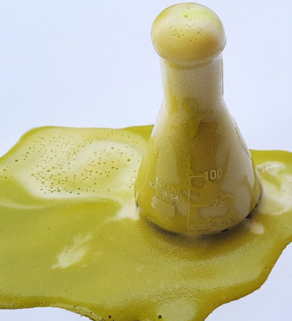
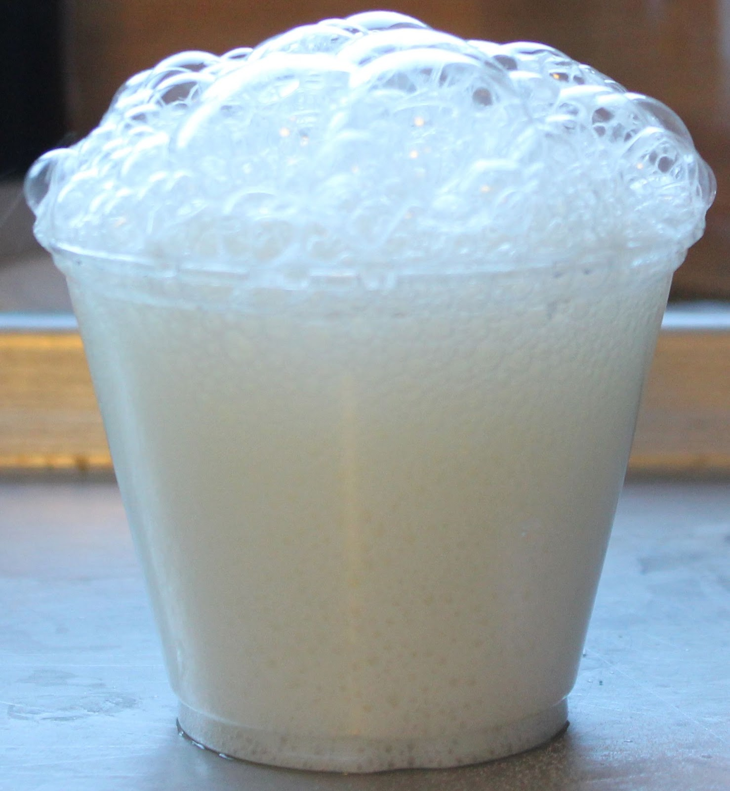

Slide 5
Observation vs. Evidence
The first step is separating what happened from what it might mean.
OBSERVATION
A direct description or measurement.
Examples:
• “Bubbles formed.”
• “The temperature rose 9°C.”
• “A white solid appeared.”
• “The solid became a liquid.”
EVIDENCE
An observation used to support an explanation.
Examples:
• Gas production may suggest a reaction.
• An unexpected temperature change may show energy transfer.
• A new precipitate may suggest a new substance formed.
STEM Scholars Hub - Middle School STEM • Physical & Chemical Changes • SC.8.P.9.2

Slide 6
What Can Suggest a Chemical Change?
These are clues—not automatic proof.
Gas / bubbles produced
May indicate formation of a gas.
New solid forms
A precipitate can be strong evidence of a new substance.
Unexpected color change
May indicate formation of different substances.
Unexpected temperature change
May show energy was released or absorbed.
Light or new odor
May accompany a chemical reaction.
STEM Scholars Hub - Middle School STEM • Physical & Chemical Changes • SC.8.P.9.2

Slide 7
The Big Question
Use the evidence to answer this—not appearance alone.
DID A NEW SUBSTANCE FORM?
If NO
The change is generally PHYSICAL.
The material may change size, shape, or state.
If YES
The change is CHEMICAL.
Support the conclusion with evidence.
The stronger the conclusion, the stronger the evidence should be.
STEM Scholars Hub - Middle School STEM • Physical & Chemical Changes • SC.8.P.9.2

Slide 8
One Observation ≠ Proof
A single clue can have more than one explanation.
BUBBLES
Not automatically chemical.
Boiling water has bubbles, but H₂O is simply changing from liquid to gas.
Ask: What produced the bubbles?
TEMPERATURE
Not automatically chemical.
Heating ice changes its temperature and state without creating a new substance.
Ask: Was the change unexpected without external heating/cooling?
COLOR
Not automatically chemical.
Appearance can change for physical reasons.
Ask: What other evidence supports formation of a new substance?
STEM Scholars Hub - Middle School STEM • Physical & Chemical Changes • SC.8.P.9.2

Slide 9
Model the Reasoning
Do one example together before students begin the case files.
DATA
Two clear liquids are mixed.
• White solid appears
• Temperature rises
22°C → 31°C
• No external heat is added
EVIDENCE
• A new solid formed.
• The mixture warmed unexpectedly.
These are multiple pieces of evidence, not just one clue.
CONCLUSION
The evidence strongly supports that a chemical change occurred.
Use careful language:
“The evidence supports…”
STEM Scholars Hub - Middle School STEM • Physical & Chemical Changes • SC.8.P.9.2

Slide 10
Sentence Frame for the Case Files
Students should cite the data provided on the worksheet.
I observed ________________________________.
This provides evidence that __________________.
The evidence suggests _______________________.
Therefore, my conclusion is _________________ because __________________.
Find the clues in the data. Do not guess.
STEM Scholars Hub - Middle School STEM • Physical & Chemical Changes • SC.8.P.9.2

Slide 11
Your Job: Analyze the Case Files
You are reviewing data collected by another laboratory.
STEP 1
READ the case carefully.
STEP 2
IDENTIFY the observations and measurements.
STEP 3
DECIDE which observations are useful evidence.
STEP 4
INTERPRET what the evidence suggests.
STEP 5
CONCLUDE—and defend your answer with data.
STEM thinking: evidence first, conclusion second.
STEM Scholars Hub - Middle School STEM • Physical & Chemical Changes • SC.8.P.9.2

