Slide 1


Slide 2


Slide 3
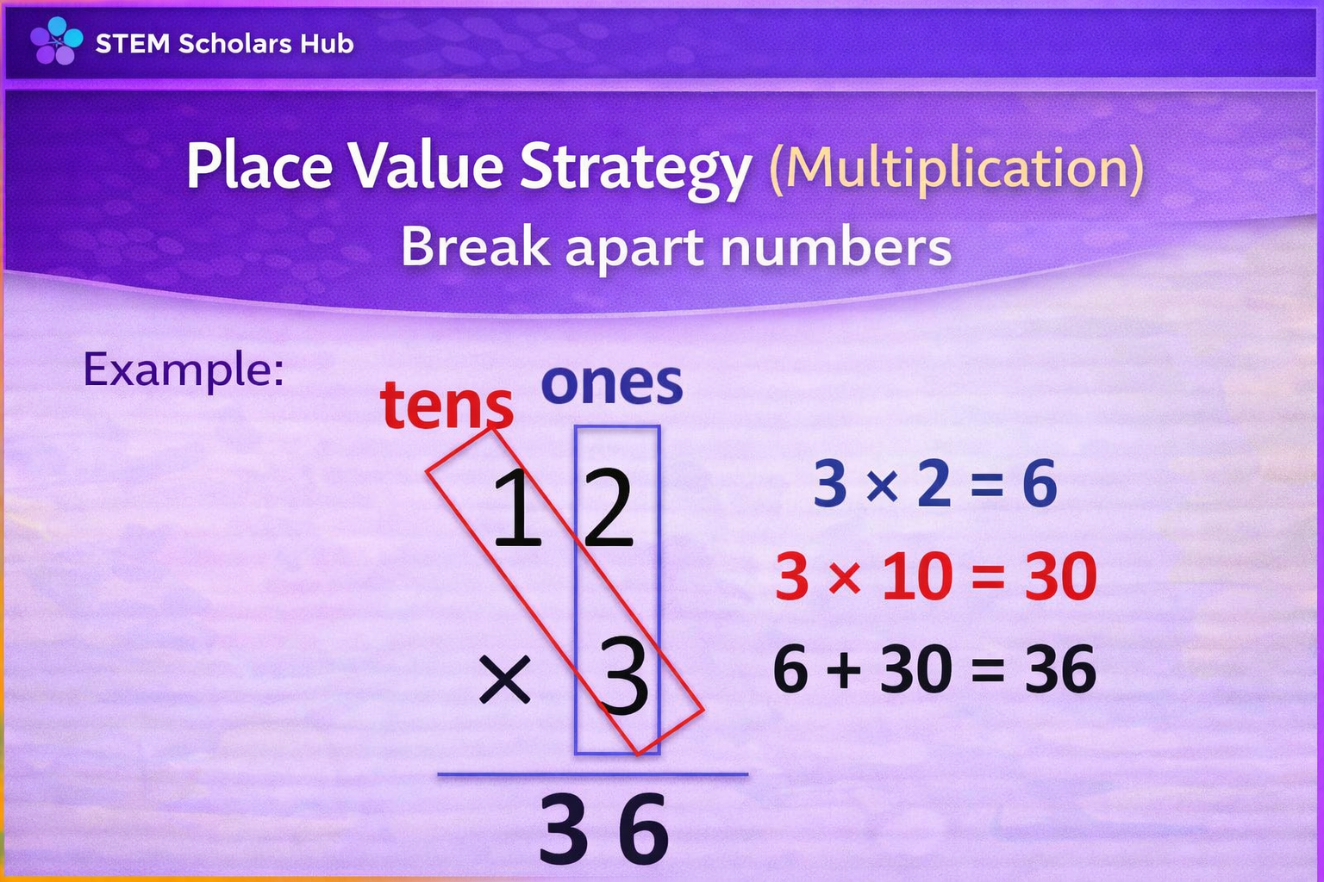

Slide 4
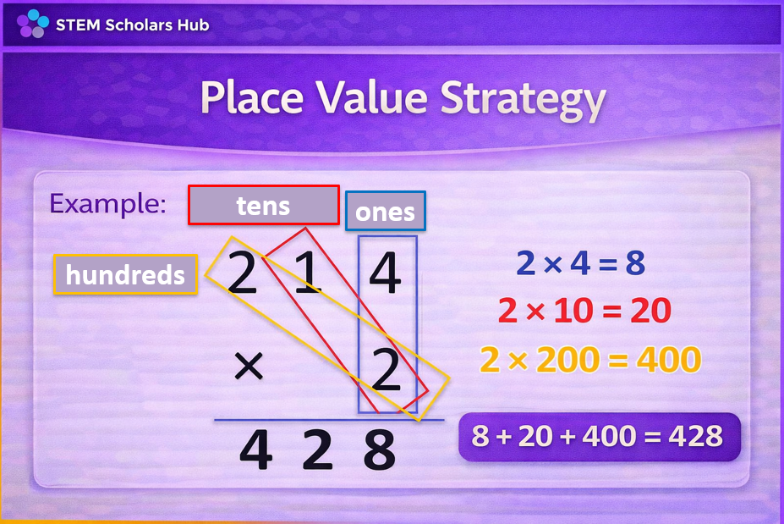

Slide 5
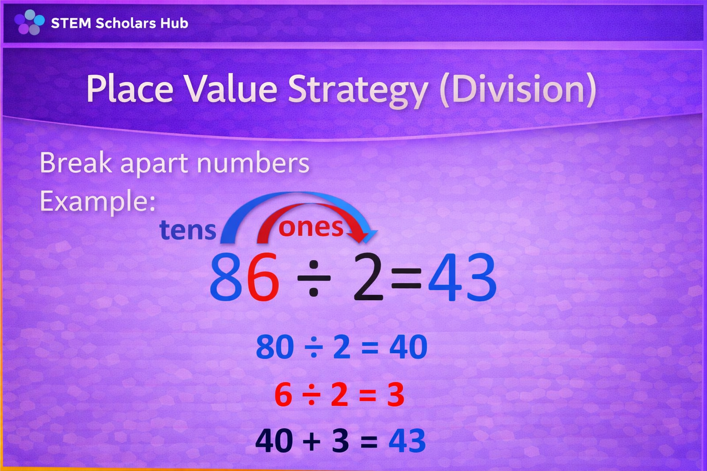

Slide 6
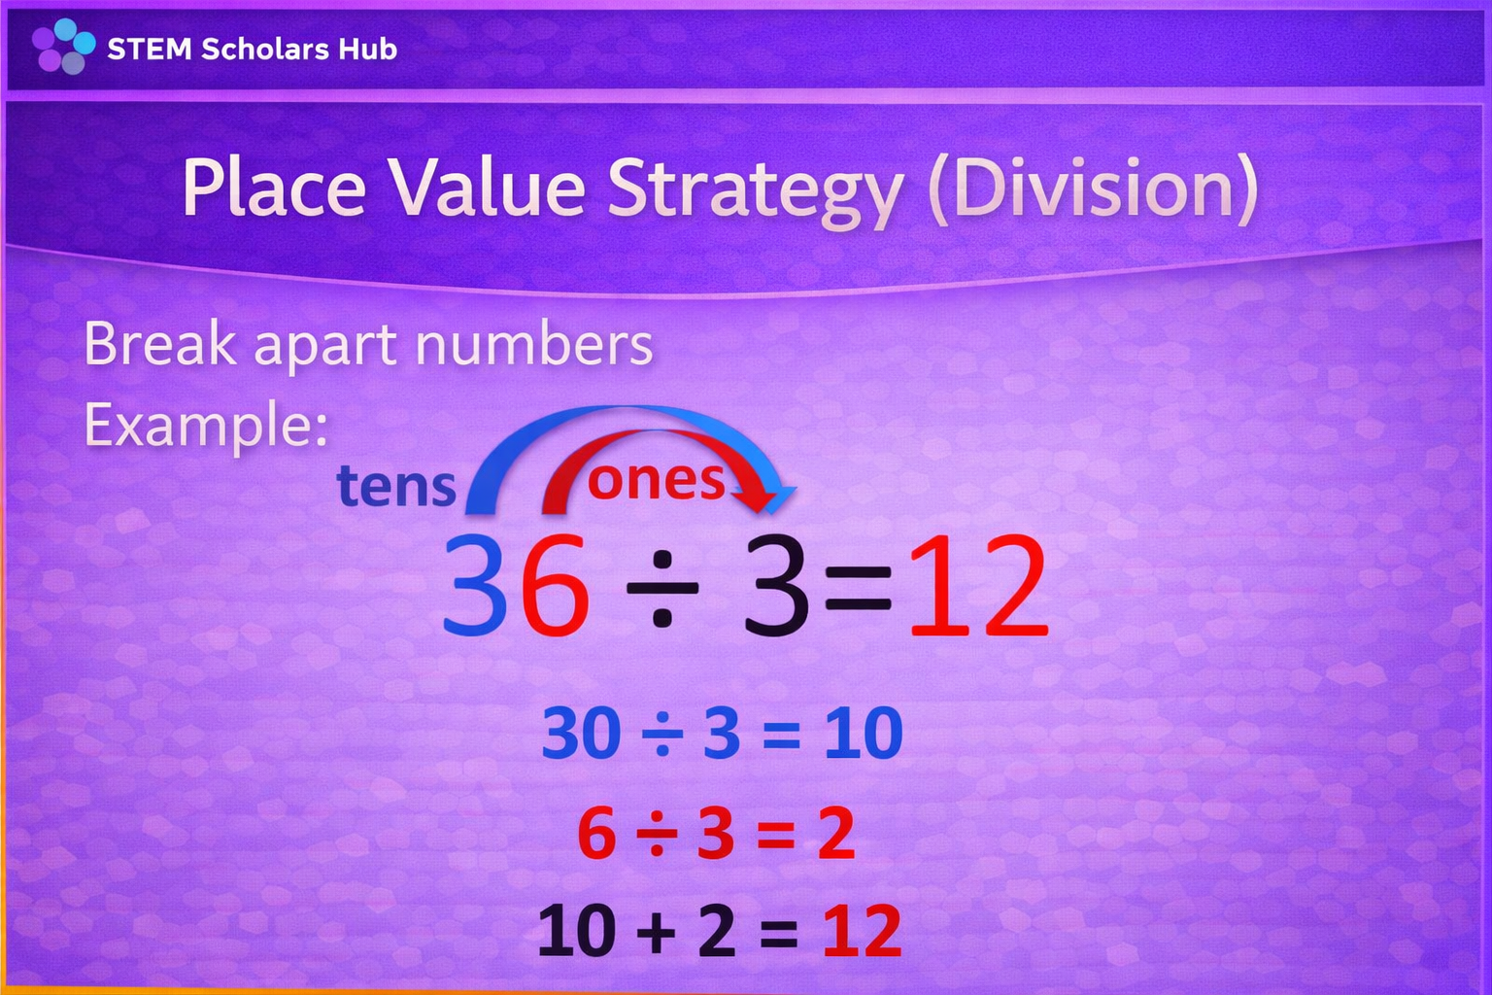

Slide 7
Practice
Instruction: Use the Place value strategy
14 × 2 = ___
24 ÷ 4 = ___
13 × 3 = ___
30 ÷ 5 = ___

