Slide 1
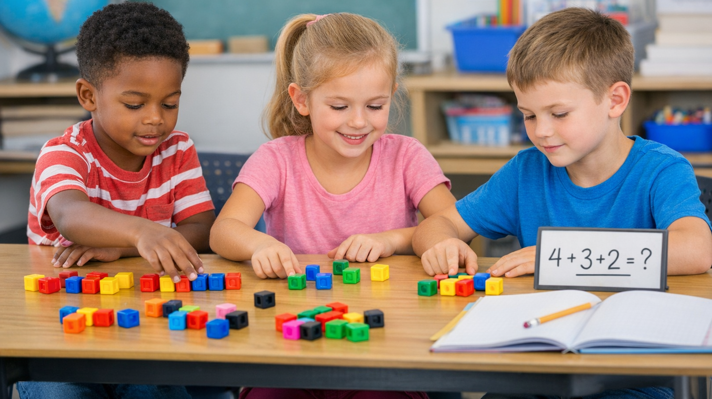
Benchmark: MAFS.1.OA.1.2 - Adding Three Numbers in Word Problems
Learning to Add Three Numbers Up to 20

Slide 2
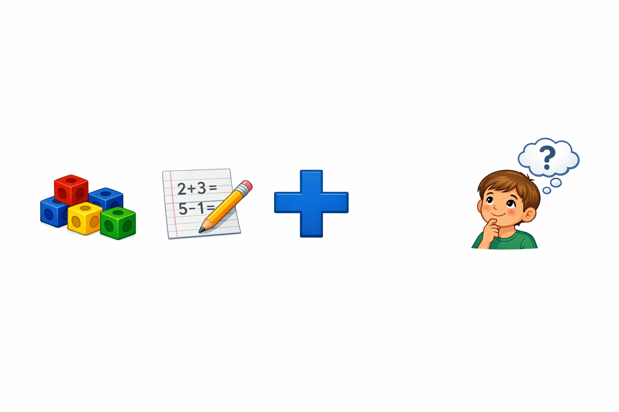
Learning Goal
Today we will learn how to:
• Add three numbers together
• Solve fun word problems
• Use pictures or drawings to help us count
• Write a math equation
Notes:
Teacher Tip:
Ask students to repeat:
“I can add three numbers!”

Slide 3
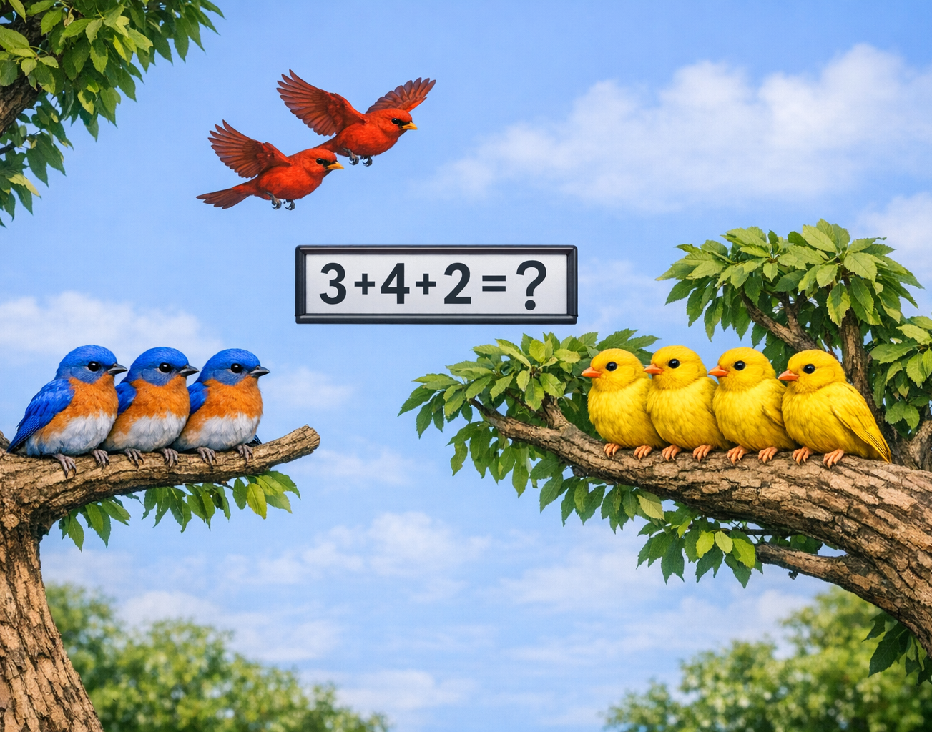
Let’s Think!
🐦 3 birds on a tree
🐦 4 birds on another branch
🐦 2 birds flying nearby
How many birds are there in all?
We can add the numbers together!
3 + 4 + 2 = ?

Slide 4



Key Vocabulary
Add: Putting numbers together
Sum: The answer to an addition problem
Equation: A math sentence with numbers
Unknown: A missing number we must find
Example: There are 5 blue flowers, 5 yellow flowers, and 3 red flowers in the garden. How many flowers are there in all?
5 + 5 + 3 = □

Slide 5
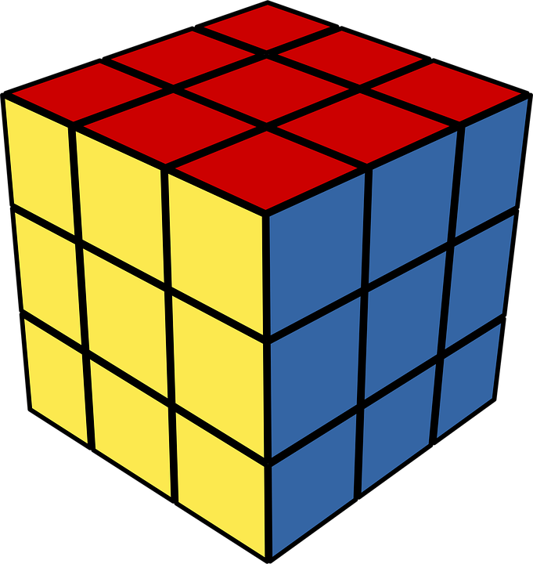

We Can Use Objects to Count
Students can solve problems using:
• cubes
• counters
• toys
• drawings
Example:
3 cubes
4 cubes
2 cubes
3 + 4 + 2 =?

Slide 6
Draw to Solve
Example:
3 apples
4 apples
2 apples
🍎🍎🍎
🍎🍎🍎🍎
🍎🍎
3+4+2=
9
Notes:
Instruct the student to draw when solving. Show the picture when the student is done drawing.

Slide 7
Step-by-Step Strategy
Step 1: Read the problem.
Step 2: Find the three numbers.
Step 3: Add them together.
Step 4: Check your answer.
Example:
5 + 3 + 2
First add:
5 + 3 = 8
Then add:
8 + 2 = 10

Slide 8
We add numbers when we count:
• toys
• snacks
• animals
• books
Example:
4 toy cars
3 toy trucks
2 toy buses
How many toys?
4 + 3 + 2 = 9

Slide 9
Let’s Practice
Solve these problems.
1️⃣3 + 5 + 2 = □
2️⃣6 + 1 + 3 = □
3️⃣There are 🐶 4 dogs running in the park, then🐶 3 more dogs arrive and 🐶 2 are dogs are playing. How many dogs are there?

Slide 10
What Did We Learn?
Today we learned how to:
✔ Add three numbers
✔ Solve word problems
✔ Use drawings or objects
✔ Write equations
Exit Ticket
Solve:
5 + 4 + 1 = □
Draw a picture to show your answer.

