Slide 1
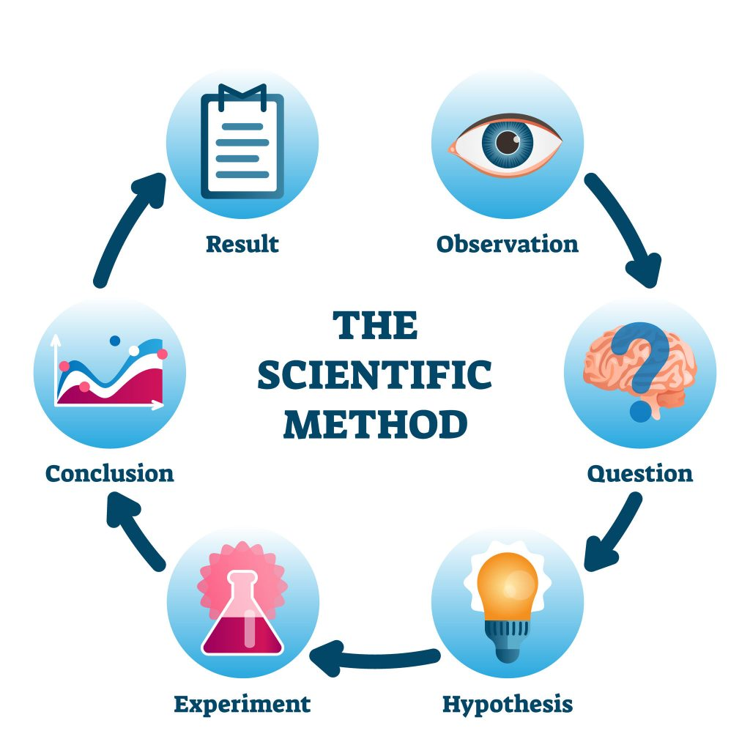
The Scientific Method
How Scientist Solve Problems
SC.6.N.1.1 – Students plan and carry out scientific investigations using the scientific method, including asking questions, forming hypotheses, conducting experiments, and analyzing data.
JOHN MARK L. BARBADO, M.Ed.
STEM Teacher
Image Source: Scientific-Method-1024x1024.jpg (1024×1024)

Slide 2

What is the Scientific Method?
The Scientific Method is a systematic, step-by-step process scientists use to investigate questions, test ideas, and understand the world. It ensures investigations are organized, fair, and based on evidence.
Steps of the Scientific Method
1. Observe – Notice something interesting or unusual.
2. Ask Questions – Identify a specific, testable problem.
3. Hypothesize – Make an educated guess that can be tested.
4. Test Ideas (Experiment) – Conduct experiments changing one variable at a time.
5. Gather Evidence (Data Collection) – Record observations and measurements.
6. Draw Conclusions – Decide whether your hypothesis is supported.
7. Communicate Results – Share findings so others can learn and repeat the experiment.

Slide 3
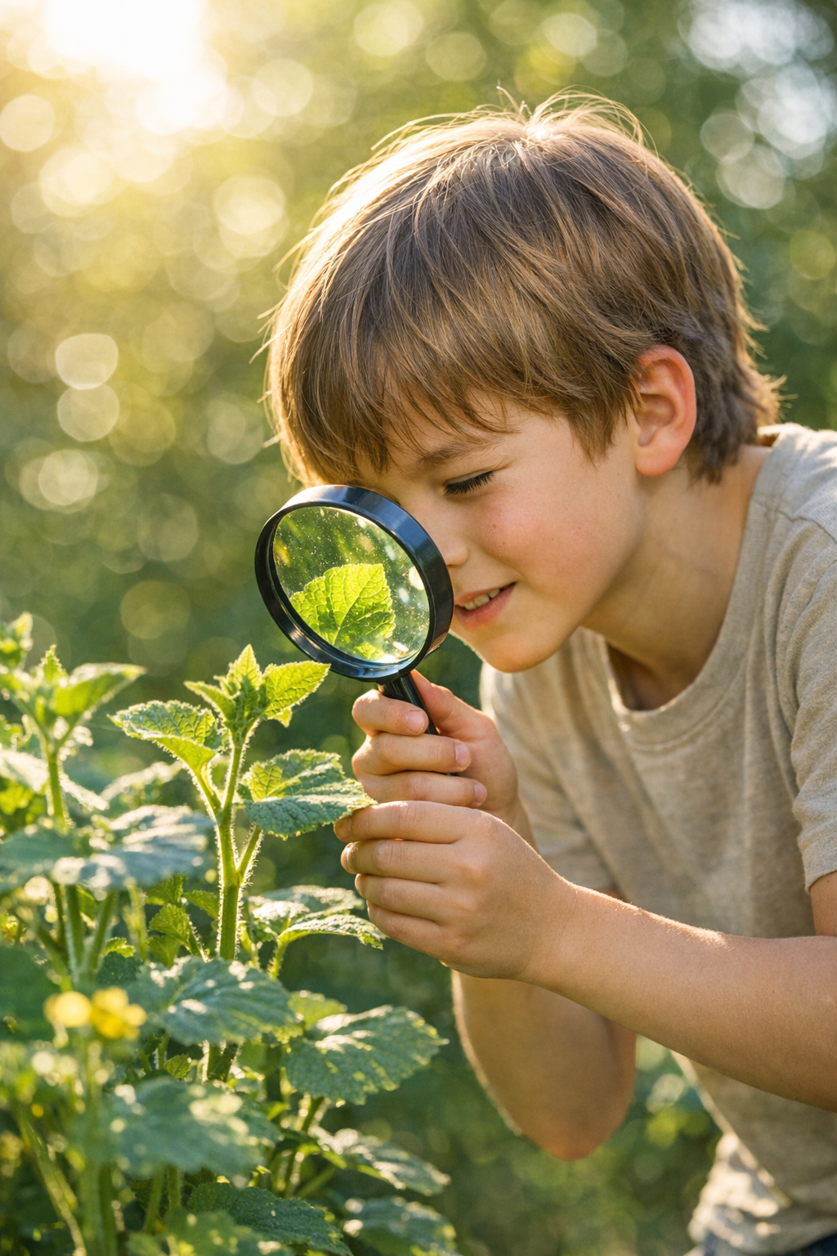
Observe and Ask Questions
Every scientific investigation begins with observations.
Observations can be qualitative (descriptions) or quantitative (measurements).
From observations, scientists ask a specific, testable question.
Example:
A student notices that plants near a window are taller than plants placed in shade.
Question: Does sunlight affect how fast a plant grows?

Slide 4

Research and Form a Hypothesis
Research: Gather information from books, articles, previous studies, or reliable websites.
Hypothesis: A testable prediction based on your observations and research.
Usually written as If…Then…Because… to explain the reasoning.
Example Hypothesis:
If a plant receives more sunlight, then it will grow taller because sunlight helps plants produce food through photosynthesis.

Slide 5
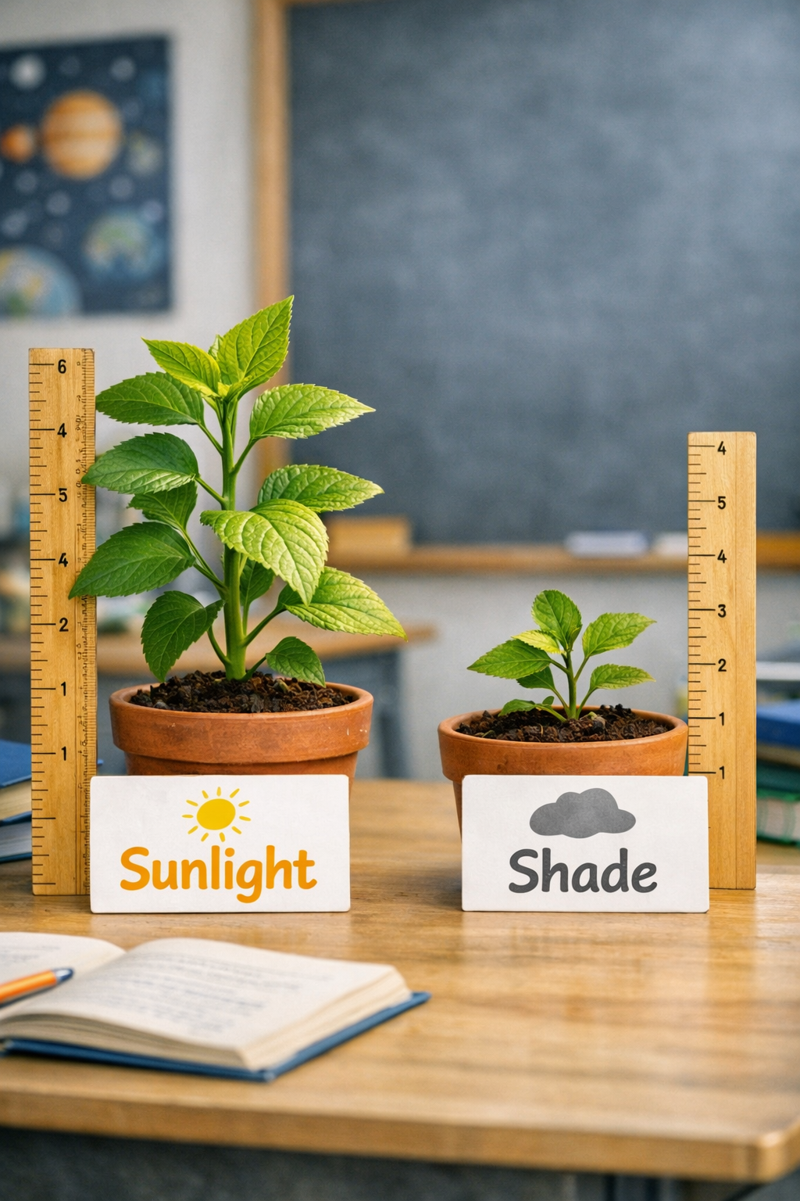
Conduct an Experiment
Design a test to check the hypothesis.
Identify variables:
  Independent Variable: The factor that is changed (amount of sunlight).
  Dependent Variable: The factor that is measured (plant height).
  Controlled Variables: Factors kept the same (soil type, water amount, pot size, plant species).
Example Experiment:
Plant A in sunlight, Plant B in shade
Water both equally for 3 weeks
Observe growth weekly

Slide 6
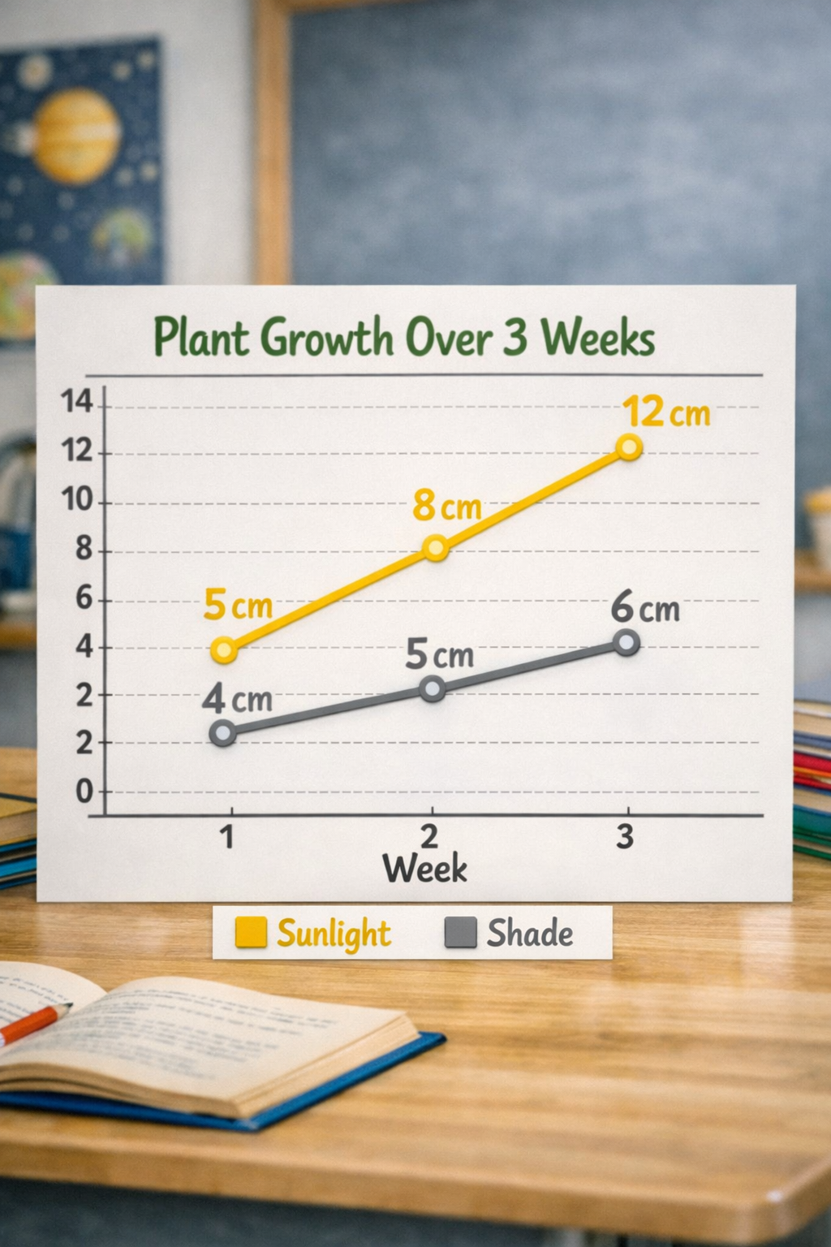
Collect and Analyze Data
Data Collection: Record measurements and observations carefully.
Data Analysis: Organize data to identify patterns. Use tables, charts, or graphs.
Example Data Table:
Week | Plant in Sunlight | Plant in Shade
1 | 5 cm | 4 cm
2 | 8 cm | 5 cm
3 | 12 cm | 6 cm
Graphs can visually show which plant grew faster.

Slide 7
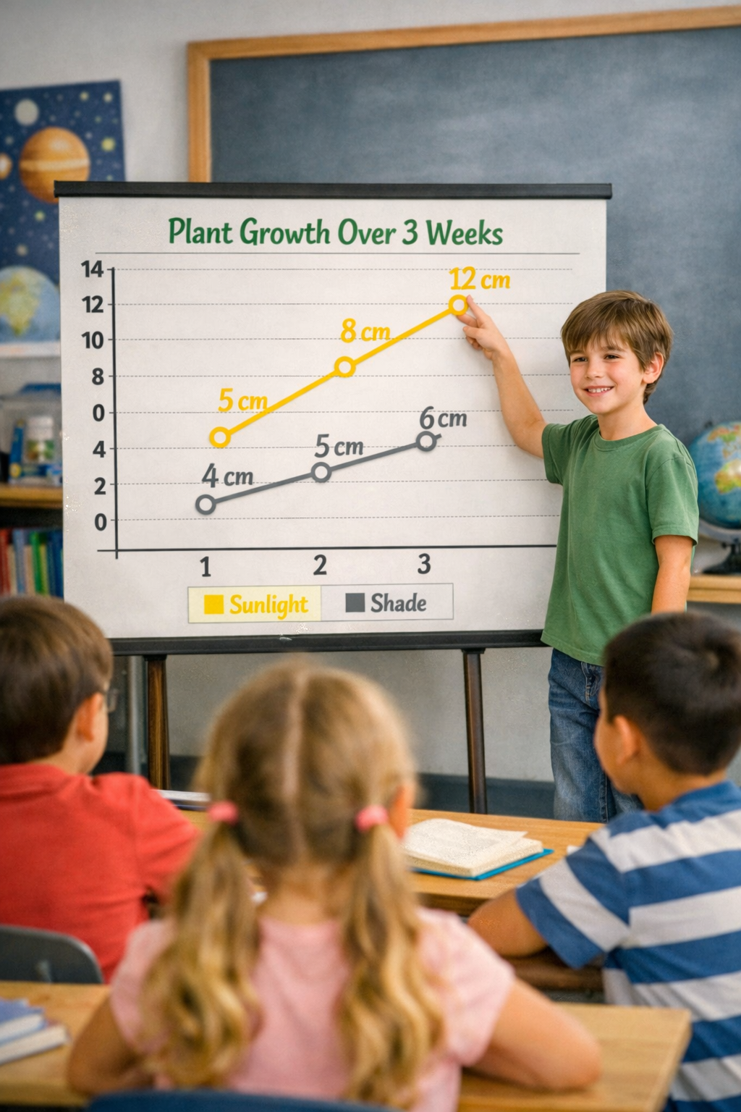
Draw Conclusions and Communicate Results
Conclusion: Compare data to your hypothesis. Was it supported?
Communication: Share results through reports, presentations, or discussions. This allows other scientists to review and repeat the investigation.
Example Conclusion:
The plant in sunlight grew taller, supporting the hypothesis that sunlight helps plants grow.

Slide 8
Friction Experiment
Instructions: Use the Scientific Method to complete the experiment. Fill in your answers as you go.
Steps:
Observation: What do you notice about how objects move on different surfaces?
Question: What do you want to find out?
Hypothesis: If a toy car rolls on a ______ surface, then it will travel ______ because ______.
Experiment Design:
  Independent Variable: ______
  Dependent Variable: ______
  Controlled Variables: ______
Data Collection: Record distances traveled.
Conclusion: Was your hypothesis supported? Explain.
Communicate Results: Share your findings in a graph, chart, or short report.
Surface | Distance Traveled
Download Note: Download the full Experiment Guide at www.innovatewithmrbarbado.com for detailed instructions and templates.

