Slide 1
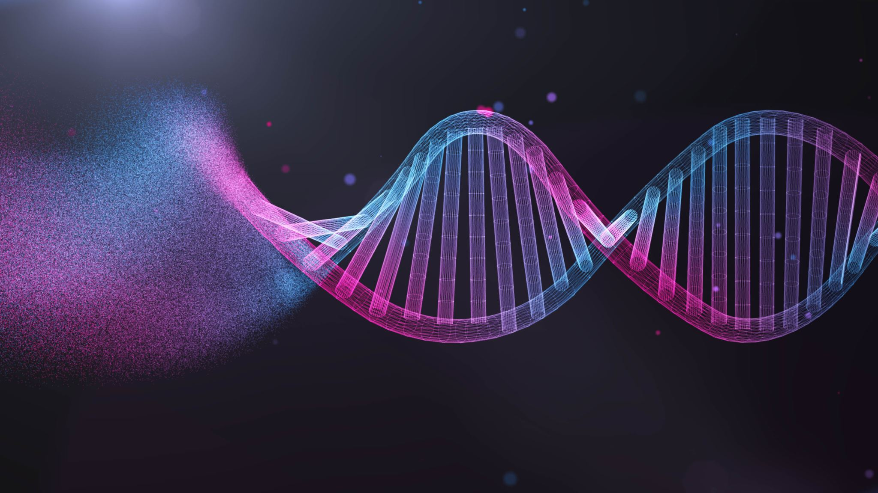
DNA Model Project
The DNA model helps us learn and understand the structure and function of DNA molecules with the help of a model. In this project, we will use materials that are easily available and follow simple instructions on how to make a model systematically.

Slide 2
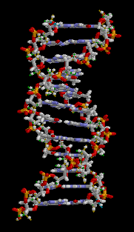
What does DNA stands for?
DNA stands for deoxyribonucleic acid, and it's a molecule that supplies the genetic instructions that tell living creatures how to develop, live and reproduce. DNA can be found inside every cell and is passed down from parents to their offspring.
DNA is a molecule that can be thought of as the
blueprint of life. In other words, it acts as a template
which is replicated before cell division. It provides the
information for building all the proteins within every
living thing.

Slide 3
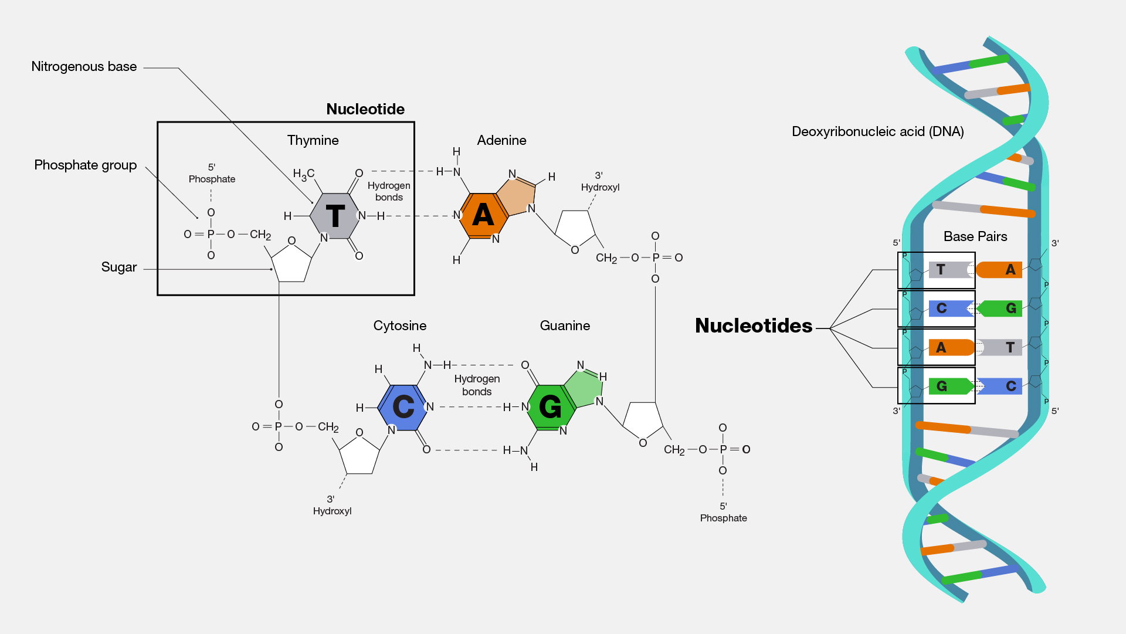

Slide 4
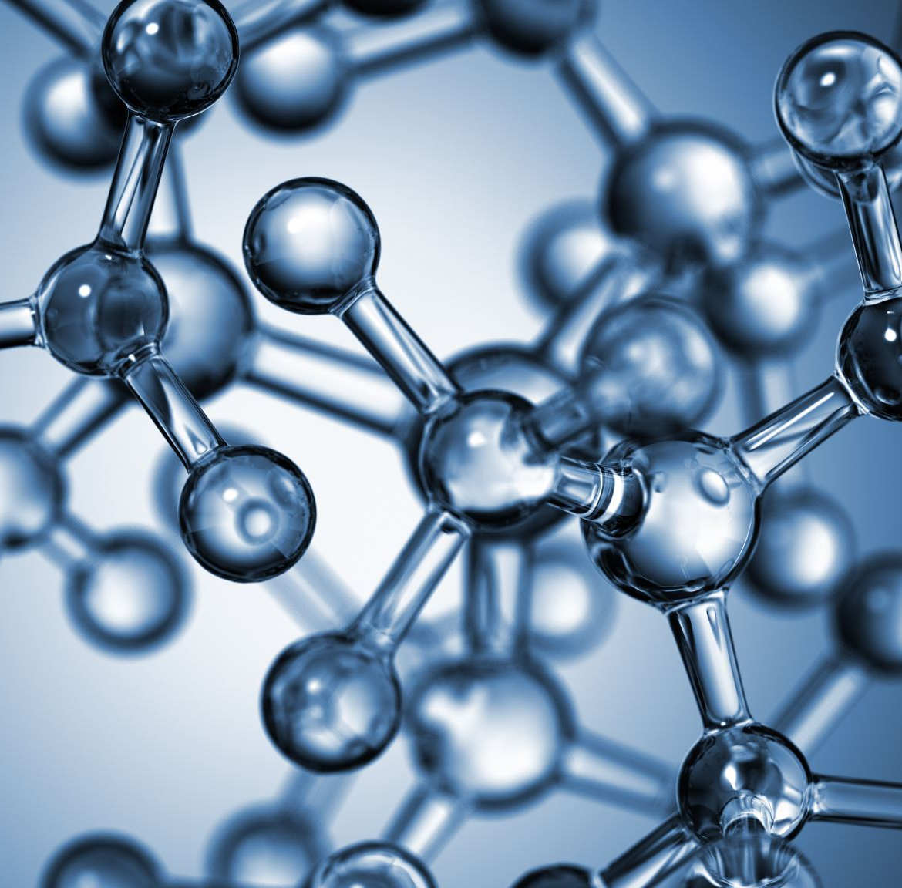
Is a person's DNA unique?
Although each organism's DNA is unique, all DNA is composed of the same nitrogen-based molecules. So how does DNA differ from organism to organism? It is simply the order in which these smaller molecules are arranged that differs among individuals.

Slide 5
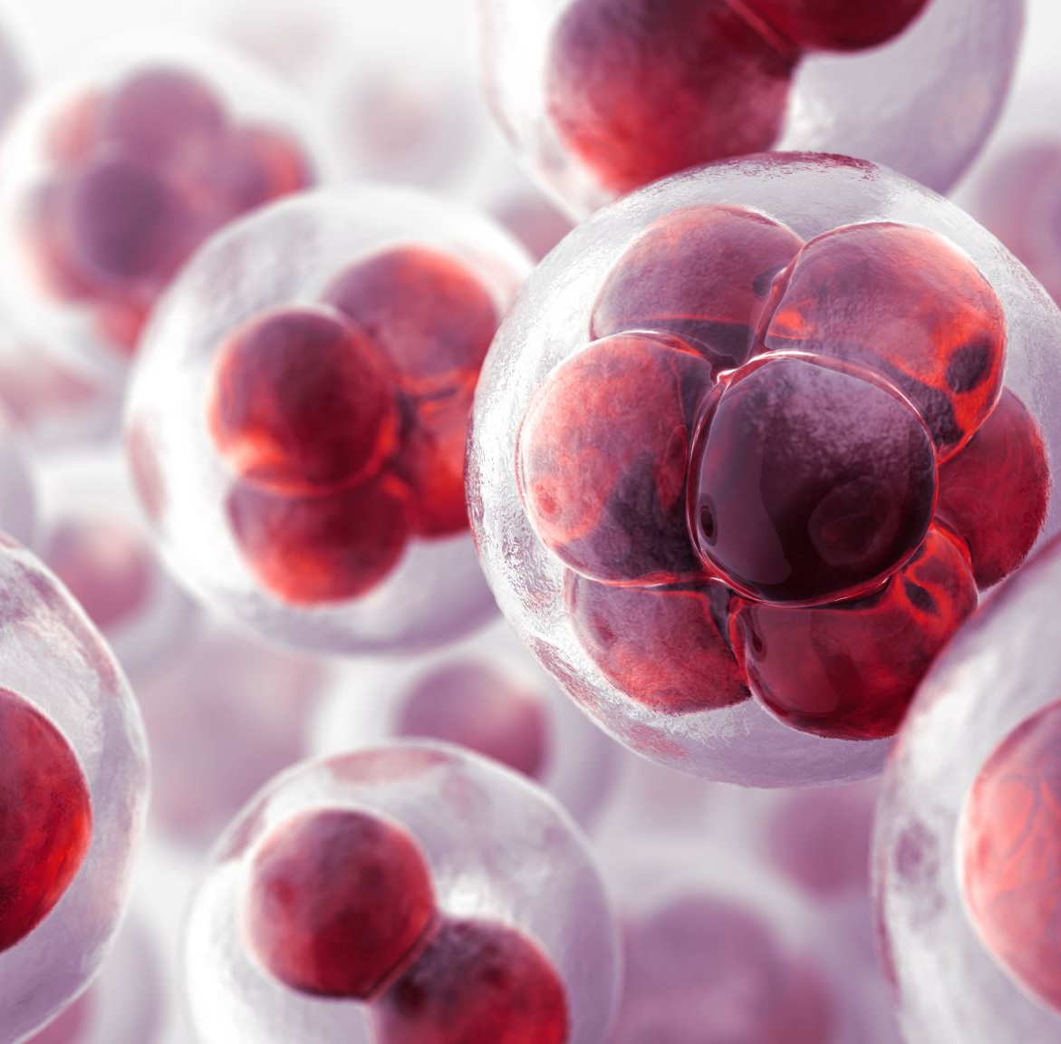
Is DNA unique for everyone with one exception?
Every person has unique DNA, a signature uniquely reproduced in his or her cells. The only exception to this is identical siblings; identical siblings will have the same DNA.

Slide 6
How unique am I genetically?
It's often said that humans are 99.9% identical. And what makes us unique is a measly 0.1% of our genome. This may seem insignificant. But what these declarations fail to point out is that the human genome is made up of three billion base pairs—which means 0.1% is still equal to three million base pairs

Slide 7
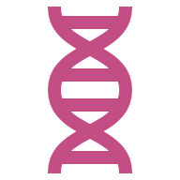
How is DNA used to identify relationships?
Special locations (called loci) in human DNA display predictable inheritance patterns that could be used to determine biological relationships. These locations contain specific DNA sequences, called markers, that forensic and DNA scientists use as identifying marks for individuals.

Slide 8
What is the importance of DNA in family?
While DNA tests can't predict the future, they can tell you if you are biologically related to the members of your family with a history of certain diseases. Alzheimer's, Parkinson's, some cancers, blood diseases, and mental health issues can all be genetic.

Slide 9
Materials:
Base/Stand
Cardboard
1 Strip of folder (2”)
Pencil
Hot glue stick
Scissors
DNA
5pcs straws
- Printer paper
2 strips of folder (1”)
Hot glue stick
Scissors

Slide 10
DNA Model Instructions
Prepare the DNA bases: Cut each plastic straw into three equal pieces.
1
Create base pairs
2
Use tape to connect two straw pieces side by side.
Follow the base-pair rules:
Adenine (A) with Thymine (T)
Cytosine (C) with Guanine (G)
Create at least 12 base pairs, alternating between A–T and C–G.
Create the helix support: Roll the folder tightly into a tube that can slide over the pencil and spin freely.
3
Attach the base pairs: Glue the base-pair straws onto the rolled folder in a spiral pattern. Slightly rotate each pair to form the double helix shape.
4
Build the base: Use a glue gun to secure the pencil upright in the center of the base of the plastic cup. Allow the glue to dry completely.
5
Assemble the DNA model: Slide the rolled folder with attached base pairs onto the pencil so the model can spin.
6
Label the model: Clearly label all required parts.

Slide 11
Follow the instructions in the video to make a paper DNA model.
https://www.youtube.com/watch?v=YihxOv9vhtc

Slide 12
After challenge!
Make your own version of DNA model using available materials at your home. Good luck!

