Slide 1
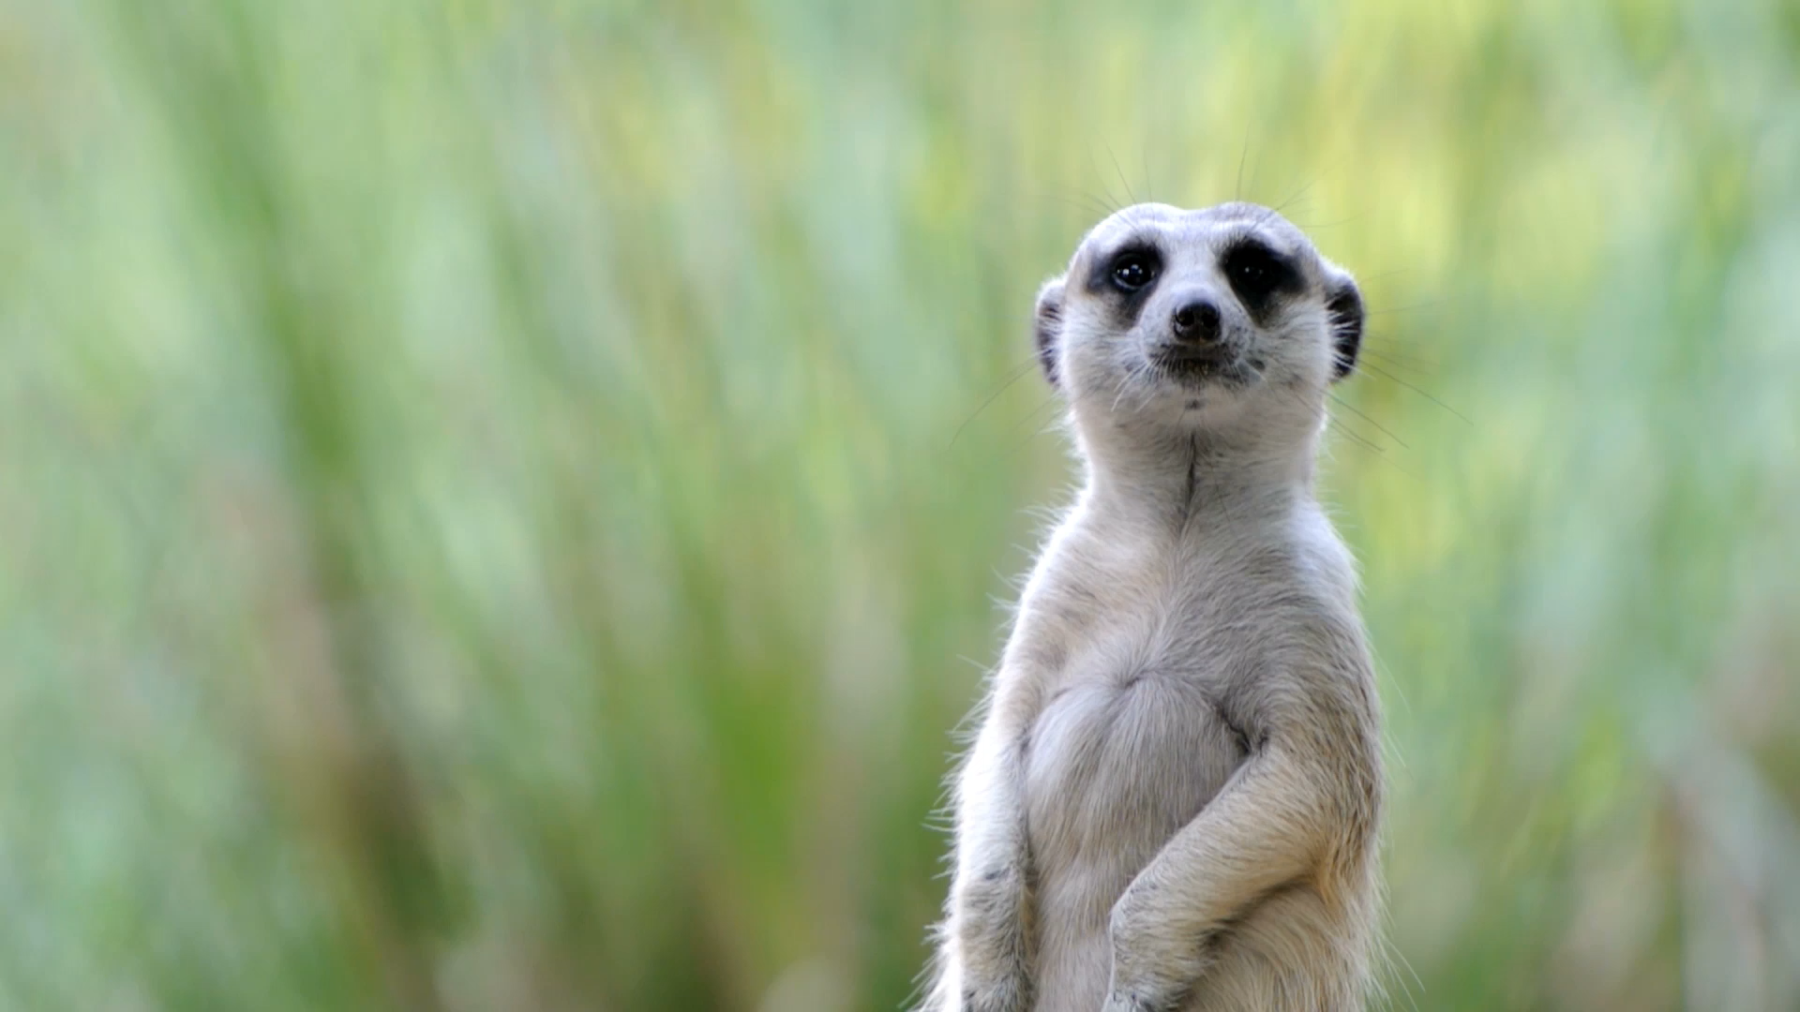
Classification of Animals
Florida Benchmark: SC.3.L.15.1 - Classify animals into major groups according to their physical characteristics and behaviors.
NGSS Standard: 3-LS3-1 - Analyze and interpret data to provide evidence that plants and animals have traits inherited from parents and variation of these traits exists in a group of similar organisms.

Slide 2
Essential Questions:
How do scientists use physical traits and behaviors to classify animals into different groups, and why is this classification important?
What adaptations help animals survive in their environments, and how do these adaptations relate to their classification?
How does classifying animals into specific groups help us understand biodiversity and the relationships between different species?

Slide 3
The 6 Major Animal Groups
1. Mammals
2. Birds
3. Reptiles
4. Amphibians
5. Fish
6. Insects

Slide 4
Mammals 🐘🐶🐬
📌 Mammals are warm-blooded vertebrates that have hair or fur and produce milk to feed their young.
📌 Characteristics:
✔ Mammary glands (females produce milk) 🍼
✔ Hair or fur for insulation 🦁
✔ Warm-blooded (constant body temperature) 🌡️
✔ Live birth (most species) 👶
✔ Lungs for breathing 🫁
✔ Four-chambered heart ❤️
✔ Specialized teeth for different diets 🦷
✔ Intelligent brains 🧠
Notes:
Mammals
Definition: Mammals are a group of warm-blooded vertebrates characterized by the presence of mammary glands in females, which produce milk to nourish their young. They also have hair or fur, a neocortex (a region of the brain), and three middle ear bones.
Characteristics:
Mammary Glands – Female mammals produce milk to feed their young.
Hair or Fur – All mammals have some form of hair or fur, which helps with temperature regulation.
Warm-Blooded (Endothermic) – Mammals maintain a constant body temperature regardless of the environment.
Live Birth (Mostly) – Most mammals give birth to live young, except monotremes like the platypus and echidna, which lay eggs.
Lungs for Breathing – Mammals have well-developed lungs and breathe oxygen.
Four-Chambered Heart – This helps in efficient circulation of oxygen-rich blood.
Specialized Teeth – Mammals have different types of teeth (incisors, canines, molars) suited for their diets.
Highly Developed Brain – Mammals generally have larger and more complex brains compared to other animals.

Slide 5
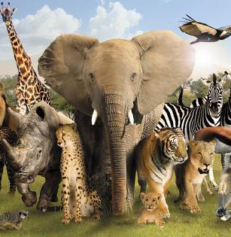
📌 Examples:
🐕 Dogs – Loyal pets with sharp senses
🐘 Elephants – Large, intelligent herbivores
🐬 Dolphins – Smart aquatic mammals
🦇 Bats – The only flying mammals
🦘 Kangaroos – Carry young in pouches
More examples are in the picture to the right.
wild-world_a-G-8678139-0.jpg (473×315)
Notes:
Examples of Mammals:
Humans (Homo sapiens) – Walk upright, have advanced cognitive abilities, and use tools.
Dogs (Canis lupus familiaris) – Domesticated mammals with keen senses of smell and hearing.
Cats (Felis catus) – Agile hunters with sharp claws and whiskers for detecting movement.
Elephants (Loxodonta africana) – Large land mammals known for their intelligence and social behavior.
Dolphins (Delphinidae) – Aquatic mammals that use echolocation for navigation and communication.
Bats (Chiroptera) – The only mammals capable of true flight.
Kangaroos (Macropus) – Marsupials that carry and nurse their young in pouches.

Slide 6
Birds 🐦🦜🦢
📌 Birds are warm-blooded vertebrates characterized by feathers, beaks, and the ability to lay hard-shelled eggs. Most birds can fly, but some, like ostriches and penguins, are flightless.
📌 Characteristics:
✔ Feathers – Unique to birds, used for flight and insulation 🪶
✔ Beak (No Teeth) – Adapted for different diets 🦜
✔ Lay Eggs – Hard-shelled eggs protect developing young 🥚
✔ Hollow Bones – Lightweight for flight ✈️
✔ Warm-Blooded – Maintain a constant body temperature 🌡️
✔ High Metabolism – Need lots of energy for flight ⚡
✔ Strong Respiratory System – Efficient lungs for oxygen intake 🫁
Notes:
Birds 🐦🦜🦢
📌 Definition:
Birds are warm-blooded vertebrates distinguished by their feathers, beaks, and ability to lay hard-shelled eggs. They have a highly efficient respiratory system and lightweight skeletal structure, which aids in flight. While most birds can fly, some species—such as ostriches, emus, and penguins—are flightless and have adapted to life on land or in the water.
📌 Characteristics:
✔ Feathers – Unique to birds, feathers provide insulation, waterproofing, and enable flight 🪶
✔ Beak (No Teeth) – Birds have specialized beaks suited to their diets, such as sharp beaks for carnivores and curved beaks for seed-eaters 🦜
✔ Lay Eggs – Birds reproduce by laying hard-shelled eggs, which protect the developing young until they hatch 🥚
✔ Hollow Bones – Most birds have lightweight, hollow bones to reduce body weight and aid in flight ✈️
✔ Warm-Blooded – Birds maintain a constant body temperature, allowing them to survive in various climates 🌡️
✔ High Metabolism – Birds require a lot of energy to support their active lifestyle and flight capabilities ⚡
✔ Strong Respiratory System – Their efficient lungs and air sacs provide a continuous oxygen supply, crucial for flying 🫁

Slide 7
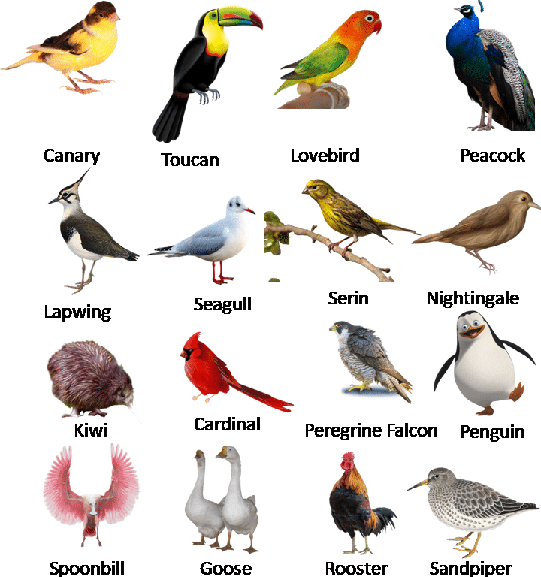
📌 Examples:
🦅 Eagles – Powerful hunters with sharp talons
🦜 Parrots – Intelligent, colorful birds that mimic sounds
🐧 Penguins – Flightless birds adapted to cold environments
🦩 Flamingos – Wading birds with long legs and pink feathers
🐓 Chickens – Domesticated birds raised for eggs and meat
More examples are in the picture to the right.
Slide2-5.png (720×960)
Notes:
📌 Examples of Birds:
🦅 Eagles – Large, powerful birds of prey with keen eyesight, sharp talons, and strong beaks used for hunting small animals and fish.
🦜 Parrots – Social and intelligent birds known for their bright feathers, strong beaks, and ability to mimic sounds and human speech.
🐧 Penguins – Flightless birds adapted to cold environments, with flipper-like wings for swimming and a thick layer of fat for insulation.
🦩 Flamingos – Wading birds recognized for their long legs, curved beaks, and pink feathers, which come from their diet of shrimp and algae.
🐓 Chickens – Domesticated birds that are widely raised for their eggs and meat. They communicate using different sounds and follow a social hierarchy.

Slide 8
Reptiles 🐍🐊🦎
📌 Reptiles are cold-blooded vertebrates that have scaly skin, breathe with lungs, and typically lay soft-shelled eggs on land. They are found in various environments, from deserts to rainforests.
📌 Characteristics:
✔ Cold-Blooded (Ectothermic) – Body temperature depends on the environment 🌡️
✔ Scaly, Dry Skin – Protects against water loss 🦎
✔ Lay Eggs (Mostly) – Most reptiles lay eggs, but some give birth to live young 🥚
✔ Lungs for Breathing – Fully developed lungs for respiration 🫁
✔ Slow Metabolism – Can survive long periods without food ⏳
✔ Simple Teeth (No Chewing) – Swallow food whole or in large pieces 🦷
Notes:
Reptiles 🐍🐊🦎
📌 Definition:
Reptiles are cold-blooded vertebrates that have scaly, waterproof skin, breathe using lungs, and primarily lay soft-shelled eggs on land. They are incredibly diverse and can be found in a variety of environments, including deserts, rainforests, swamps, and even oceans. Unlike mammals and birds, reptiles rely on external heat sources to regulate their body temperature.
📌 Characteristics:
✔ Cold-Blooded (Ectothermic) – Reptiles cannot generate their own body heat and depend on their environment to stay warm or cool. They often bask in the sun to raise their body temperature and seek shade to cool down. 🌡️
✔ Scaly, Dry Skin – Their tough, keratin-based scales help prevent water loss and provide protection against predators and rough terrain. Unlike amphibians, reptiles do not need a moist environment to survive. 🦎
✔ Lay Eggs (Mostly) – Most reptiles lay soft-shelled eggs on land, while some species, like certain snakes and lizards, give birth to live young. 🥚
✔ Lungs for Breathing – Reptiles have well-developed lungs for respiration and cannot breathe through their skin like amphibians. Some, like crocodiles, have specialized lungs for staying underwater for extended periods. 🫁
✔ Slow Metabolism – Reptiles have a lower metabolic rate than mammals, allowing them to survive long periods without eating. Some large snakes can go weeks or even months between meals. ⏳
✔ Simple Teeth (No Chewing) – Unlike mammals, reptiles have simple, cone-shaped teeth designed for grabbing and tearing prey rather than chewing. Many swallow their food whole or in large chunks. 🦷

Slide 9
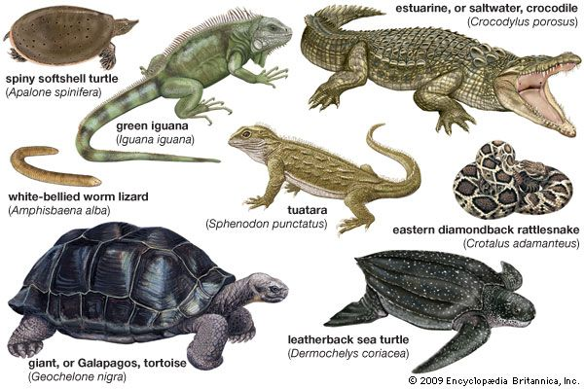
📌 Examples:
🐍 Snakes – Limbless reptiles with flexible jaws for swallowing prey
🐊 Crocodiles – Large, powerful reptiles that live in freshwater habitats
🦎 Lizards – Diverse group, including geckos and chameleons
🐢 Turtles – Reptiles with protective shells
🦖 Komodo Dragons – The largest living lizards, found in Indonesia
55306-004-71608E4D.jpg (600×400)
More examples are in the picture to the right.
Notes:
📌 Examples:
🐍 Snakes – Limbless reptiles with flexible jaws for swallowing prey
🐊 Crocodiles – Large, powerful reptiles that live in freshwater habitats
🦎 Lizards – Diverse group, including geckos and chameleons
🐢 Turtles – Reptiles with protective shells
🦖 Komodo Dragons – The largest living lizards, found in Indonesia

Slide 10
Amphibians 🐸🦎🐍
Amphibians are cold-blooded vertebrates that live both in water and on land. They typically undergo metamorphosis, starting as aquatic larvae (like tadpoles) before developing into their adult form.
📌 Characteristics:
✔ Cold-Blooded (Ectothermic) – Body temperature depends on the environment 🌡️
✔ Moist, Permeable Skin – Absorbs water and oxygen 🐸
✔ Lay Soft Eggs in Water – Eggs need a moist environment to develop 🥚
✔ Metamorphosis – Undergo transformation (e.g., tadpole → frog) 🔄
✔ Lungs & Skin for Breathing – Larvae breathe with gills, adults use lungs and skin 🫁
✔ Usually Found Near Water – Need moisture to survive 💧
Notes:
Amphibians 🐸🦎🐍
📌 Definition:
Amphibians are cold-blooded vertebrates that can live both in water and on land. They are unique because they undergo metamorphosis—starting life as aquatic larvae (like tadpoles) with gills, then transforming into adults with lungs and legs. Amphibians are often found in wet or humid environments since their moist, permeable skin helps them breathe and absorb water.
📌 Characteristics:
✔ Cold-Blooded (Ectothermic) – Amphibians rely on their surroundings to regulate body temperature, so they are commonly found in warm, damp areas. 🌡️
✔ Moist, Permeable Skin – Their thin, moist skin absorbs oxygen and water, allowing them to breathe through their skin. However, this also makes them vulnerable to dehydration. 🐸
✔ Lay Soft Eggs in Water – Amphibians lay their gel-like eggs in water, as they need moisture to develop. Unlike reptiles, their eggs lack hard shells. 🥚
✔ Metamorphosis – Amphibians go through a dramatic transformation from larvae to adults. For example, frogs start as tadpoles with gills, then grow legs and develop lungs. 🔄
✔ Lungs & Skin for Breathing – Young amphibians breathe using gills, while adults develop lungs but can still absorb oxygen through their skin. This ability allows some species to survive underwater for long periods. 🫁
✔ Usually Found Near Water – Amphibians need moisture to keep their skin hydrated and often live near ponds, swamps, or rainforests. 💧

Slide 11
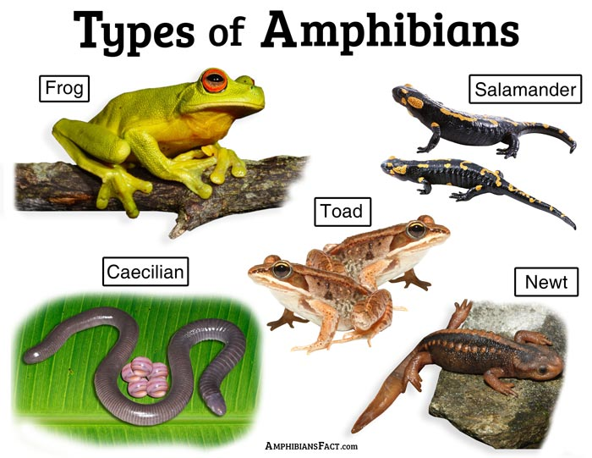
📌 Examples:
🐸 Frogs – Jumping amphibians that start life as tadpoles
🦎 Salamanders – Lizard-like amphibians with moist skin
🐍 Caecilians – Legless, burrowing amphibians
🐊 Newts – Semi-aquatic amphibians that regenerate limbs
More examples are in the picture to the right.
Types-of-Amphibians.jpg (700×541)
Notes:
📌 Examples of Amphibians:
🐸 Frogs – Jumping amphibians that start as tadpoles in water before developing legs and lungs for land life.
🦎 Salamanders – Lizard-like amphibians with moist skin and the ability to regenerate lost limbs.
🐍 Caecilians – Legless, burrowing amphibians that resemble worms or snakes. They live underground and are rarely seen.
🐊 Newts – Semi-aquatic amphibians that can live in water and on land. Like salamanders, they can regrow lost body parts.

Slide 12
Fish 🐠🐟🦈
📌Fish are cold-blooded vertebrates that live in water, breathe through gills, and have fins for swimming. They are the largest group of vertebrates, found in both freshwater and saltwater environments.
📌 Characteristics:
✔ Cold-Blooded (Ectothermic) – Body temperature depends on water temperature 🌡️
✔ Gills for Breathing – Extract oxygen from water 🫁
✔ Fins for Swimming – Helps in movement and balance 🏊‍♂️
✔ Scales Cover Their Bodies – Provides protection 🐟
✔ Lay Eggs (Mostly) – Some species give birth to live young 🥚
✔ Lateral Line System – Senses vibrations and movement in water 🌊
Notes:
Fish 🐠🐟🦈
📌 Definition:
Fish are cold-blooded vertebrates that live in water (both freshwater and saltwater) and breathe through gills. They are the largest group of vertebrates, with more than 30,000 species, ranging from small, colorful aquarium fish to large, powerful sharks. Fish are adapted to aquatic life with features like fins for swimming and scales for protection.
📌 Characteristics:
✔ Cold-Blooded (Ectothermic) – Fish cannot regulate their body temperature internally and rely on the water around them to stay warm or cool. This makes them more active in warmer water and slower in cooler water. 🌡️
✔ Gills for Breathing – Fish have gills that extract oxygen from water as it flows over them, allowing them to breathe underwater. 🫁
✔ Fins for Swimming – Fish have various fins (pectoral, dorsal, caudal) that help them swim, steer, and maintain balance in the water. These fins make movement efficient and precise. 🏊‍♂️
✔ Scales Cover Their Bodies – Fish are typically covered in small, overlapping scales that act as a shield against predators and the environment, providing protection and reducing water resistance. 🐟
✔ Lay Eggs (Mostly) – Most fish lay eggs, but some species (like sharks) give birth to live young. These eggs often develop in water, where the young are hatched or born. 🥚
✔ Lateral Line System – Fish possess a specialized lateral line system along their bodies that helps them detect vibrations and movements in the water, allowing them to sense the presence of prey, predators, or obstacles. 🌊

Slide 13
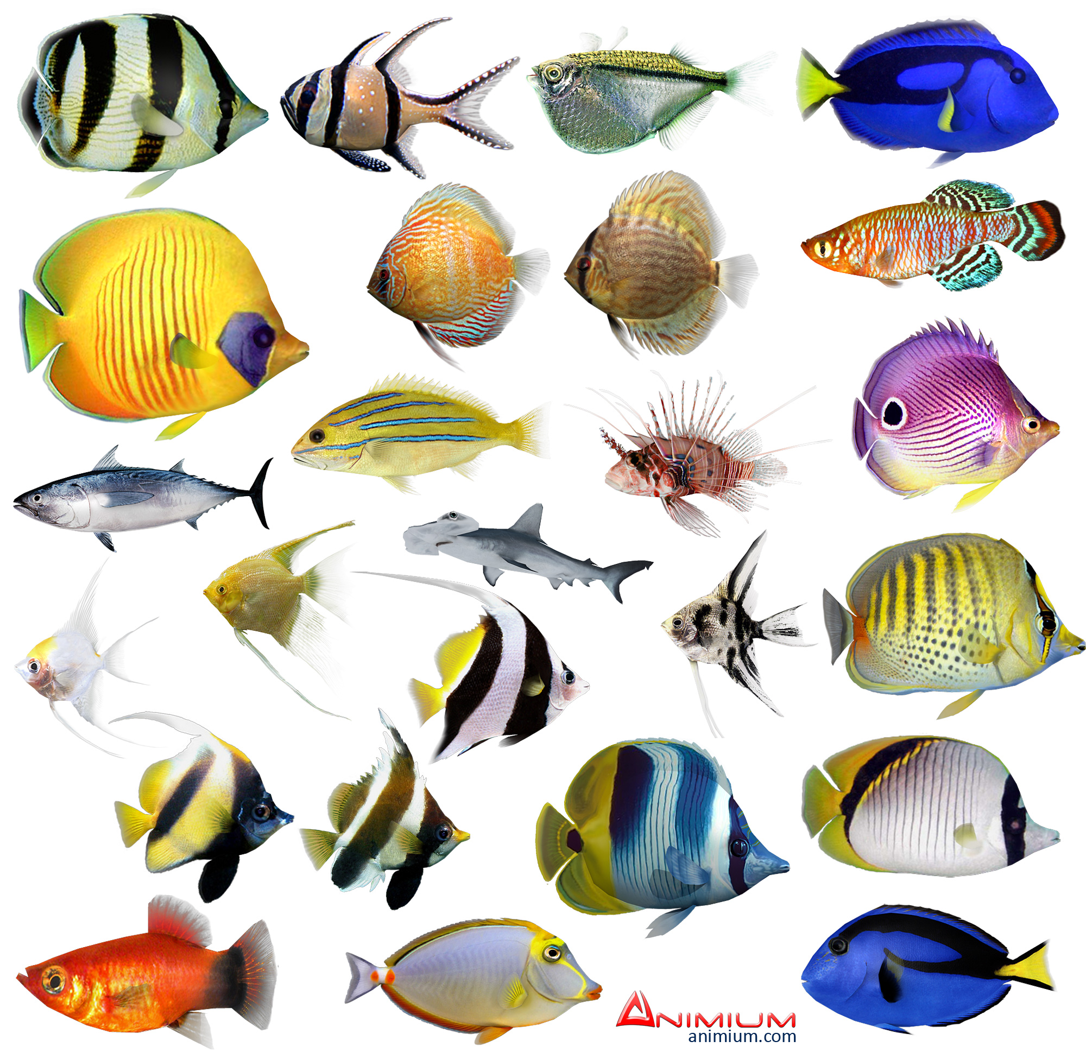
📌 Examples:
🐠 Goldfish – Popular freshwater aquarium fish
🦈 Sharks – Large fish with cartilage instead of bones
🐟 Salmon – Migrate from freshwater to the ocean
🐡 Pufferfish – Inflate their bodies as a defense mechanism
🐠 Clownfish – Live in coral reefs and form mutualistic relationships with sea anemones
More examples are in the picture to the right.
Tropical-fishes-3d-model.jpg (2000×1953)
Notes:
📌 Examples of Fish:
🐠 Goldfish – One of the most popular freshwater aquarium fish known for their vibrant colors and ease of care.
🦈 Sharks – Large, predatory fish with cartilage instead of bones, giving them flexibility. Sharks are apex predators in many ocean ecosystems.
🐟 Salmon – Known for their migratory behavior, salmon are born in freshwater, travel to the ocean to grow, and then return to freshwater to spawn.
🐡 Pufferfish – Famous for their ability to inflate their bodies as a defense mechanism to appear larger and more threatening to predators.
🐠 Clownfish – Small fish that live in coral reefs and have a mutualistic relationship with sea anemones, where they find shelter and protection from predators while the anemones benefit from leftover food.

Slide 14
Insects 🐜🐝🦗
📌Insects are the largest group of animals on Earth, characterized by their three-part body structure (head, thorax, abdomen), six legs, and often wings. They are found in almost every habitat.
📌 Characteristics:
✔ Three-Part Body – Head, thorax, and abdomen 🧠
✔ Six Legs – Attached to the thorax 🦵
✔ Exoskeleton – Hard outer covering for protection 🛡️
✔ Wings (Many Species) – Many insects can fly 🦋
✔ Antennae – Used for sensing the environment 🦗
✔ Small Size – Most insects are small and lightweight 🌍
✔ Metamorphosis – Undergo complete or incomplete metamorphosis 🔄
Notes:
Insects 🐜🐝🦗
📌 Definition:
Insects are the largest group of animals on Earth, known for their three-part body structure (head, thorax, abdomen), six legs, and often wings. These adaptable creatures can be found in almost every habitat, from forests to deserts, and even inside your home.
📌 Characteristics:
✔ Three-Part Body – Insects have a body divided into three sections: the head (where the brain and sensory organs are), the thorax (where the legs and wings are attached), and the abdomen (where internal organs are located). 🧠
✔ Six Legs – All insects have six legs, which are attached to the thorax. This is one of the key features that define them as insects. 🦵
✔ Exoskeleton – Insects have an external skeleton (exoskeleton) made of chitin, providing protection, structure, and helping to retain moisture. 🛡️
✔ Wings (Many Species) – Many insects, such as butterflies and bees, have wings, allowing them to fly and move quickly between habitats. 🦋
✔ Antennae – Antennae help insects sense their surroundings by detecting chemicals, vibrations, and other environmental cues. 🦗
✔ Small Size – Most insects are small and lightweight, which helps them fit into small spaces and evade predators. 🌍
✔ Metamorphosis – Insects undergo metamorphosis during their life cycle. Some, like butterflies, experience complete metamorphosis, while others, like grasshoppers, undergo incomplete metamorphosis (developing through several stages without a pupal stage). 🔄

Slide 15
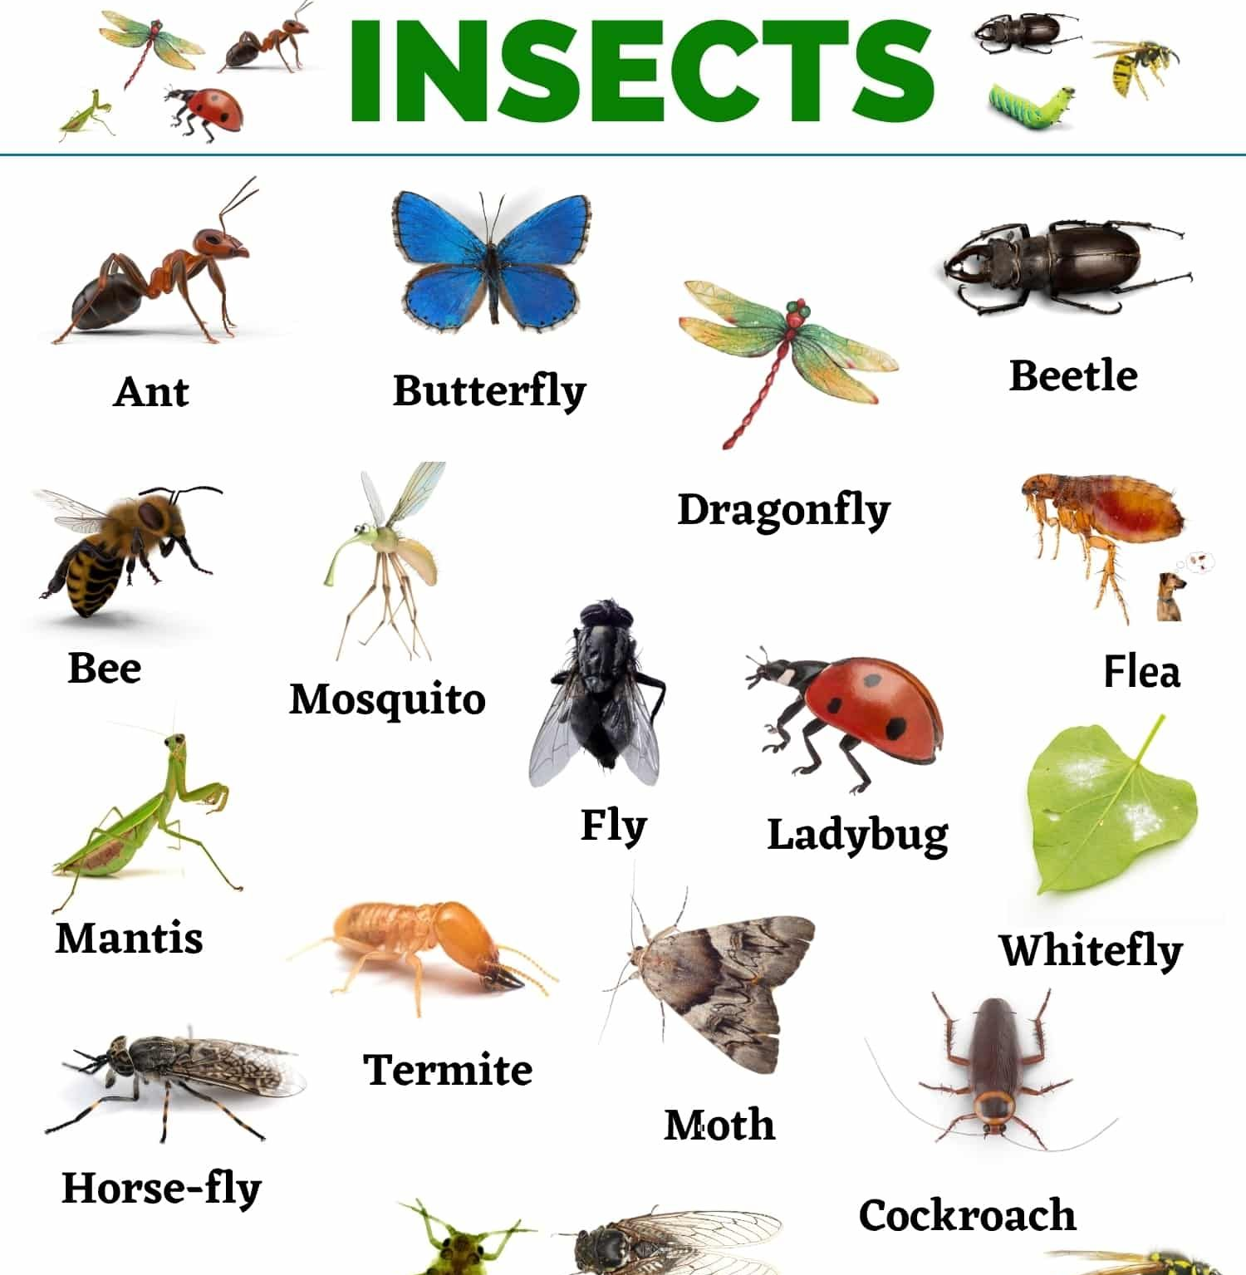
📌 Examples:
🐝 Bees – Pollinators with a vital role in ecosystems
🦗 Grasshoppers – Known for their jumping ability and loud chirping
🦋 Butterflies – Known for their beautiful wings and metamorphosis
🐜 Ants – Social insects living in large colonies
🪲 Beetles – The largest group of insects, with hard shells
More examples are in the picture to the right.
Notes:
📌 Examples of Insects:
🐝 Bees – Vital pollinators that help plants reproduce by transferring pollen. Their role in ecosystems is crucial to food production and biodiversity.
🦗 Grasshoppers – Known for their powerful jumping ability and loud chirping, often heard in warm weather.
🦋 Butterflies – Famous for their colorful wings and remarkable life cycle, including metamorphosis from larvae to adult.
🐜 Ants – Highly social insects that live in organized colonies and work together to gather food, build nests, and protect their queen.
🪲 Beetles – The largest group of insects, with hard outer shells that protect their bodies. They are diverse in appearance and habitat, with some species being important for decomposition.

Slide 16
Essential Questions & Answers
1. How do scientists use physical traits and behaviors to classify animals into different groups, and why is this classification important?
- Scientists classify animals based on traits like body covering, how they reproduce, and how they breathe. This helps organize living things, making it easier to study and understand biodiversity.
2. What adaptations help animals survive in their environments, and how do these adaptations relate to their classification?
- Animals have adaptations like fur for warmth (mammals), scales for protection (reptiles and fish), and wings for flight (birds and some insects). These adaptations help define their classification and how they live.
3. How does classifying animals into specific groups help us understand biodiversity and the relationships between different species?
- Classification helps scientists see how animals are related, track evolution, and protect species. It also helps us understand ecosystems and how different species interact.

Slide 17
Related Concepts:
1. Kingdom Animalia
All animals belong to the Kingdom Animalia, which includes organisms that are multicellular, heterotrophic (consume food for energy), and capable of movement at some stage of life.
2. Classification Levels (Taxonomy)
Scientists classify animals using a hierarchical system:
Kingdom → Phylum → Class → Order → Family → Genus → Species
Example: Humans → Kingdom Animalia, Phylum Chordata, Class Mammalia, Order Primates, Family Hominidae, Genus Homo, Species sapiens (Homo sapiens).
3. Animal Body Temperature
Warm-blooded (Endothermic) Animals (Mammals & Birds): Maintain a constant body temperature.
Normal body temperature:
Humans: ~ 37°C (98.6°F)
Dogs: ~ 38–39°C (100–102°F)
Birds: ~ 39–42°C (102–108°F)
Cold-blooded (Ectothermic) Animals (Reptiles, Amphibians, Fish, Insects): Their body temperature changes with the environment.

Slide 18
Related Concepts:
4. Vertebrates vs. Invertebrates
Vertebrates: Animals with a backbone (e.g., mammals, birds, reptiles, amphibians, fish).
Invertebrates: Animals without a backbone (e.g., insects, jellyfish, worms, mollusks).
5. Animal Adaptations
Animals develop physical (fur, scales, feathers) and behavioral (migration, hibernation) adaptations to survive in their environments.
6. Importance of Animal Classification
Helps scientists understand evolution, identify new species, and study ecosystems.
Animal classification. Science for kids - My pals are here!

Slide 19

“Time to work on the Classification of Animals Project”

