Slide 1

The Parts of the Plant
Florida Benchmark: SC.3.L.14.1: Describe structures in plants and their roles in food production, support, water and nutrient transport, and reproduction.
NGS Standard: SC.3.L.14.1: Describe structures in plants and their roles in food production, support, water and nutrient transport, and reproduction.

Slide 2

Essential Questions
What are the main structures of plants, and how do they help plants survive and grow?
How do plants transport water and nutrients to different parts of their structure?
How do flowers and seeds help plants reproduce and create new plants?

Slide 3
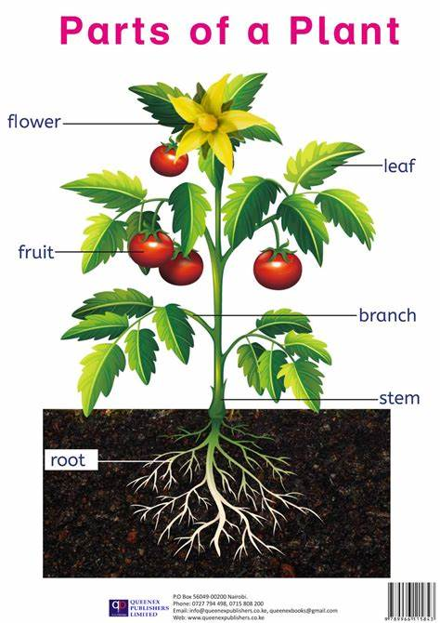
Parts of the Plant
Plants are essential to life on Earth as they provide oxygen, food, and shelter, while also regulating the environment by reducing carbon dioxide through photosynthesis. The main parts of a plant include the roots, stem, leaves, flowers, and fruits, each with a specific role. Roots anchor the plant and absorb water and nutrients, while the stem supports the plant and transports essential materials. Leaves perform photosynthesis, making food for the plant, and flowers are crucial for reproduction by producing seeds. Finally, fruits protect seeds and help in their dispersal, ensuring the plant's survival and growth.
Source: parts-of-a-plant.jpg (989×1400)

Slide 4
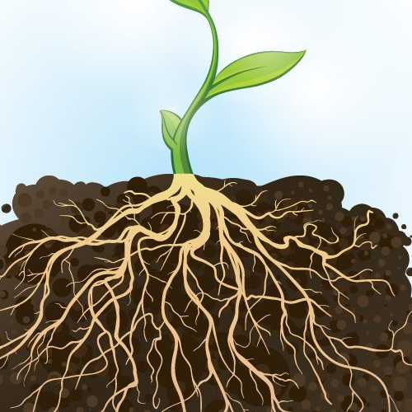
Roots
Roots are important because they hold the plant in place and take in water and nutrients from the soil. Some roots, like carrots, even store food for the plant and can be eaten!
Source: Plant-roots-go-to-extreme-lengths-to-find-water-800x500.jpg (800×500)

Slide 5
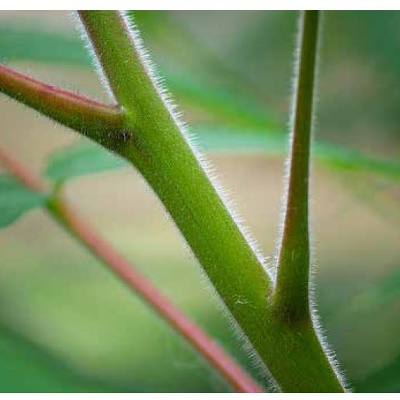
Stem
The stem is like a plant's helper. It supports the plant and helps it stand tall while carrying water and nutrients from the roots to the leaves. It also moves food made by the leaves to other parts of the plant!
Source: web-1.jpg (795×515)

Slide 6
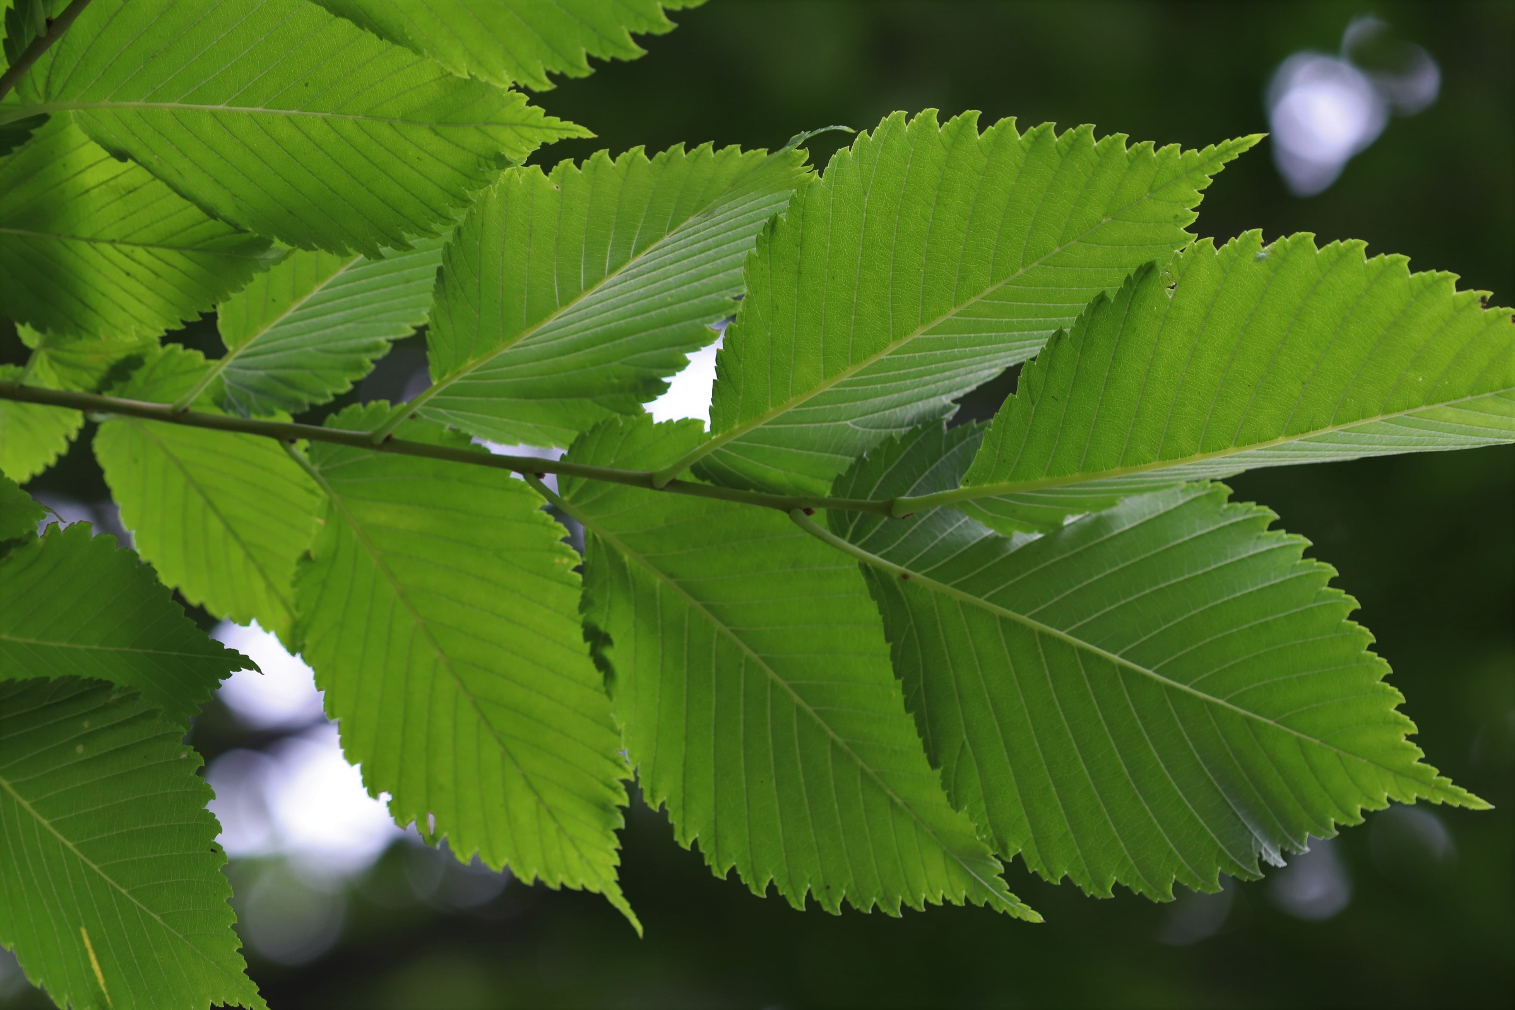
Leaf
The leaf is the part of the plant that makes food. Using sunlight, water, and air, it performs photosynthesis to create energy for the plant. Leaves also release oxygen, which is important for people and animals to breathe!
mature-leaves-underside.jpg (2400×1600)

Slide 7
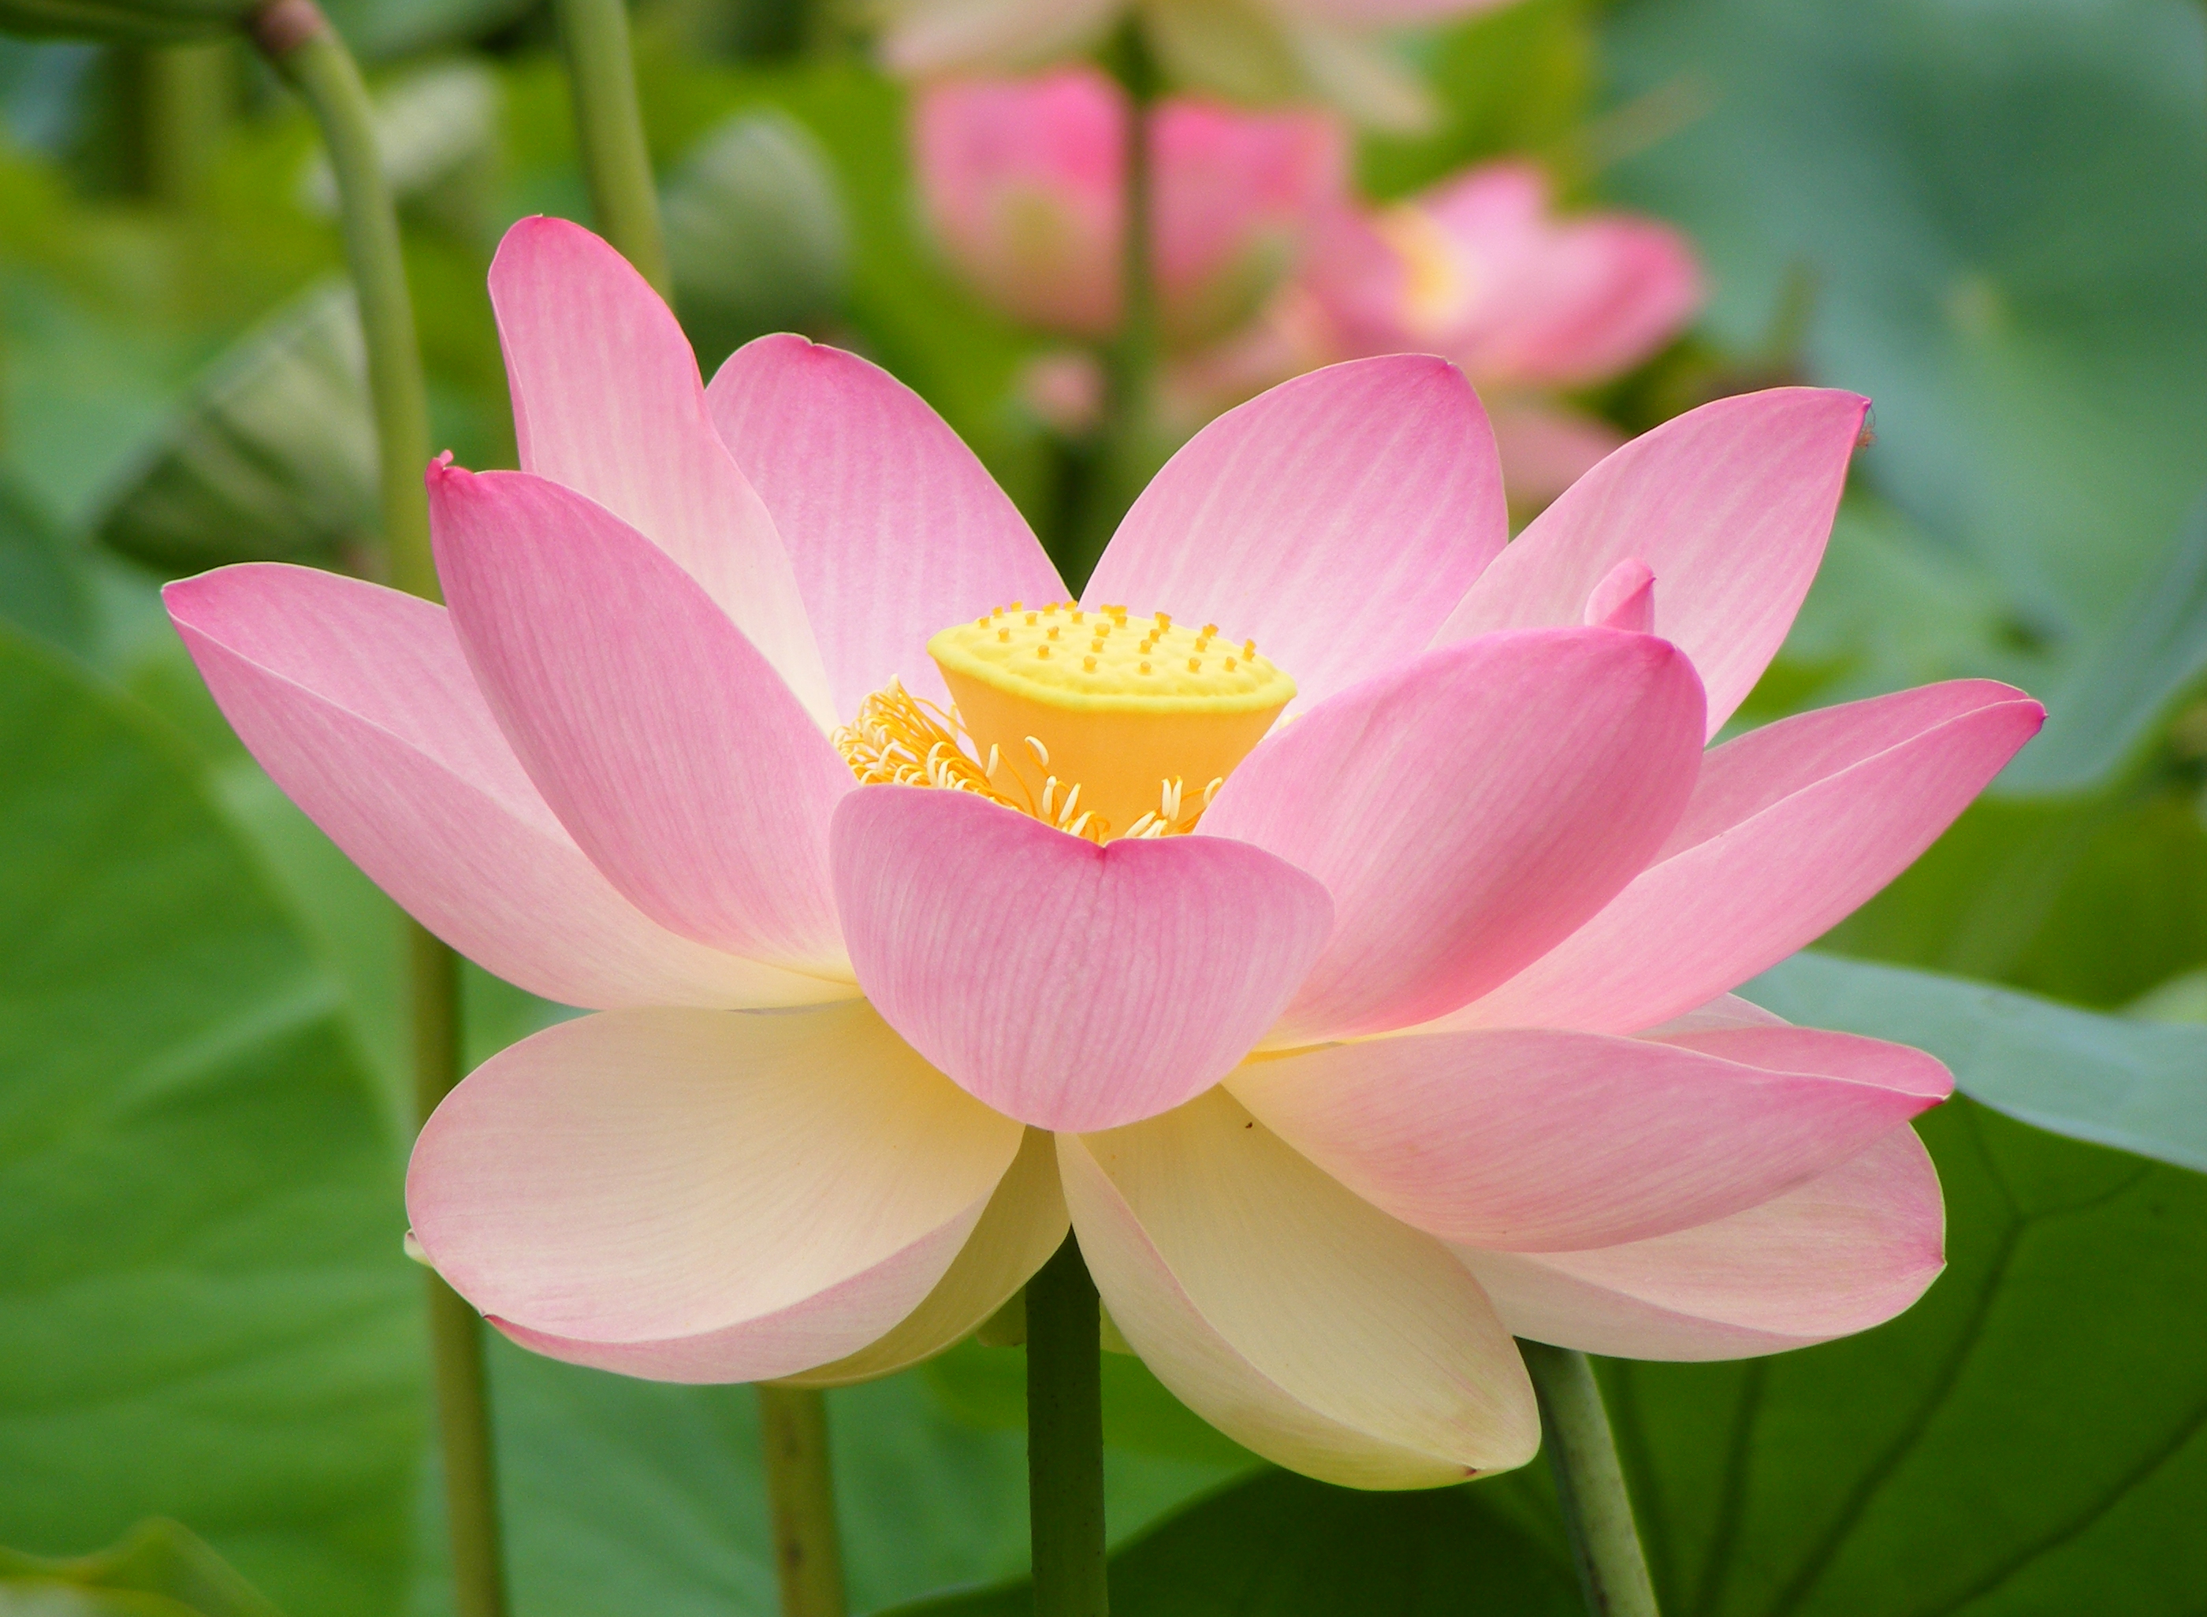
Flower
The flower is the part of the plant that helps it make seeds for new plants to grow. Flowers attract bees, butterflies, and other animals to help with pollination, which is how seeds are formed. They also make plants look beautiful!
Nelumno_nucifera_open_flower_-_botanic_garden_adelaide2.jpg (2800×2052)

Slide 8
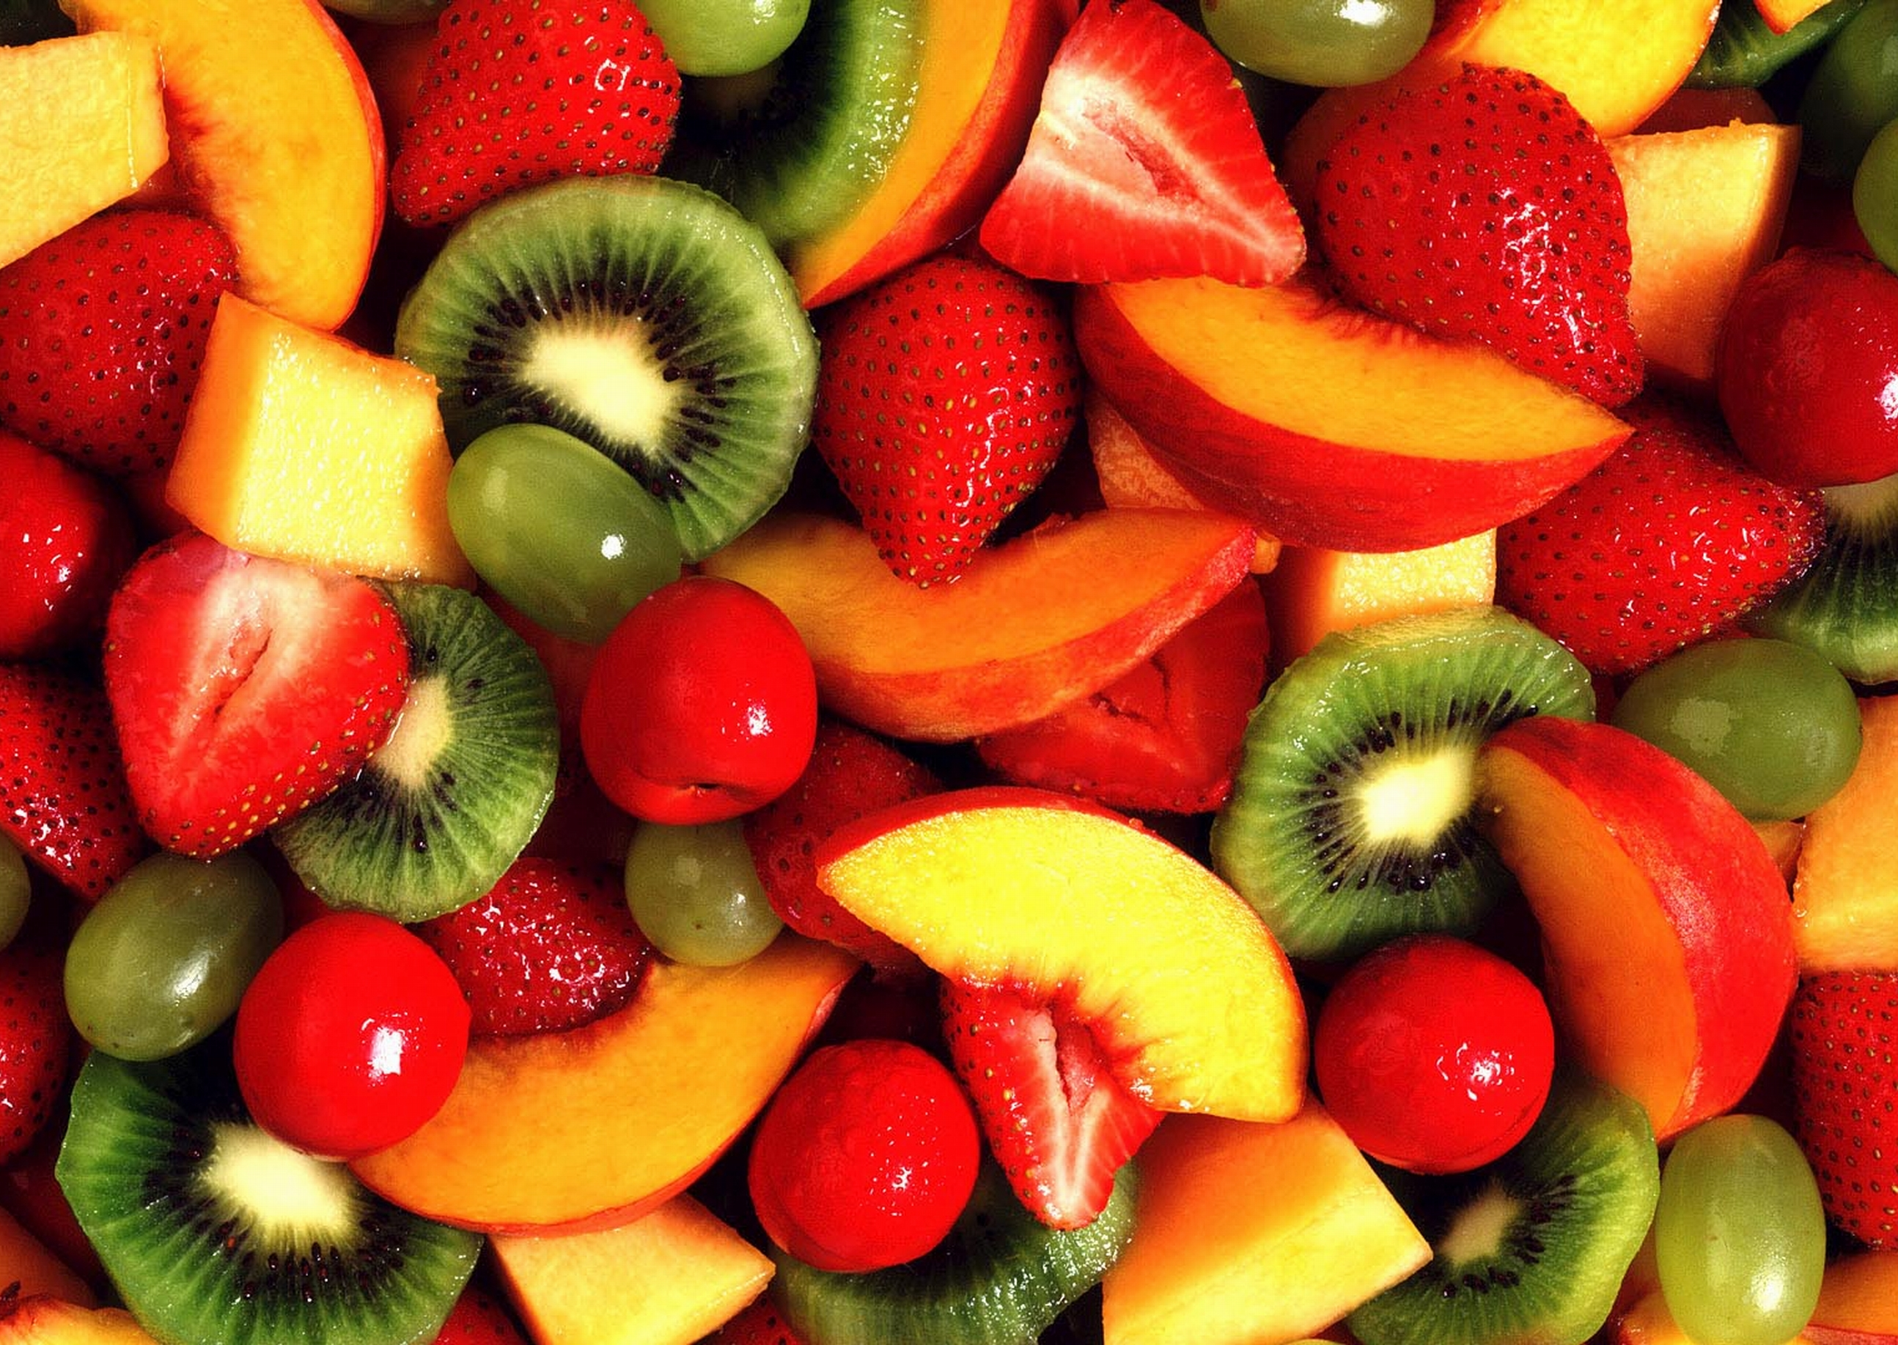
Fruit
The fruit is the part of the plant that protects the seeds inside. It helps in spreading seeds to grow new plants, often by being eaten by animals who carry the seeds to new places. Some fruits, like apples and oranges, are also delicious and healthy for us to eat!
fruit02.jpg (3264×1836)

Slide 9
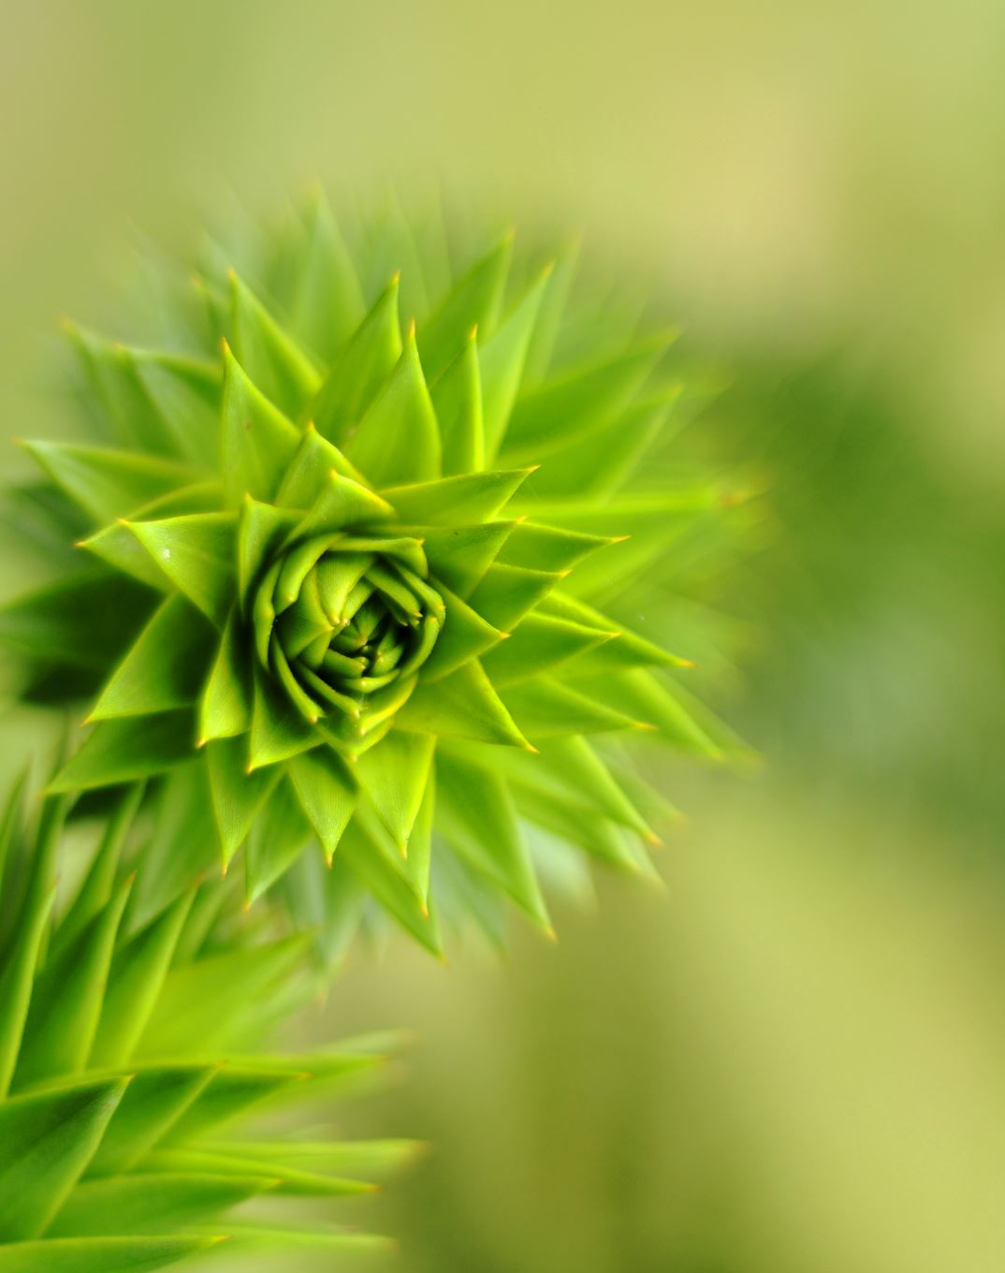
Parts of the Plant
Parts Of A Plant | The Dr. Binocs Show | Learn Videos For Kids

Slide 10
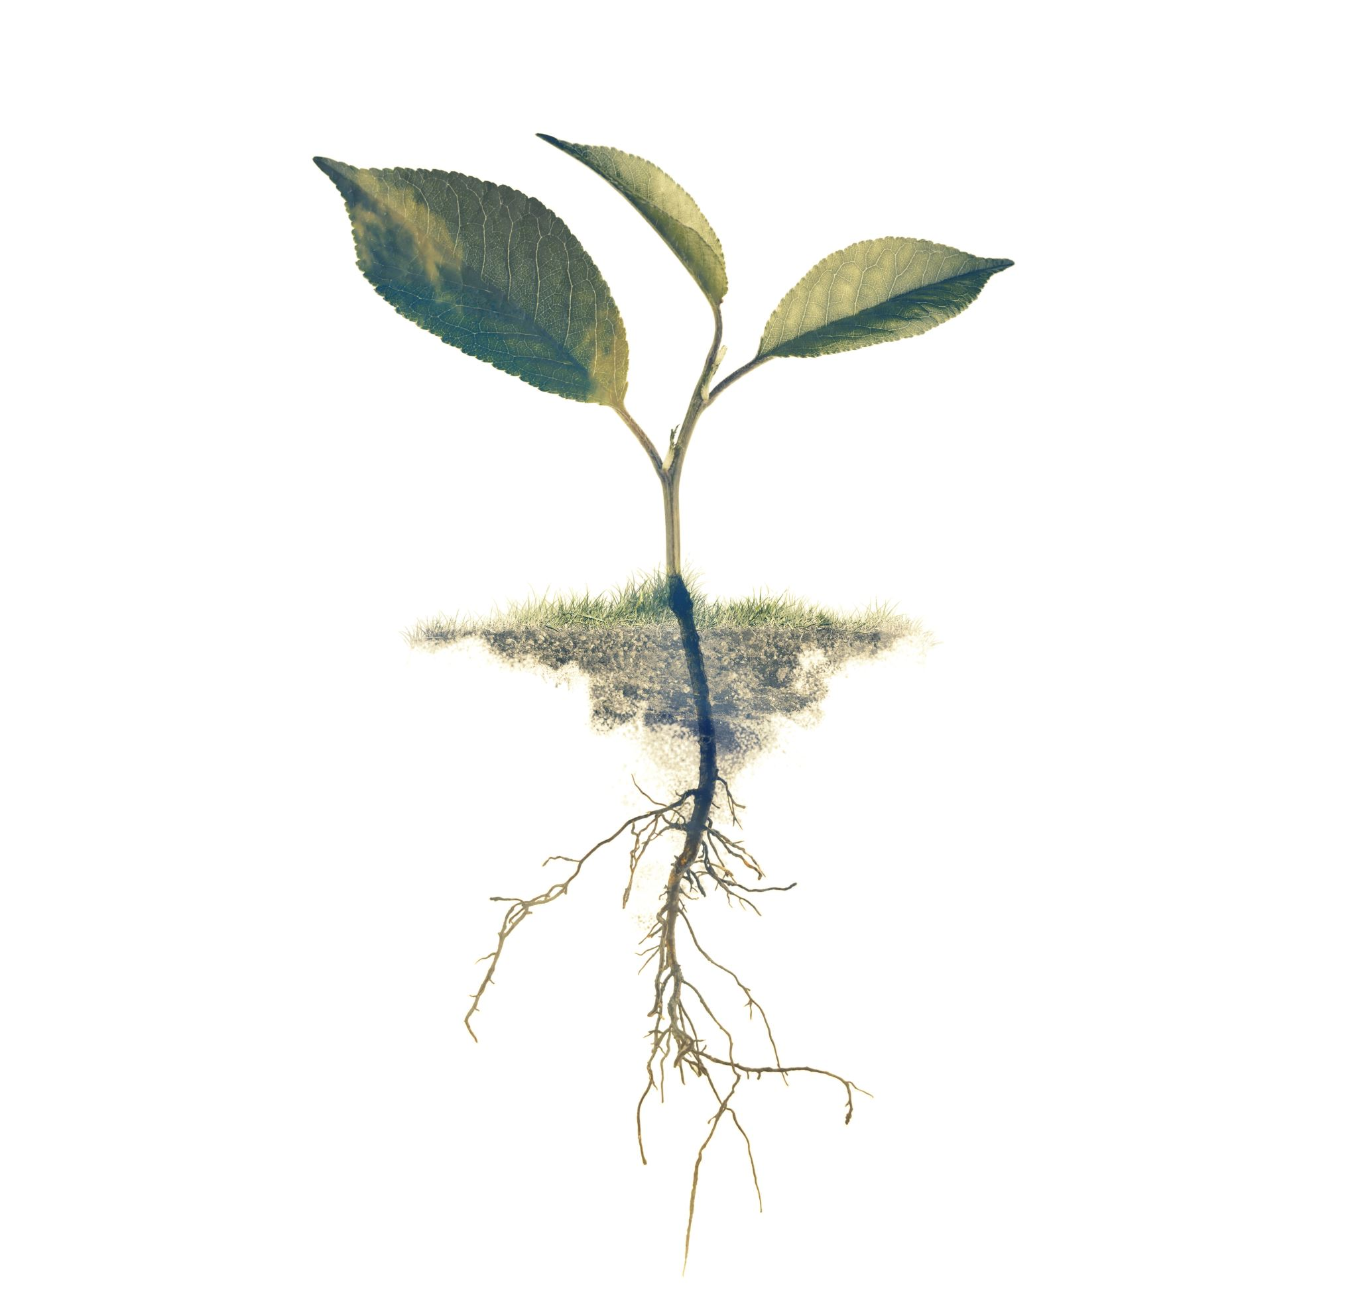
Related Concepts
Photosynthesis – The process plants use to make food from sunlight, water, and carbon dioxide.
Biology – The study of living things, including plants, animals, and humans.
Botany – The branch of biology that focuses on studying plants.
Producer – An organism, like a plant, that makes its own food and provides energy for other living things in an ecosystem.
Capillary Action - a phenomenon that causes the movement of groundwater through the different zones of soil1. It is also responsible for the transportation of fluids inside the xylem vessels of plants1. As water evaporates from the surface of the leaves, water from the roots is drawn up by this phenomenon

Slide 11

Experiment Time!
Refer to the experiment guide for the materials and procedures!

