Slide 1

Force and Motion
What are the Types of Forces?

Slide 2

STEM Focus Goal #1
Analyze a Model to Identify Contact vs. Non-Contact Forces

Slide 3

Do objects have to touch each other to apply a force?
Day 1

Slide 4
Today’s mini-lab investigation focuses on exploring how forces act on objects. The activity aims to help students describe and differentiate between contact and non-contact forces, such as friction, magnetism, and gravity. Mastery is demonstrated when students can clearly explain whether or not objects need to touch in order to exert a force on each other.

Slide 5
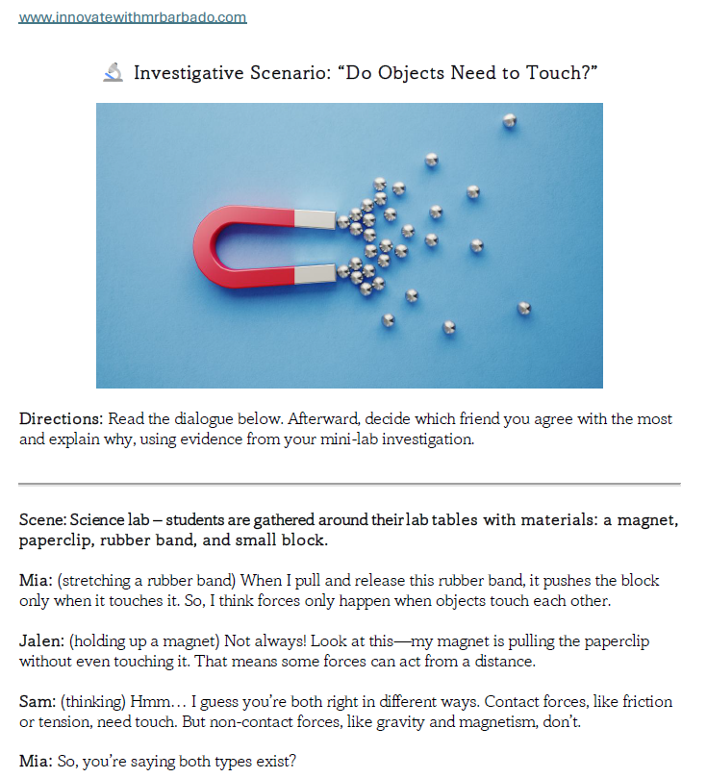
Engage:
Knowledge Check
Read the scenario carefully.
Think about each friend’s idea.
Decide which friend you agree with and explain why.

Slide 6
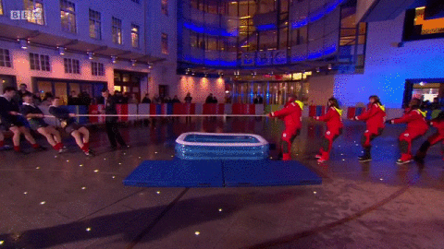
Force is a push or pull between two objects that can change their motion. It is measured in Newtons (N) using a spring scale or a force sensor. One Newton is the force needed to make a 1-kilogram object accelerate at 1 meter per second squared. A spring scale measures force by how much the spring stretches when pushed or pulled.
What is a force?

Slide 7

STEM Focus Goal #2
Day 2
Use simple tools and materials, such as magnets, blocks, toy cars, and strings, to investigate how forces affect the motion of objects.

Slide 8

Objective
Students will identify and describe the two major types of forces (contact and non-contact) and their specific kinds and explain how they affect objects.

Slide 9
Two Major Types of Forces
Contact Forces – forces that require objects to touch.
Examples:
Friction: Resists motion between surfaces (e.g., sliding a book).
Tension: Force in a stretched rope or string (e.g., tug-of-war).
Applied Force: Force applied directly to move an object (e.g., pushing a box).
Normal Force: Support force from a surface (e.g., a book on a table).

Slide 10
Two Major Types of Forces
Non-Contact Forces – forces that act at a distance; no touching needed.
Examples:
Gravity: Pulls objects toward the center of the Earth (e.g., a falling ball).
Magnetic Force: Pulls or pushes magnetic objects (e.g., magnet attracting a paperclip).
Electric / Electrostatic Force: Pulls or pushes objects with electric charges (e.g., static electricity making hair stand up).

Slide 11

Discussion Questions
Can you give real-life examples of contact and non-contact forces?
How do contact and non-contact forces affect motion differently?
Why is it important to classify forces by type rather than just saying “push or pull”?

Slide 12
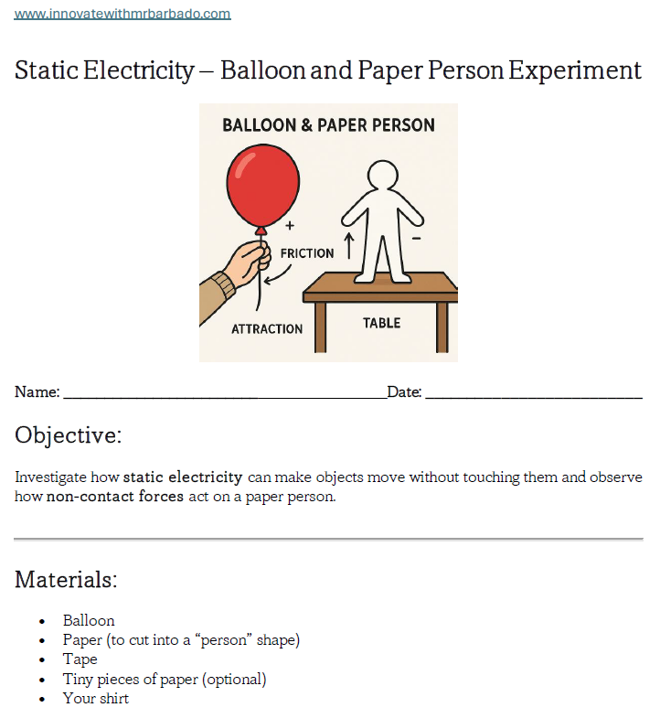
Static Electricity – Balloon and Paper Person Experiment

Slide 13
Friction and Motion
Day 3
Why do some objects move easily while others don’t?
Why does a car slide on ice but not on asphalt?
Notes:
1. Why do some objects move easily while others don’t?
Objects move more easily when there is less friction between their surfaces.
Rough surfaces or heavier objects usually increase friction, making them harder to move.
2. Why does a car slide on ice but not on asphalt?
Ice is a very smooth surface, so it has less friction, allowing the car to slide.
Asphalt is rough, which creates more friction, helping the tires grip the road and stop sliding.
3. Examples: playground slides, walking on ice, car brakes
Playground slides: Smooth slides → less friction → children slide easily
Walking on ice: Low friction → harder to stop → slipping occurs
Car brakes: Brakes create friction to slow down or stop the car

Slide 14

Motion is the change in position of an object over time
Motion happens when a force is applied
Can be described by: speed, direction, and distance traveled
Notes:
Speed: How fast an object is moving (e.g., 5 meters per second).
Direction: The path the object is moving along (e.g., north, downward, along the ramp).
Distance Traveled: How far the object has moved from its starting point (e.g., 10 meters).
✅ Together, these three things fully describe the motion of an object, because knowing just one (like speed) isn’t enough—you also need to know where it’s going and how far it moved.

Slide 15

Friction is a contact force that resists motion between surfaces
Types of Friction:
Static friction: Prevents motion from starting
Sliding friction: Resists motion while sliding
Rolling friction: Resists rolling motion (e.g., wheels)
Factors Affecting Friction:
Surface type: Rough → more friction, smooth → less friction
Weight of object: Heavier → more friction

Slide 16

STEM Focus Goal #3
Engineering & Data Analysis:
Analyze experimental data to see how surfaces and weights affect motion
Use results to design or improve objects and systems that rely on friction (e.g., wheels, brakes, ramps)
Connects classroom learning to real-world engineering problems

Slide 17
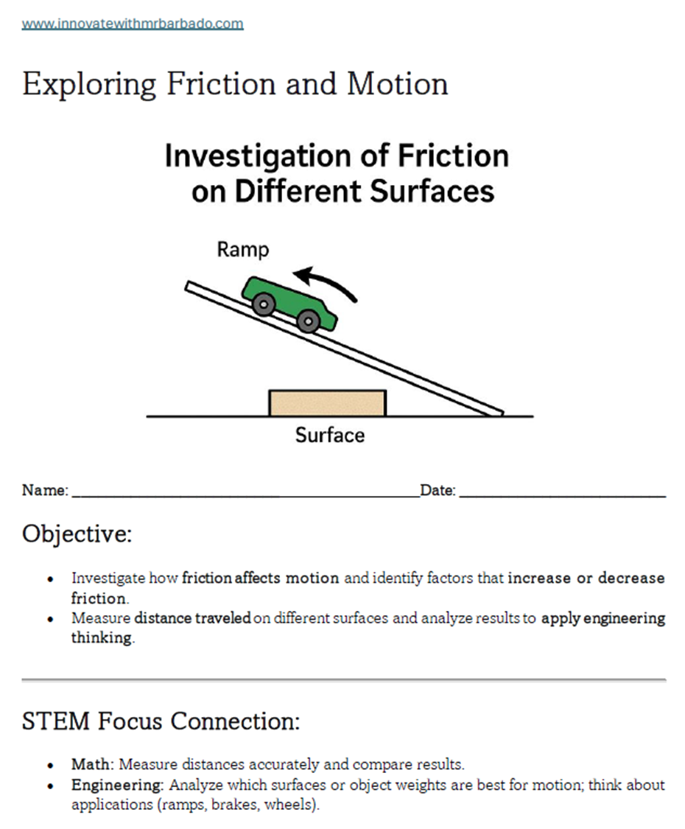
Exploring Friction and Motion

Slide 18

Calculating Force and Motion
Day 4
What makes some objects accelerate faster than others?
How does mass affect the motion of an object?
How can we determine the force needed to move an object?

Slide 19

Newton’s 2nd Law
The acceleration of an object depends on the net force acting on it and its mass.
Formula: F = m × a
  F = force (N), m = mass (kg), a = acceleration (m/s²)
Rome://settings/searchEngines
Shop
Notes:
Example:
Mass = 2 kg, Acceleration = 3 m/s²
Force = 2 × 3 = 6 N

Slide 20

STEM Focus Goal #4
Real-World Problem Solving
Apply Newton’s 2nd Law (F = m × a) to solve word problems involving motion.
Connect calculations to everyday situations such as cars accelerating, elevators moving, or athletes pushing objects.
Develop critical thinking and quantitative reasoning skills by interpreting data and solving problems relevant to real life.

Slide 21

Day 5
STEM Focus Goal #5
Show understanding of forces, motion, and Newton’s Laws.
Apply problem-solving to real-world scenarios.
Instructions:
Complete the review test online.
Include units and show your work.
Access Here:
🔗 www.innovatewithmrbarbado.com

