Slide 1

The Human Skeletal System
Florida Benchmark: Identify the organs in the human body and describe their functions, including the skin, brain, heart, lungs, stomach, liver, intestines, pancreas, muscles and skeleton, reproductive organs, kidneys, bladder, and sensory organs. (Adapted from NGS Standard)
Understanding the Structure and Function of Our Bones
John Mark L. Barbado, M.Ed.
STEM Educator

Slide 2
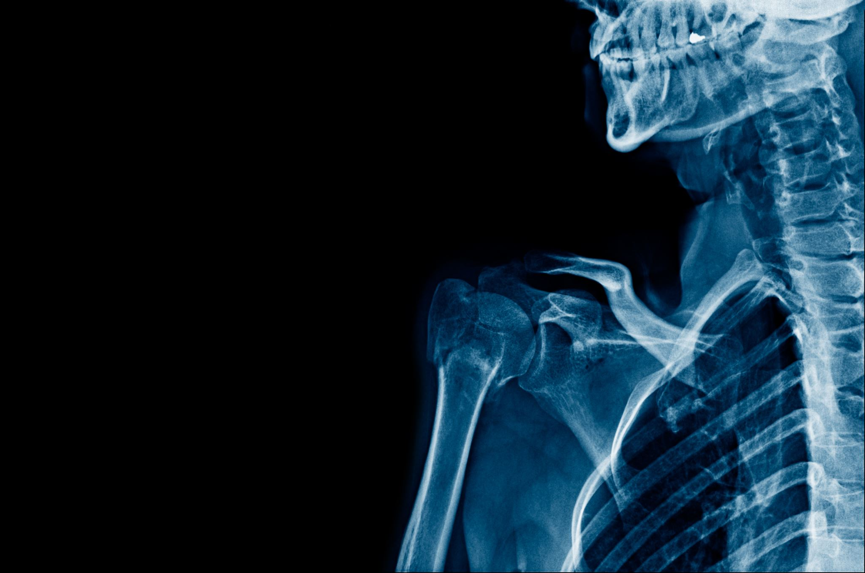
Essential question:
How does the skeletal system help the body function and stay healthy?

Slide 3
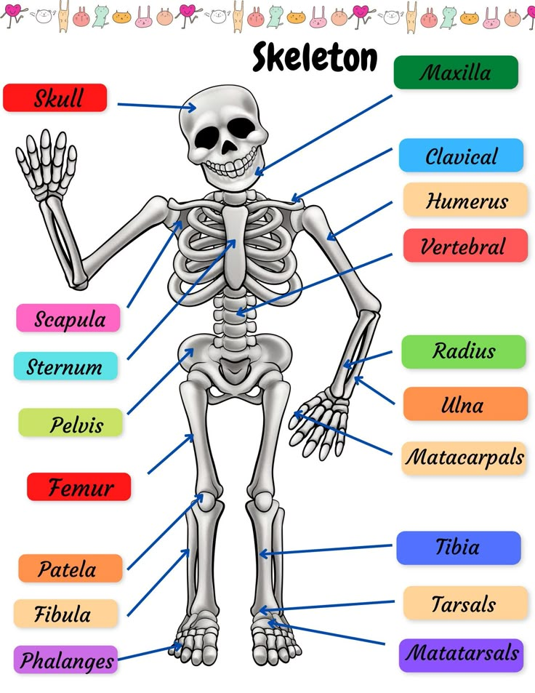
The Human Skeletal System
The human skeletal system is the body’s central framework that consists of bones and connective tissue. It is also called the musculoskeletal system. The human skeleton has 206 bones that are connected by tendons, ligaments and cartilage. The skeletal system provides the structural support for the body and protects the organs.
65bd3086edbfd80a85aff69191d477dc.jpg (736×953)

Slide 4
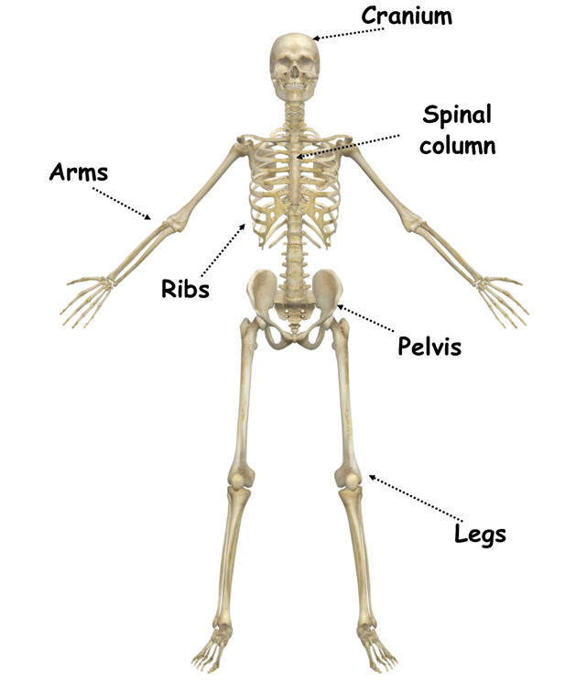
What is the Skeletal System?
The skeletal system is made up of bones that support the body and help it move.
It protects important organs like the brain, heart, and lungs.
It gives structure to the body and allows movement with the help of muscles.
Bones-parts-1.png (1209×1537)

Slide 5
Comparison of Young
VS.
Adult Human Bones
Feature | Young Humans | Adults
Number of Bones | About 270 | About 206
Bone Structure | More cartilage, less dense | More bone tissue, denser
Growth Plates | Present (bones still growing) | Growth plates closed (no more growth)
Flexibility | More flexible | Less flexible, more brittle
Healing Time | Faster bone healing | Slower bone healing
Bone Density | Lower bone density | Higher bone density, then may decrease with age

Slide 6
All bones in the human body are important because they work together as a system to provide support, movement, and protection. However, some bones are considered more essential because they play a critical role in survival and daily function.
Skull (Cranium) – Protects the brain, which controls all body functions. Damage to the skull can lead to severe brain injuries, affecting memory, movement, or even life functions.
Spinal Column (Vertebrae) – Protects the spinal cord, which carries messages between the brain and body. A spinal injury can cause paralysis or loss of function.

Slide 7
Ribcage (Ribs & Sternum) – Acts as a shield for the heart and lungs, the organs responsible for keeping us alive by circulating blood and oxygen.
Pelvis – Provides structural support, helping us stand and walk while also protecting the reproductive organs and intestines.
Femur (Thigh Bone) – The strongest bone in the body, essential for walking, running, and carrying body weight. A broken femur can severely limit movement.

Slide 8
Humerus (Upper Arm Bone) – Enables movement in the arms, which is essential for daily activities like eating, lifting, and writing.
Radius & Ulna (Forearm Bones) – Help in wrist and arm movement, allowing us to grasp objects, push, and pull.
Tibia & Fibula (Lower Leg Bones) – Support weight and movement, making activities like walking, jumping, and running possible.

Slide 9
Every bone has a specific function. While some bones may not be as vital for survival, they still contribute to balance, flexibility, and fine motor skills.
Phalanges (Finger and Toe Bones) - help us grab and manipulate small objects, which is essential for tasks like writing, holding tools, and picking up small items.
Clavicle (Collarbone) - connects the arms to the body, allowing for shoulder movement and providing structural support.
Patella (Kneecap) - protects the knee joint and helps in leg movement, especially when bending and walking.
Stapes (Smallest Bone in the Human Body) - Located in the middle ear, this tiny, stirrup-shaped bone helps transmit sound vibrations from the eardrum to the inner ear, allowing us to hear. Despite its small size (about 3 mm), the stapes is crucial for our sense of hearing and balance.

Slide 10
The Ossicles
Malleus (Hammer) – Connects to the eardrum and transmits vibrations to the incus.
1
Incus (Anvil) – Passes vibrations from the malleus to the stapes.
2
Stapes (Stirrup) – The smallest bone in the human body, which sends vibrations to the inner ear for sound processing.
3

Slide 11
The General Functions of the Human Skeletal System
Support: Keeps your body upright.
Movement: Works with muscles to move the body.
Protection: Protects vital organs (e.g., heart, brain).
Blood Cell Production: Produces red and white blood cells.
Mineral Storage: Stores minerals like calcium and phosphorus.

Slide 12
How to Keep Your Bones Healthy
Eat calcium-rich foods (e.g., milk, cheese, spinach).
1
Get enough Vitamin D (e.g., sunlight or foods like salmon).
2
Exercise regularly (e.g., running, jumping, weight-bearing activities).
3
Wear protective gear during sports (e.g., helmets, pads).
4

Slide 13
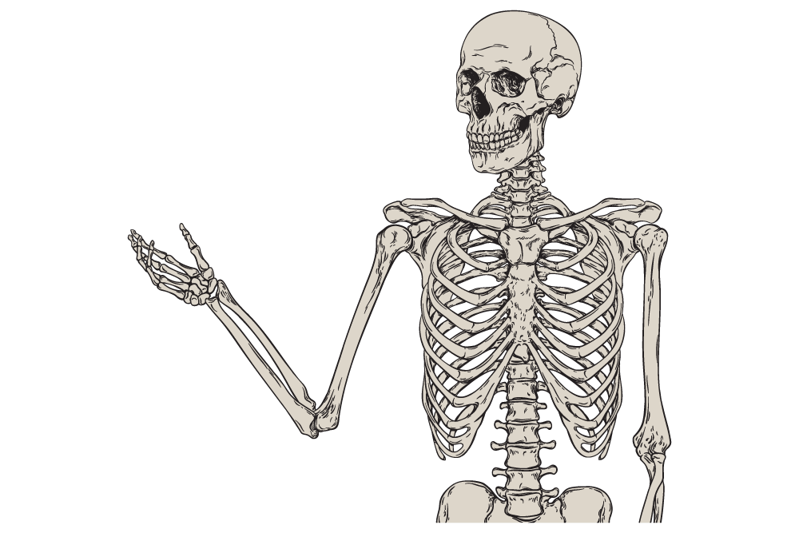
Did you know?
270 bones in babies, but 206 bones in adults.
The smallest bone is in the ear.
Bones are constantly rebuilding themselves.
Bone density peaks around age 30.
orthopedic-trivia.png (1000×667)

Slide 14
Check for understanding
1. Can you name three bones in your
body?
2. How do bones help you move?
3. Why do babies have more bones
than adults?
Notes:
Can you name three bones in your body?
Skull 🏴‍☠️ (Protects the brain)
Femur 🦵 (Longest bone in the body, supports movement)
Humerus 💪 (Upper arm bone, helps in lifting and movement)
How do bones help you move?
Bones work with muscles and joints to create movement. Muscles pull on bones to make the body move, like bending your arm or walking. The joints act as flexible connections that allow motion.
New Question: Why do babies have more bones than adults?
Babies are born with around 300 bones, but as they grow, some bones fuse together, forming the 206 bones found in an adult. This helps create stronger and more stable structures in the body.

Slide 15
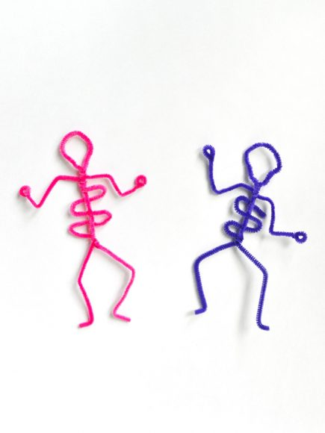
It’s time for the project making!
The Human Skeletal System

