Slide 1
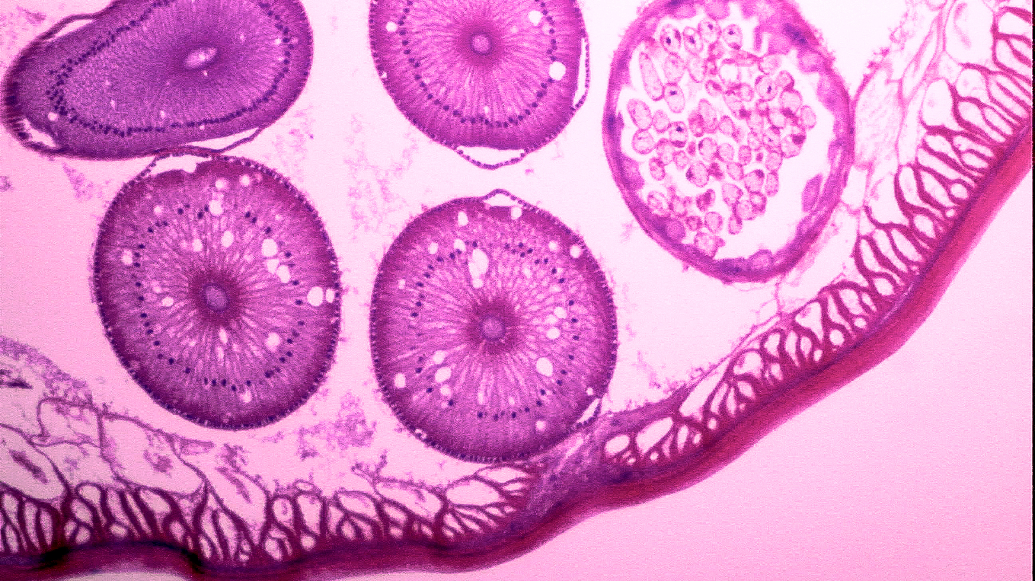
What is the Basic Unit of Life?
Day 1
Cells and Cell Systems
Objective: Understand that cells are the basic structural and functional unit of life.
www.innovatewithmrbarbado.com

Slide 2
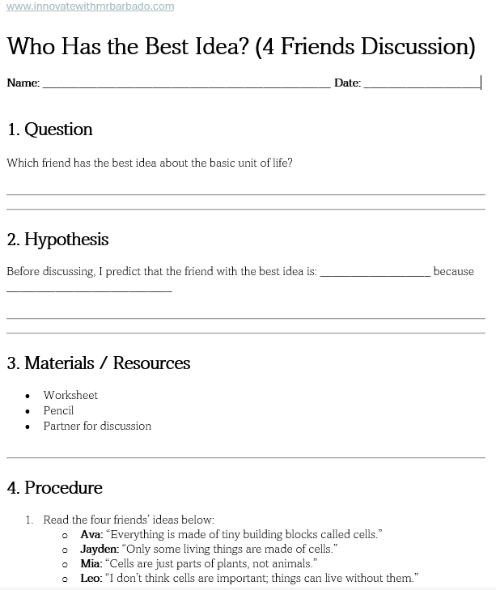
Who Has the Best Idea?

Slide 3
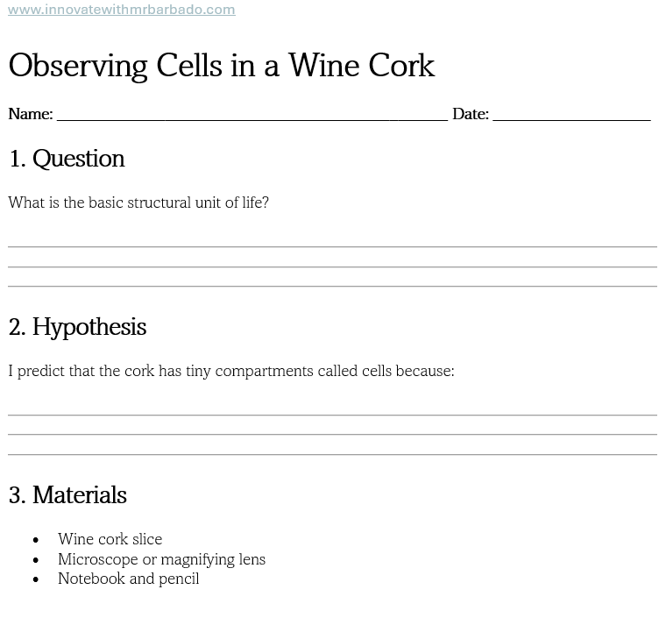
Observing Cells in a Wine Cork
Robert Hooke first observed cork from a cork oak tree in 1665 and saw tiny, box-like compartments, which he called ‘cells.’ Today, we are using a wine cork to see similar box-like structures. This activity helps us understand that cells are the basic structural and functional units of all living things.
Notes:
Teacher Notes / Narration:
Introduce the activity: “Today, we are going to see the tiny compartments Robert Hooke called cells. He first saw them in cork!”
Demonstrate using the magnifying lens or microscope, showing how to focus.
Remind students to draw carefully and label cells in their notebook.
Connect to Cell Theory: Even though cork tissue is dead, it shows that cells are the building blocks of living things.
Circulate to assist with observations, sketches, and discussion.
Activity Worksheet:
Use the Scientific Method worksheet for this slide:
Question: What is the basic structural unit of life?
Hypothesis: I predict...
Materials: List them
Procedure: Observe, sketch, label
Data / Observation: Draw and take notes
Analysis / Thinking: What does this show?
Conclusion: What can you conclude?
Timing: ~10–12 minutes for observation, sketching, and notes.

Slide 4
Cell Theory Word Wall
Word | Definition / Meaning | Function / Importance
Cell | The basic structural and functional unit of life | Makes up all living things and carries out life processes
Cork | Dead plant tissue from a tree | Lets us see the box-like structure of cells under a microscope
Observation | Using your senses to gather information | Helps scientists notice cell structures and collect data
Microscope | A tool that magnifies tiny objects | Allows us to see cells too small for the naked eye
Structural Unit | Part of an organism that forms its structure | Gives organization and shape to living things
Functional Unit | Part of an organism that performs a specific function | Performs tasks necessary for life
Cell Theory | Idea that all living things are made of cells and all cells come from pre-existing cells | Explains the fundamental concept of life
Notes:
Introduction / Explanation:
“Students will organize key vocabulary from the lesson on cells and Cell Theory. These words help explain what cells are, how they function, and why they are important for all living things. Each word will be added to the Interactive Word Wall in the notebook, with a short definition or a small drawing, followed by a reflection on what was learned from the cork observation.”
Guiding Questions During Activity:
“What does each word mean in your own words?”
“Can you draw a small picture to help remember the word?”
“Which word is most important for understanding Cell Theory? Why?”
“How does observing cork cells connect to these words?”
Closing Discussion:
“Organizing these words and reflecting helps students understand that cells are the basic structural and functional units of all living things, which is the first principle of Cell Theory.”

Slide 5
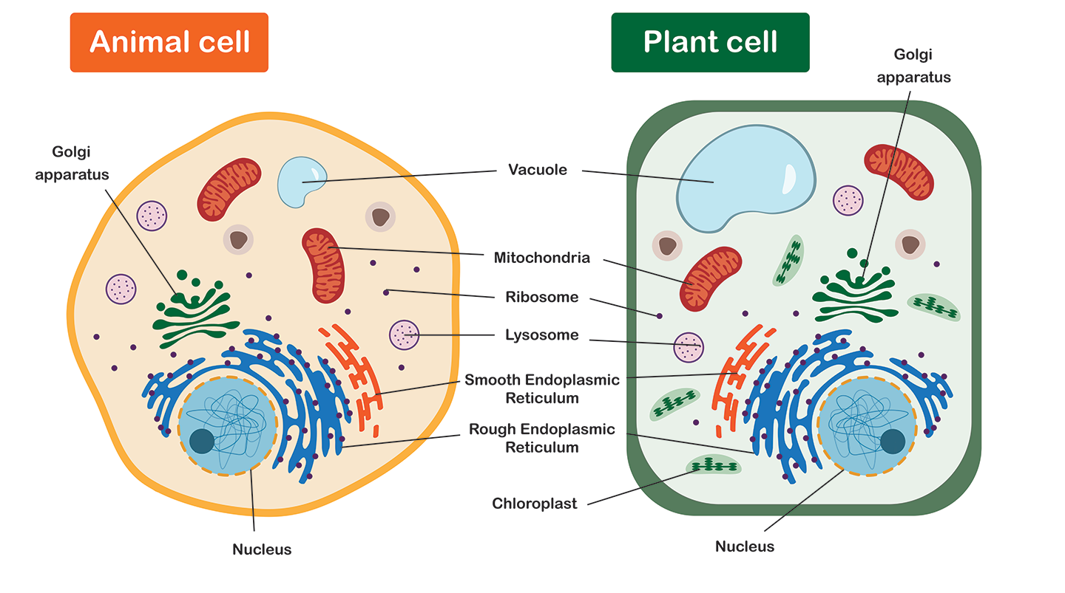
Types of Cells and Organelles
Cells have specialized parts called organelles, each with a job to help the cell survive. Plant, animal, and bacteria cells have some differences in their organelles.
Plant and animal cells share some organelles: nucleus, mitochondria, cell membrane.
Plant cells have unique organelles: chloroplasts, cell wall, large central vacuole.
Animal cells have small vacuoles and no cell wall or chloroplasts.
Day 2

Slide 6

Plant Cell Organelles
A plant cell is the basic unit of life in plants, and it has specialized parts called organelles, each with a unique job that helps the plant survive and grow. Some organelles are found in both plant and animal cells, while some are unique to plant cells.
Cell Wall – A strong, rigid layer outside the cell membrane. It protects the cell and gives the plant its structure and shape. Without a cell wall, plants would not be able to stand upright.
Cell Membrane – A thin layer just inside the cell wall. It controls what enters and leaves the cell, keeping harmful substances out and nutrients in.
Nucleus – The control center of the cell. It stores DNA and directs all cell activities, like a brain for the cell.
Chloroplasts – Found only in plant cells. They capture sunlight to make food through photosynthesis, turning light energy into chemical energy the plant can use.
Mitochondria – The powerhouse of the cell. They produce energy by breaking down sugar so the plant can grow and perform functions.
Vacuole – A large storage sac that holds water, nutrients, and waste. It also helps maintain the cell’s shape and keeps the plant firm.
Day 2
Notes:
Introduction / Hook:
“Now that we know cells are the basic units of life, let’s look closer at a plant cell and see what each part does. Each organelle has a special job that helps the plant survive and grow.”
Guiding Questions While Showing the Slide:
“Can anyone point out the cell wall? Why do you think plants need a wall around their cells?”
“Which organelle do you think makes food for the plant? How does it do that?”
“Why do you think the vacuole is so large in plant cells?”
“Which organelles are similar to ones in animal cells, and which are unique to plants?”
Discussion / Engagement:
Ask students to compare plant cell organelles to a factory:
“If the nucleus is the manager, the mitochondria is the power generator, and the chloroplast is the kitchen, what could the vacuole or cell wall represent?”
Encourage students to point and describe the organelles on their diagram or slide.
Check for Understanding / Quick Formative Assessment:
“Name one organelle that only plant cells have.”
“What is the job of the nucleus?”
“Why is it important for a plant cell to have a cell wall?”

Slide 7
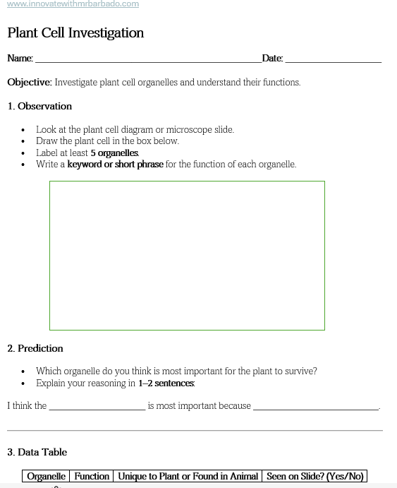

Plant Cell Investigation

Slide 8
Plant Cell Word Wall
Organelle | Definition / Description | Function
Cell Wall | Rigid outer layer of plant cells | Protects the cell and gives shape
Cell Membrane | Thin layer inside the cell wall | Controls what enters and leaves the cell
Nucleus | Control center of the cell | Directs cell activities and stores DNA
Chloroplasts | Green organelles in plant cells | Capture sunlight to make food (photosynthesis)
Mitochondria | “Powerhouse” of the cell | Produces energy for the cell
Vacuole | Large storage sac | Stores water and nutrients; helps maintain structure
Notes:
Introduction / Hook:
“Now that we’ve observed plant cells and labeled the organelles, let’s add them to our Word Wall. This will help us remember their names and what they do.”
Guiding Questions / Discussion:
“Which organelle gives the plant its shape and protects it?”
“Which organelle is the ‘kitchen’ that makes food for the plant?”
“Why do you think the vacuole is so large in plant cells?”
“Can anyone name an organelle that plant cells have but animal cells do not?”
Student Engagement:
Have students copy the organelles, definitions, and functions into their Word Wall or notebook.
Encourage students to share one organelle they found most interesting with a partner.
Check for Understanding:
Ask: “What are 3 features that make plant cells different from animal cells?”
Collect exit tickets or short answers to check comprehension before Day 3 (Animal Cells).
Transition / Next Step:
“Tomorrow, we will explore animal cells, see how they are similar and different from plant cells, and continue building our Word Wall.”

Slide 9
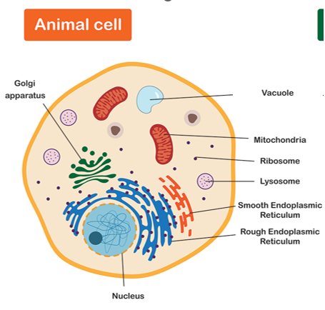
Animal Cells and Their Organelles
An animal cell is the basic unit of life in animals. Like plant cells, it contains specialized parts called organelles, each performing a specific function that helps the cell survive and work properly. Unlike plant cells, animal cells do not have a cell wall, chloroplasts, or a large central vacuole, but they do have several other organelles essential for life.
Cell Membrane – A thin layer that surrounds the cell. It controls what enters and leaves the cell, protecting it and maintaining balance.
Nucleus – The control center of the cell. It stores DNA and directs all cell activities, like a brain for the cell.
Mitochondria – The powerhouse of the cell. It produces energy from nutrients, which the cell uses to carry out its functions.
Cytoplasm – The jelly-like substance that fills the cell. It holds organelles in place and allows materials to move inside the cell.
Endoplasmic Reticulum (ER) – A network of membranes that helps make proteins and lipids.
Rough ER: Has ribosomes; makes proteins.
Smooth ER: Makes lipids and detoxifies substances.
Ribosomes – Tiny structures that produce proteins needed for growth and repair.
Golgi Apparatus – Processes and packages proteins and other materials for transport in or out of the cell.
Lysosomes – Small sacs that break down waste and worn-out cell parts, keeping the cell clean.
Day 3
Notes:
Introduction / Hook:
“Now that we’ve explored plant cells, let’s look at animal cells. While they share some organelles with plant cells, there are also differences that help animals survive and function.”
Guiding Questions / Discussion:
“Which organelle controls the activities of the cell?” (nucleus)
“Where does the cell get its energy?” (mitochondria)
“What organelles are responsible for making and transporting proteins?” (ribosomes and Golgi apparatus)
“What do you notice is missing in animal cells compared to plant cells?” (cell wall, chloroplasts, large vacuole)
Student Engagement:
Ask students to point to the organelles on the diagram or slide as you name them.
Encourage students to compare with plant cells and discuss with a partner:
“Which organelle is in both plant and animal cells?”
“Which organelle is unique to animal cells?”
Check for Understanding / Quick Formative Assessment:
“Name one organelle that helps the animal cell clean up waste.” (lysosome)
“Why is the cytoplasm important for organelles?”
“Which organelle acts like the cell’s power plant?” (mitochondria)

Slide 10
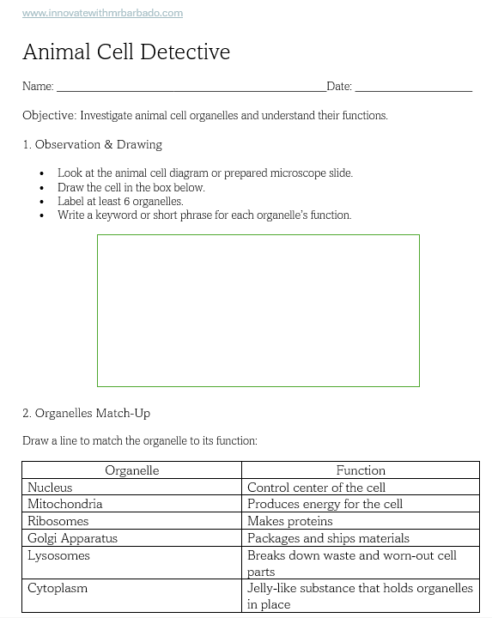
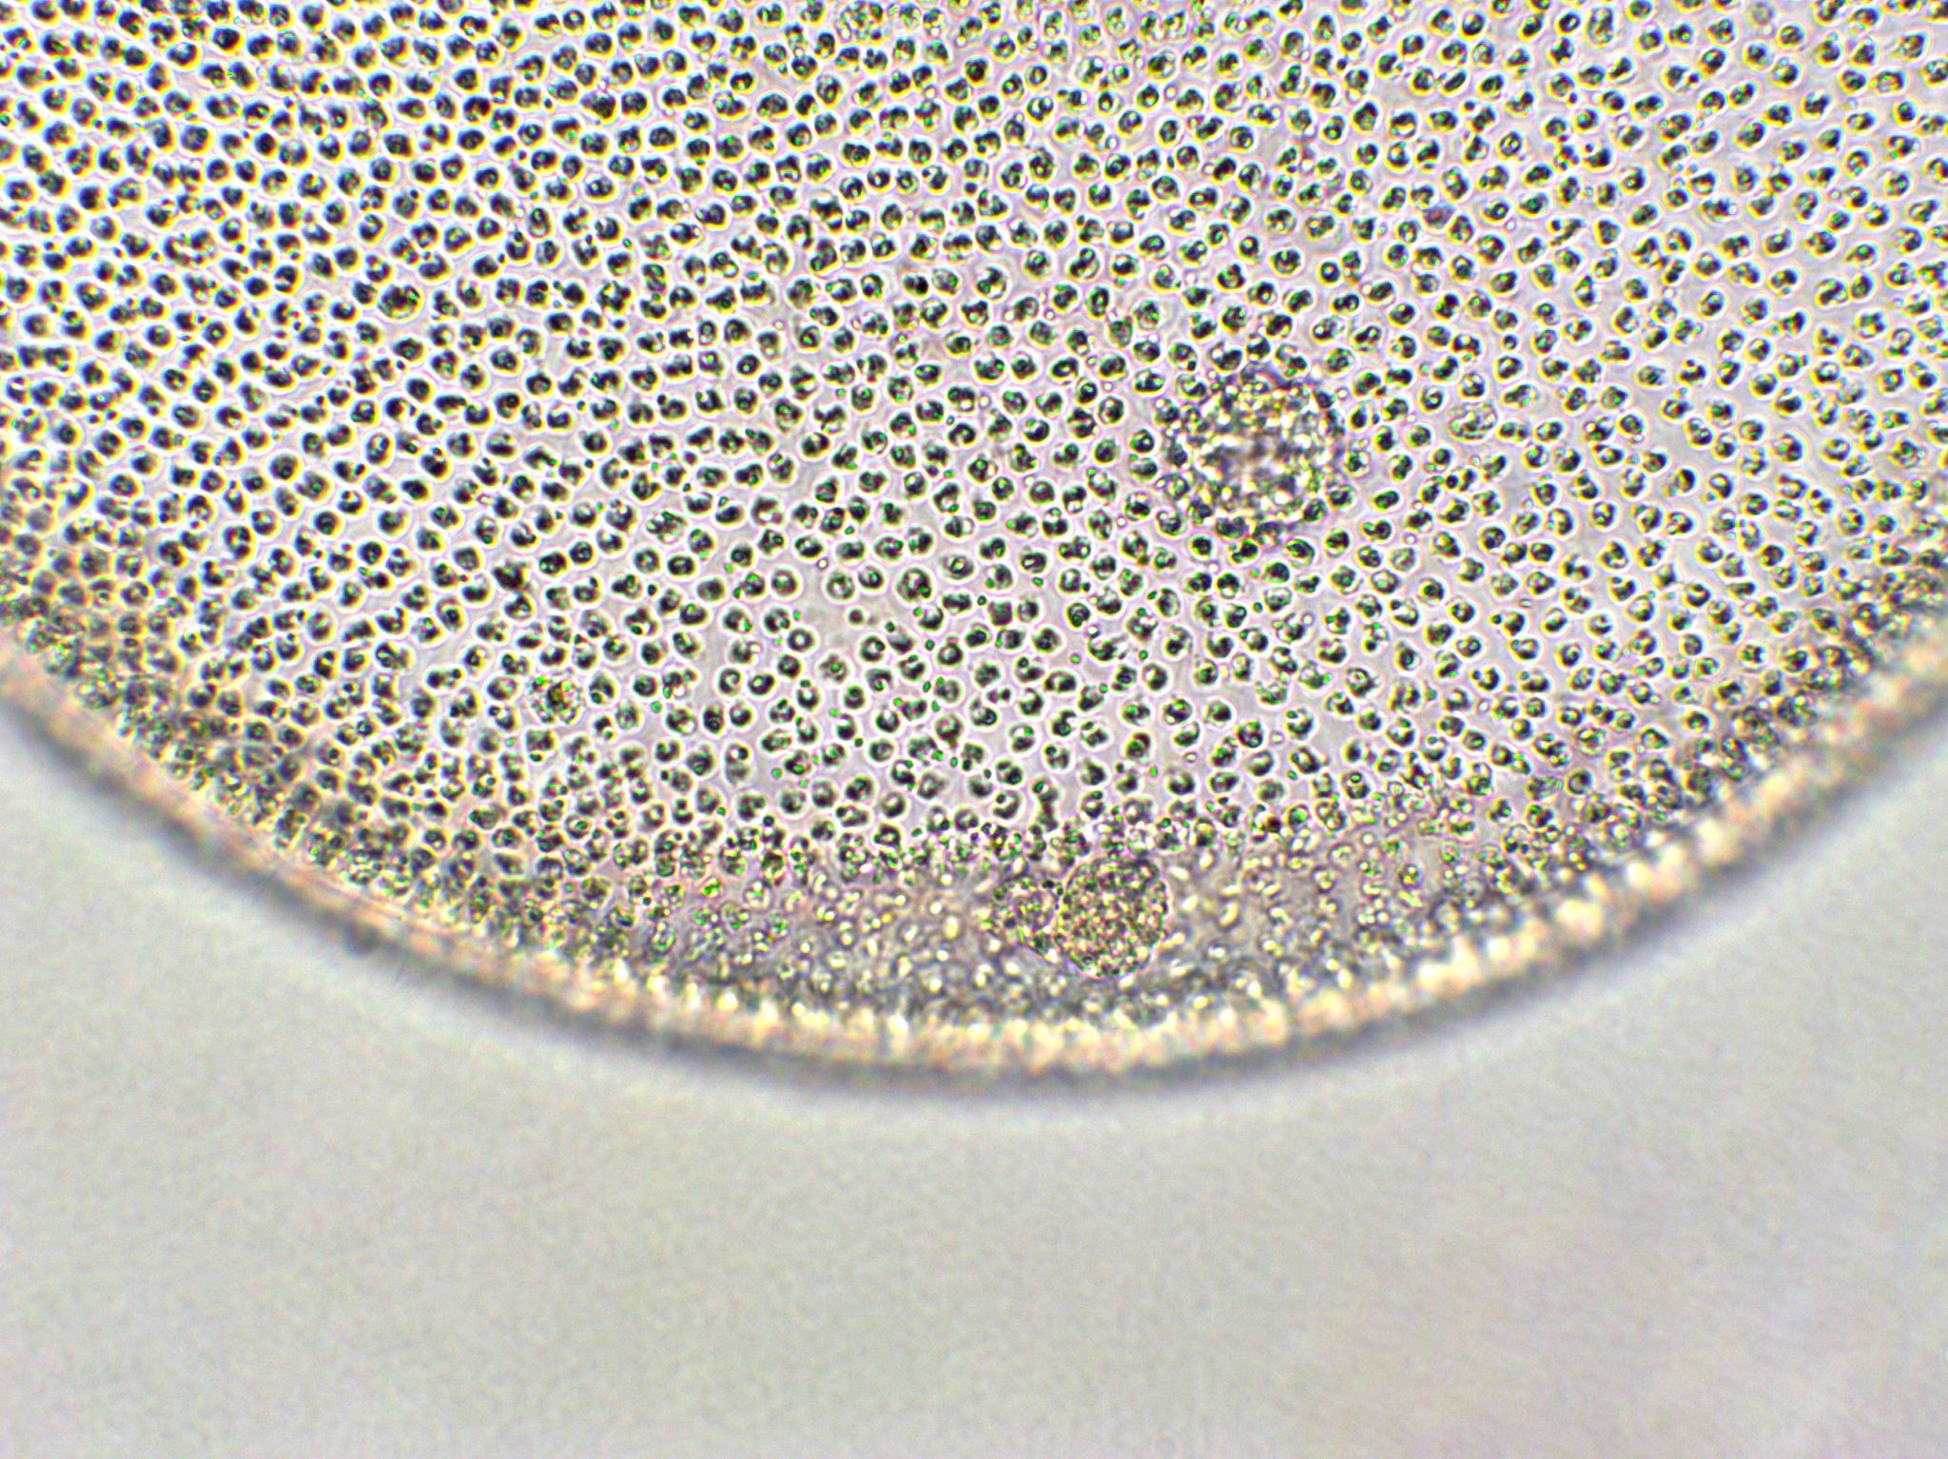
Animal Cell Detective
Notes:
Introduction / Hook:
“Today, we’re going to investigate animal cells like real scientists. You’ll observe, draw, label, and think critically about each organelle and what it does.”
Guiding Questions / Discussion:
“Which organelle acts as the control center of the cell?” (nucleus)
“Where does the cell get its energy?” (mitochondria)
“What organelles help produce and transport proteins?” (ribosomes and Golgi apparatus)
“How is an animal cell different from a plant cell?” (no cell wall, chloroplasts, or large vacuole)
Student Engagement:
Have students draw and label the animal cell using the diagram or prepared slide.
Encourage students to think like detectives for the challenge questions:
Which organelle would they visit first?
Which organelle is most important for energy?
What happens if an organelle stops working?
Allow students to compare answers with a partner before sharing with the class.
Check for Understanding / Formative Assessment:
Review the match-up table answers together.
Collect reflection answers to see which organelles students found most interesting and if they understand the cell’s structure and functions.

Slide 11
Animal Cell Word Wall
Organelle | Definition / Description | Function
Cell Membrane | Thin layer surrounding the cell | Controls what enters and leaves the cell
Nucleus | Control center of the cell | Directs cell activities and stores DNA
Mitochondria | “Powerhouse” of the cell | Produces energy for the cell
Cytoplasm | Jelly-like substance filling the cell | Holds organelles in place and allows movement
Ribosomes | Tiny structures in the cell | Make proteins for growth and repair
Golgi Apparatus | Stacked membranes in the cell | Packages and ships proteins and other materials
Lysosomes | Small sacs in the cell | Break down waste and worn-out parts
Endoplasmic Reticulum (ER) | Network of membranes | Makes proteins and lipids; rough ER has ribosomes
Notes:
Teacher Notes / Narration:
Highlight that animal cells lack a cell wall, chloroplasts, and large vacuole (unlike plant cells).
Students copy these into their Word Wall or notebooks.
Ask students to share one organelle they found most interesting with a partner.
Reinforce connections to Cell Theory: all living things are made of cells, and organelles perform essential functions.

Slide 12
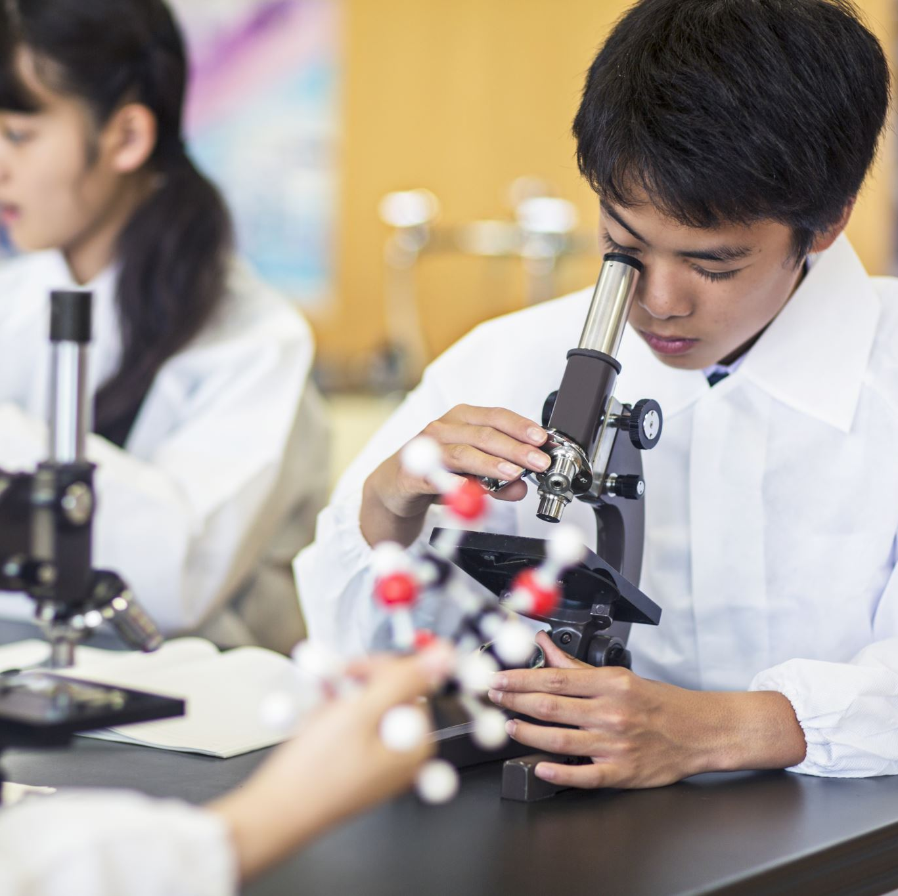
Using Microscopes to Explore Cells
Day 4
Identify the parts of a microscope and explain their functions.
Demonstrate proper microscope handling and safety.
Observe plant and animal cells under a microscope.
Record observations in a simple investigation table.

Slide 13
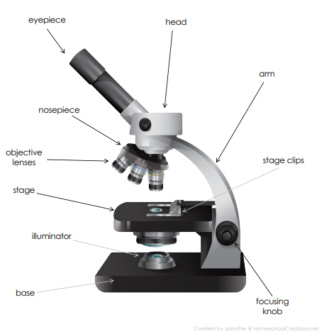
Parts of a Microscope
Microscope Part | Definition / Description | Function
Eyepiece (Ocular Lens) | The lens you look through at the top | Magnifies the specimen, usually 10x
Arm | Connects the eyepiece and base | Used to carry the microscope safely
Stage | Flat platform where the slide is placed | Holds the specimen in position
Stage Clips | Small clips on the stage | Secure the slide so it doesn’t move
Nosepiece (Revolving / Turret) | Rotating part that holds objective lenses | Allows switching between magnifications
Focusing Knobs | Knobs on the side of the microscope | Coarse: rough focus; Fine: sharpens image
Illuminator / Light Source | Built-in light or mirror | Illuminates the specimen
Objective Lenses | Lenses attached to the nosepiece | Provide different magnifications (e.g., 4x, 10x, 40x)
Head (Body Tube) | Connects eyepiece to objective lenses | Maintains proper distance for focus
Base | Bottom support of the microscope | Supports and stabilizes the microscope
Notes:
Introduction / Hook:
“Before we look at cells under the microscope, it’s important to understand the tool itself. Each part has a special function that helps us observe tiny details clearly and safely.”
Guiding Questions / Discussion:
“Which part do we look through to see the cell?” (Eyepiece)
“Which part do we hold when carrying the microscope?” (Arm & Base)
“Which knob do we use first to bring the specimen into view?” (Coarse Focus)
“Which knob gives us a clear, detailed image?” (Fine Focus)
“How does the illuminator help us?” (Provides light to see the specimen clearly)
Student Engagement:
Ask students to point to each part on a diagram as you name it.
Have students discuss with a partner which parts they think are most important for safety and proper use.
Encourage students to fill in the functions in their own words if using the table as a worksheet.
Check for Understanding / Formative Assessment:
Quick oral questions:
“What does the nosepiece do?”
“Why should we never touch the lenses?”
“Which part holds the slide in place?” (Stage & Stage Clips)

Slide 14
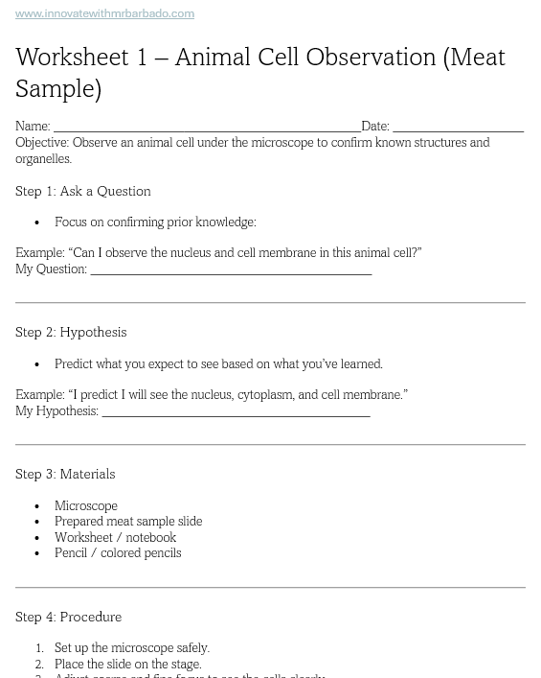
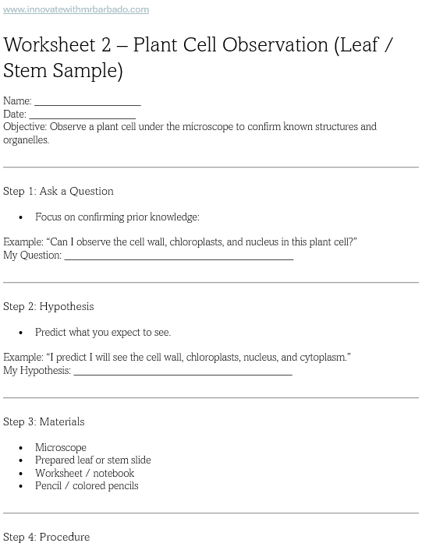
Observing Cells Under the Microscope: Confirming Plant and Animal Cell Structures
Notes:
Teacher Prompt – Microscope Observation Experiment
Before Students Begin:
“Today, we will confirm what scientists already know about plant and animal cells by observing them under the microscope.
Each group will choose either a plant sample (leaf/stem) or an animal sample (meat) to observe.
Remember: our goal is to see the organelles, draw them, label them, and connect what you see to what you’ve learned about cells.”
During Observation:
“Make sure to carry the microscope carefully with two hands and handle your slides gently.
Use the coarse and fine focus knobs to bring your cells into clear view.
Draw at least five organelles in your observation box and label them correctly.
Think: Which organelles are easy to see? Which are harder? Why?”
Scientific Thinking Prompts (to circulate and ask students):
“Can you confirm the organelles you expected to see? Which ones?”
“Why do you think some organelles are more visible than others?”
“How does observing these cells help you understand the cell theory?”
“If you had to explain to someone why cells are the basic unit of life, what would you say based on your observations?”
Wrap-Up Prompt:
“After drawing and labeling, complete your reflection: Which organelles did you confirm? Which were hardest to see? How do these organelles help the cell function?”
“Be ready to share one interesting thing you noticed about your cell with your table partner.”

Slide 15
Cells and Cell Systems: Review & Build Your Cell Model
1. Key Concepts (Quick Review):
Cells are the basic unit of life.
All living things are made of cells.
Cells come from pre-existing cells.
Plant vs Animal Cells:
  Plant: cell wall, chloroplasts, large vacuole
  Animal: no cell wall, lysosomes, small vacuoles
2. Online Review Test:
Complete the review test at: www.innovatewithmrbarbado.com

Slide 16
Build Your Cell Model: Plant or Animal Cell
Objective:
Demonstrate understanding of cell organelles and their functions by creating a 3D model of a plant or animal cell.
Instructions:
Choose Plant Cell or Animal Cell.
Build a 3D model representing the cell and its organelles.
Include at least 7 organelles and label each clearly.
Use colors, textures, or objects to differentiate organelles.
Prepare to explain your model to the class:
  Name each organelle
  Describe its function
  Explain why you chose your materials

Slide 17
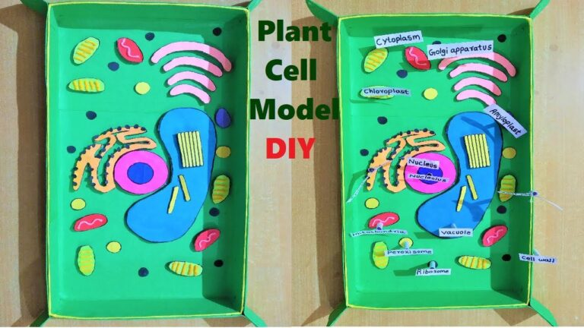
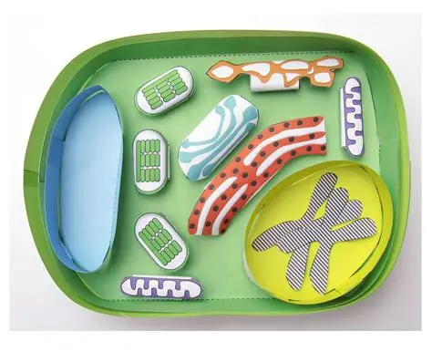
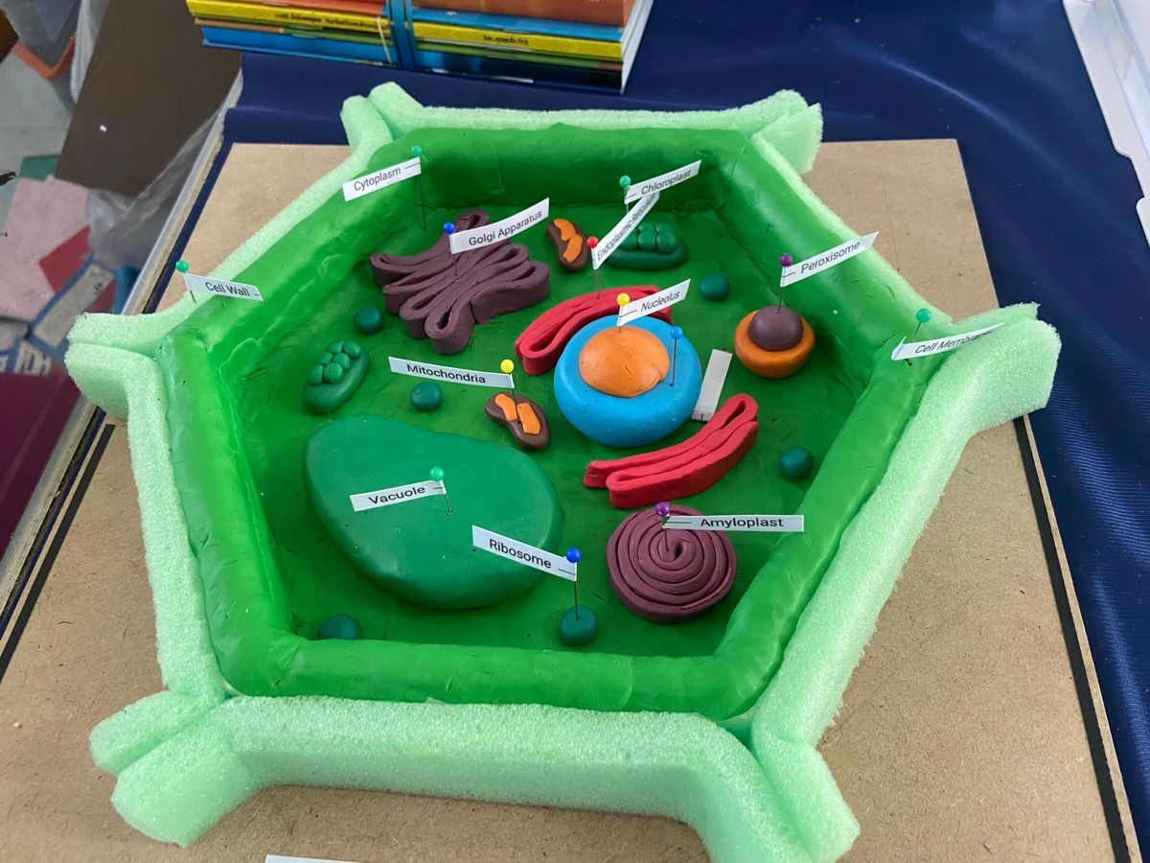
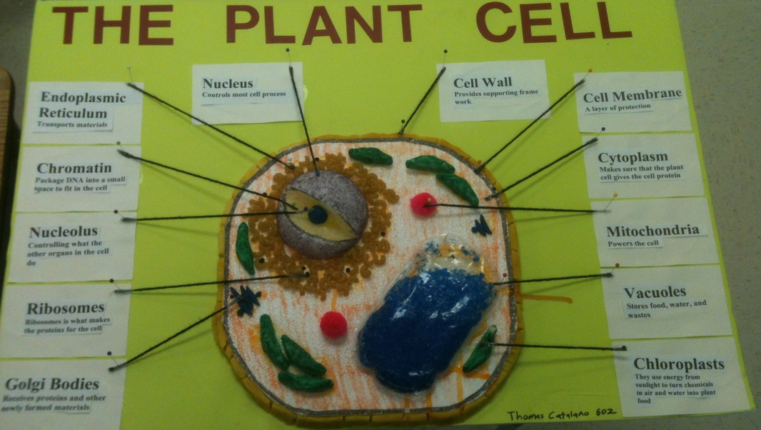

Slide 18
