Slide 1

Introduction to Polygons & Triangles
Benchmarks: MA.8.GR.1.3, MA.8.GR.1.4, MA.8.GR.2.4
John Mark L. Barbado, M.Ed.
STEM Teacher
www.innovatewithmrbarbado.com

Slide 2

What is a Polygon?
Types of polygons:
1. Convex polygon: All interior angles < 180°
2. Concave polygon: At least one interior angle > 180°
3. Regular polygon: All sides and angles are equal
Examples: Triangle, square, pentagon
Non-example: Circle (not a polygon)
Polygon: A closed figure with straight sides
www.innovatewithmrbarbado.com

Slide 3
Difference between a Convex and Concave Polygon
CONCAVE
CONVEX
www.innovatewithmrbarbado.com

Slide 4
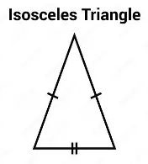
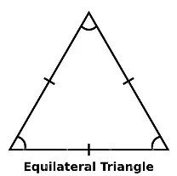
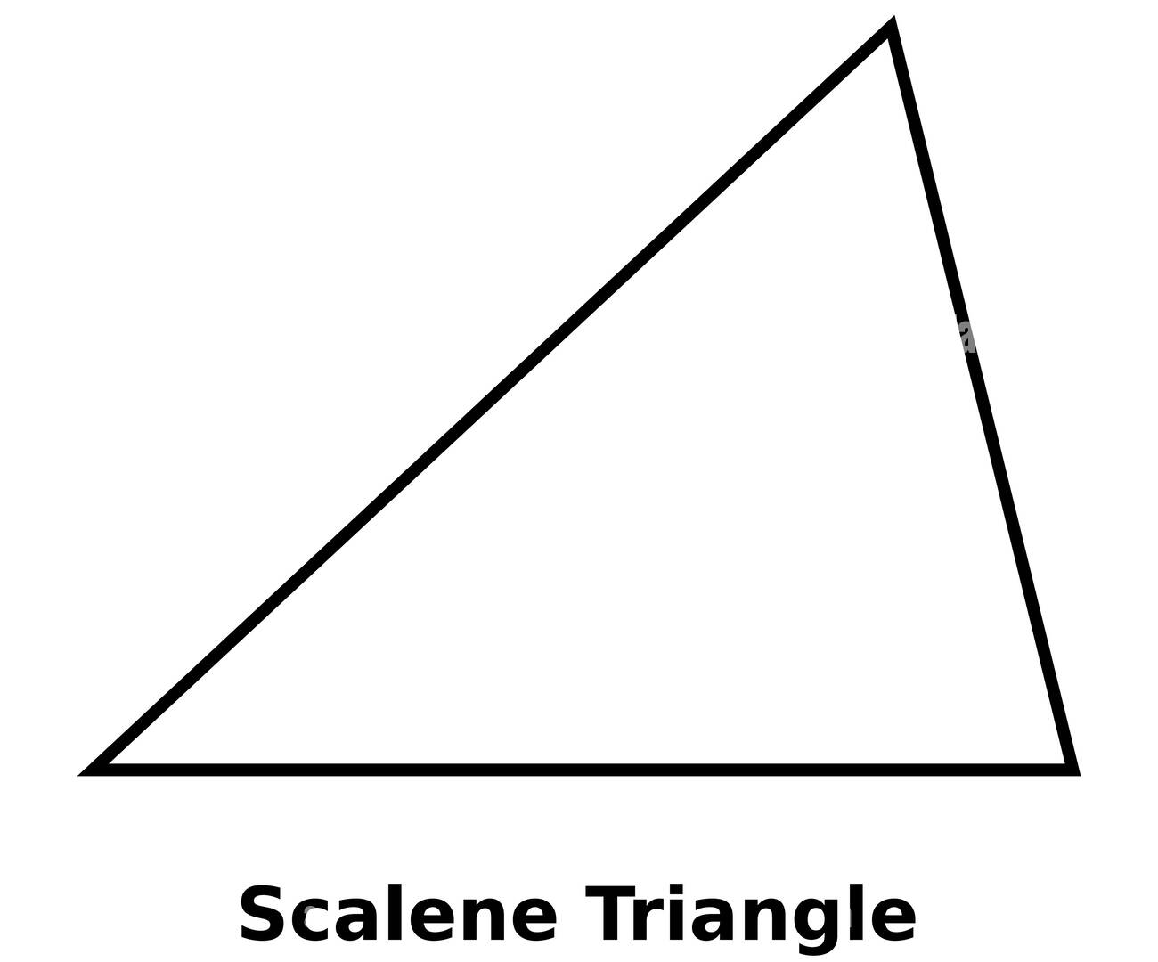
Types of Triangles
Classified by sides:
Has no equal sides
Has 3 equal sides
Has 2 equal sides
www.innovatewithmrbarbado.com

Slide 5
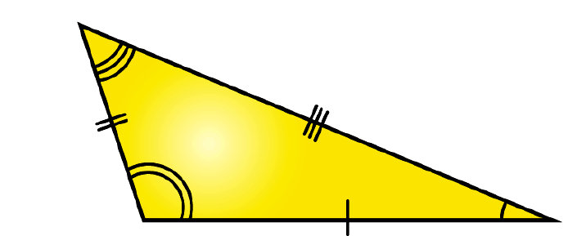
Types of Triangles
Classified by angles:
1. Acute: All angles < 90° Equilateral Triangle
2. Right: One 90° angle Right Triangle
3. Obtuse: One angle > 90° Obtuse Scalene Triangle
www.innovatewithmrbarbado.com

Slide 6
Draw & Classify Triangles Practice
Instructions: Use a ruler and protractor to draw triangles with the given angle measures. After drawing, classify each triangle by angles (acute, right, obtuse) and sides (scalene, isosceles, equilateral). Share and discuss your results with your groupmates.
Problems:
Triangle 1: 60°, 60°, 60° → ?
Triangle 2: 90°, 45°, 45° → ?
Triangle 3: 100°, 40°, 40° → ?
Triangle 4: 70°, 60°, 50° → ?
Triangle 5: 120°, 30°, 30° → ?
www.innovatewithmrbarbado.com

Slide 7
Triangle Sum Theorem
Objective: Students will measure triangle angles using protractors and apply the Triangle Sum Theorem to find missing angles.
Benchmarks: MA.8.GR.1.3, MA.8.GR.1.4
www.innovatewithmrbarbado.com

Slide 8
Triangle Sum Theorem
Definition: The sum of the three interior angles of any triangle is always 180°.
∠A+∠B+∠C=180°
Example:
  ∠A = 65°, ∠B = 75°, ∠C = ?
  Calculation:
  180 – (65 + 75) = 40° → ∠C = 40°
Tip: Use a protractor to measure and confirm.
www.innovatewithmrbarbado.com

Slide 9
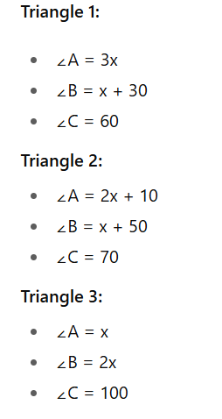
Objective: Solve for unknown angles using the Triangle Sum Theorem and classify triangles by angles.
Instructions:
Each triangle has angles represented by algebraic expressions.
Use the Triangle Sum Theorem: sum of angles = 180°
Solve for the variable x and then calculate each angle.
Classify each triangle as Acute, Right, or Obtuse.
Work with a partner, then share answers with another group (Kagan: Rally Robin).
www.innovatewithmrbarbado.com

Slide 10
Exterior Angles of Triangles
Objective: Apply the Exterior Angle Theorem to find missing angles in a triangle.
Benchmark: MA.8.GR.1.5
www.innovatewithmrbarbado.com

Slide 11
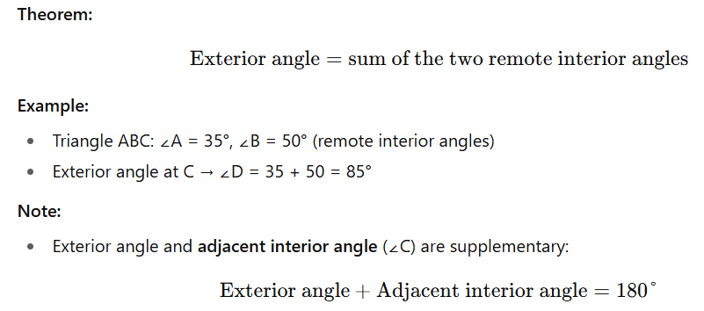
Exterior Angle Theorem
www.innovatewithmrbarbado.com

Slide 12
Instructions: Solve for the missing exterior angle. Work with a partner (Think-Pair-Share).
Remote interior angles 40° and 55° → exterior = ?
Remote interior angles 30° and 70° → exterior = ?
Remote interior angles 25° and 60° → exterior = ?
Challenge: Create your own triangle, label two remote interior angles, and calculate the exterior angle.
www.innovatewithmrbarbado.com

Slide 13
Angles in Special Triangles
Objective: Find missing angles in isosceles and equilateral triangles.
Benchmark: MA.8.GR.1.3
www.innovatewithmrbarbado.com

Slide 14
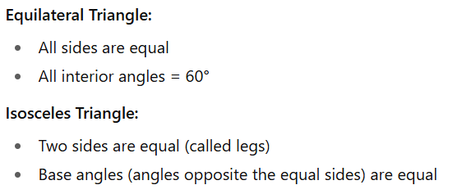
Properties of Special Triangles
www.innovatewithmrbarbado.com

Slide 15

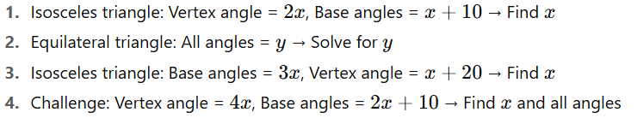
Instructions: Solve for missing angles in the triangles below. Work with a partner.
www.innovatewithmrbarbado.com

Slide 16
Mid-Unit Review – Triangles
Objective: Solve problems using triangle angle relationships and explain my reasoning.
Benchmarks: MA.8.GR.1.3, MA.8.GR.1.5
www.innovatewithmrbarbado.com

Slide 17
Instructions: Solve the following problems as a team. Discuss reasoning.
1. Triangle angles: 50°, 60° → Find the third angle and classify the triangle by angles.
2. Exterior angle = sum of remote interior angles: 40° + 65° → Find exterior angle.
3. Isosceles triangle: Vertex angle = 70° → Find base angles.
4. Equilateral triangle: Each side = 6 cm → Find all angles.
Kagan Strategy: Numbered Heads Together – one student from each team explains solution to the class.
www.innovatewithmrbarbado.com

Slide 18

Solve for missing angles.
1. Triangle: Angle 1 = 2𝑥+10, Angle 2 = 𝑥+20 → Find Angle 3 and classify the triangle by angles.
2. Triangle: Exterior angle = 3y+40, Angle 1 (remote interior) = y+10 → Find Angle 2 (other remote interior angle).
3. Isosceles triangle: Angle 1 = Angle 2 = 4x+5, Angle 3 (vertex) = 2x–15 → Find 𝑥 and all angles.
www.innovatewithmrbarbado.com

Slide 19

Homework:
Available at www.innovatewithmrbarbado.com

