Slide 1


Slide 2

Technology is anything created to solve problems or make life easier.

Slide 3
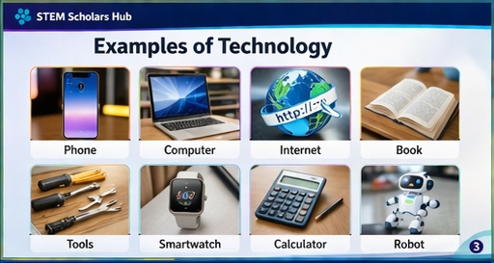

Slide 4
