Slide 1
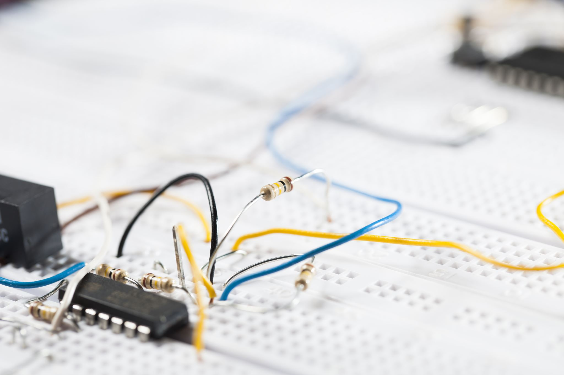
Understanding Electricity and Circuits!
Objective: To explore electricity, how it moves, and how circuits work.
Florida Benchmark: SC.5.P.11.1
NGSS Standard: 4-PS3-2
John Mark L. Barbado, M.Ed.
STEM Educator

Slide 2
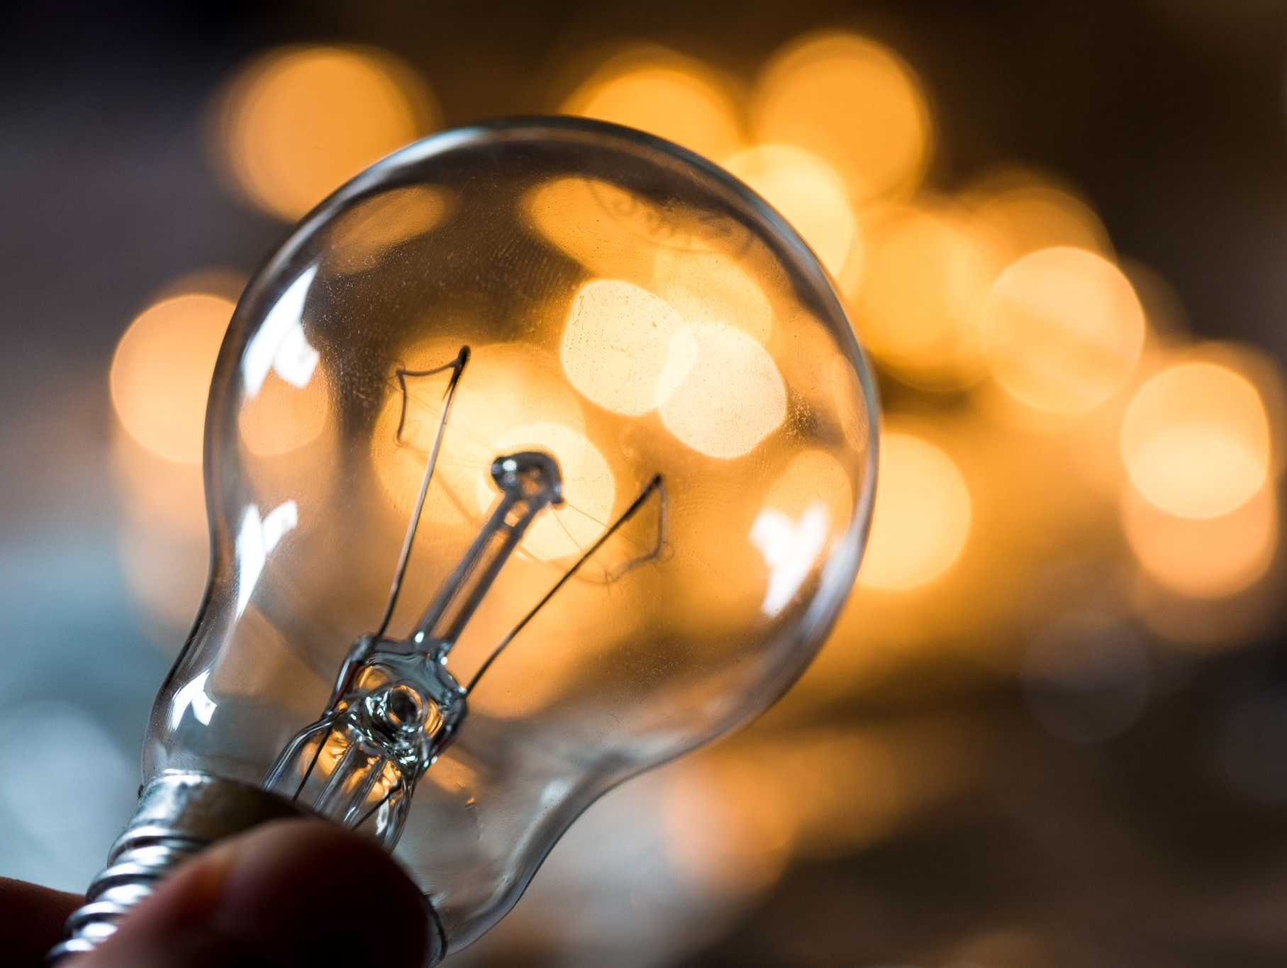
Essential Question
How does electricity move through a circuit, and why is it important in our daily lives?

Slide 3

What Is Electricity?
Electricity is a type of energy that powers many things around us. It’s created by tiny particles called electrons moving through wires.

Slide 4

How Does Electricity Move?
Electricity moves through a "circuit", which is a path that the electricity follows. A complete circuit allows electricity to flow, while an open circuit stops it.

Slide 5
What is a circuit?
An electric circuit is a loop that lets electricity flow from one place to another. There are four main parts: power source, conductor, load, and switch.

Slide 6
Types of Circuits
Series Circuit: One path for electricity.
Parallel Circuit: Multiple paths, so if one part fails, others keep working.

Slide 7
Why are circuits important?
Circuits power our daily devices like phones, lights, and appliances. Understanding circuits helps us troubleshoot when things stop working.

Slide 8
Be Careful with Electricity!
Electricity is powerful.
Always turn off the power before fixing electrical things.
Never touch wires with wet hands and use batteries the right way.

Slide 9
Recap: Why Circuits and Electricity Are Cool!
Electricity is the energy that makes everything work.
Understanding circuits helps us see why things turn on and how they stay powered up.

Slide 10
References
1. U.S. Department of Energy. (2023). Electricity Basics: Circuits and Currents. Retrieved from [DOE Website]
2. National Science Teaching Association. (2024). Understanding Electric Circuits. Retrieved from [NSTA Website]

