Slide 1
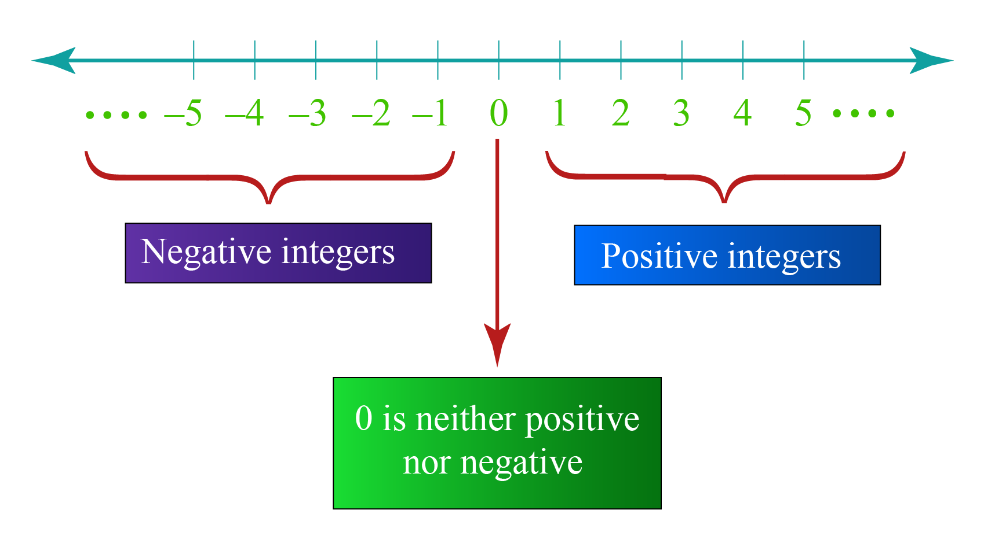
Exploring Rational and Irrational Numbers
Starting with Integers
Source: usha-integers-01-1596003798.png (1698×953)

Slide 2

What are Integers?
Whole numbers that can be positive, negative, or zero.
Source: usha-integers-01-1596003798.png (1698×953)

Slide 3
What are Rational Numbers?
3 → can be written as 3/1
1/2 → already a fraction
Rational numbers are numbers that can be written as a fraction.
A fraction means one number on top of another (numerator/denominator).
The denominator cannot be 0.
-4 → can be written as -4/1
0.25 → equals 25/100

Slide 4
Why are They Called Rational Numbers?
3 = 3/1 → a ratio of 3 to 1.
1/2 → a ratio of 1 to 2.
They are called “rational” because they come from the word “ratio” → a ratio is another word for a fraction.
-4 = -4/1 → a ratio of -4 to 1.
0.25 = 25/100 → a ratio of 25 to 100.
Notes:
Review about place value on how you to transform decimal numbers into fraction.

Slide 5
What are Irrational Numbers?
3.14159…
π (pi) ≈ 3.14159…
Cannot be written as a fraction
Decimal goes on forever without repeating
√2 ≈1.41421…
Cannot be written as a fraction
Decimal goes on forever without repeating
Numbers that cannot be expressed as exact fractions; their decimals never repeat and never end.
1.41421…

Slide 6
Rally Coach Rational or Irrational?
Practice Numbers:
√4
-3
π
0.5
-2/5
Instructions:
Partner A solves a problem and explains the reasoning.
Partner B coaches (listens, checks, and helps if needed).
Switch roles after each problem.
Note: Show your solution to your partner.
Notes:
√4 → 2 → Rational
Why: √4 simplifies to 2, and 2 = 2/1 (a ratio of integers).
-3 → Rational
Why: Integers are rational. -3 = -3/1.
π → Irrational
Why: π’s decimal never ends and never repeats, and it can’t be written as a fraction of integers.
0.5 → Rational
Why: Terminating decimal. 0.5 = 1/2.
-2/5 → Rational
Why: Already a fraction of integers (denominator ≠ 0).

Slide 7

Memory Run – Rational & Irrational Numbers
Each group gets a paper with 10 shuffled numbers placed at a distance.
On the board, there’s an empty table with “Rational” and “Irrational” columns.
One person at a time:
Run to look at the paper.
Memorize one number.
Run back and write it in the correct column.
Teammates take turns until all 10 numbers are placed.
First team to finish correctly wins! 🎉
Notes:
Example list:
3
π
-2/5
√2
0.75
√5
-4
√3
1/3
3.14159…
Rational Numbers (can be written as a fraction)
3 → 3/1
-2/5 → already a fraction
0.75 → 75/100
-4 → -4/1
1/3 → already a fraction
Irrational Numbers (cannot be written as a simple fraction, decimals never repeat or end)
π → 3.14159… (never-ending, never-repeating)
√2 → 1.414213… (non-terminating, non-repeating)
√5 → 2.23606… (non-terminating, non-repeating)
√3 → 1.73205… (non-terminating, non-repeating)
3.14159… (decimal written out, non-repeating)

Slide 8
Discover Decimal Patterns
Identify decimals as terminating, repeating, or non-repeating
Connect decimals to real-life examples
0 0.5 0.333… 0.75 1
|--------|-----------|----------|
• • •
Notes:
Example list:
3
π
-2/5
√2
0.75
√5
-4
√3
1/3
3.14159…
Rational Numbers (can be written as a fraction)
3 → 3/1
-2/5 → already a fraction
0.75 → 75/100
-4 → -4/1
1/3 → already a fraction
Irrational Numbers (cannot be written as a simple fraction, decimals never repeat or end)
π → 3.14159… (never-ending, never-repeating)
√2 → 1.414213… (non-terminating, non-repeating)
√5 → 2.23606… (non-terminating, non-repeating)
√3 → 1.73205… (non-terminating, non-repeating)
3.14159… (decimal written out, non-repeating)

Slide 9
Types of Decimals
1. Repeating Decimal: A digit or group of digits repeats forever
Example: 0.333…
2. Terminating Decimal: Stops after a finite number of digits.
Example: 0.5, 0.25
3. Non-Repeating Decimal: Never ends, never repeats (usually irrational)
Example: 3.14159…
Notes:
Example list:
3
π
-2/5
√2
0.75
√5
-4
√3
1/3
3.14159…
Rational Numbers (can be written as a fraction)
3 → 3/1
-2/5 → already a fraction
0.75 → 75/100
-4 → -4/1
1/3 → already a fraction
Irrational Numbers (cannot be written as a simple fraction, decimals never repeat or end)
π → 3.14159… (never-ending, never-repeating)
√2 → 1.414213… (non-terminating, non-repeating)
√5 → 2.23606… (non-terminating, non-repeating)
√3 → 1.73205… (non-terminating, non-repeating)
3.14159… (decimal written out, non-repeating)

Slide 10

Round Robin: Decimal Patterns
Group Setup: Groups of 3–4 students
Instructions:
1. Classify 6–8 decimal numbers as terminating, repeating, or non-repeating
2. Explain reasoning to your group
3. Write one real-life decimal example on a sticky note.
4. Sharing: Rotate and present 1–2 examples to the class
Notes:
Decimals for Round Robin Activity
0.75
0.666…
1.2
3.14159…
0.125
0.8181…
2.5
0.123456…

Slide 11
Estimating Square Roots of Non-Perfect Squares
What number is multiplied by itself gives this number?
√
Example of a perfect square: √49 = 7
50?

Slide 12
Estimating Square Roots
What number is multiplied by itself gives this number?
25 36 49 64
--|----------|------------|---------------|-----------
5 6 7 ? 8
Notes:
Square roots ask: what number times itself gives this number? For example, √49 = 7. But what if the number isn’t a perfect square, like 50? Today we’ll learn how to estimate using a number line.

Slide 13
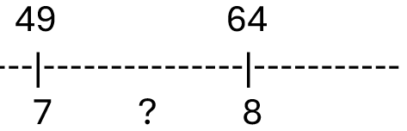
Estimation on the Number Line
Steps:
50 – 49 = 1 step away
64 – 49 = 15 steps total
1 ÷ 15 ≈ 0.07
Estimate: 7 + 0.07 = 7.07

Slide 14
Steps to Estimate a Square Root Using a Number Line
Find the nearest perfect squares.
Example: For √50 → nearest perfect squares are 49 (7²) and 64 (8²).
That tells us √50 is between 7 and 8.
Find the distance from the smaller square.
50 – 49 = 1 step away from 49.
(This tells us how far past 49 we are.)
Find the total distance between the two squares.
64 – 49 = 15 total steps between 49 and 64.
Make a fraction: how far along the gap?
1 ÷ 15 ≈ 0.07
(This means 50 is only 7% of the way from 49 to 64.)
Add this fraction to the lower root.
7 + 0.07 = 7.07 → so √50 ≈ 7.07.
Notes:
Square roots ask: what number times itself gives this number? For example, √49 = 7. But what if the number isn’t a perfect square, like 50? Today we’ll learn how to estimate using a number line.

Slide 15
Practice Together: Find the estimate square roots of the following numbers using number line.
√30 → between 5 and 6
√45 → between 6 and 7
√70 → between 8 and 9

Slide 16
Plot, order, and compare rational and irrational numbers.
You plot, order, and compare numbers by putting them on a number line, using exact values for simple numbers and estimates for roots or irrationals. Then you can arrange them from smallest to largest or largest to smallest to see how they relate.

Slide 17
Order the numbers from the greatest to smallest value:
2.5, π, √16, 3.14
Notes:
“Now, compare them: Which is the smallest? 2.5. Next is π ≈ 3.14, then 3.14, then √16 = 4.”“Ordering numbers correctly is important, especially when you work with decimals and roots.”Check for Understanding: “Turn to your partner and explain why √16 is larger than π.”

Slide 18
Groups sort number cards on a classroom number line
√10, 2.5, π, 3.14, 4.2
Notes:
Teacher Say / Script:
“Now, we will practice in groups. Each group has number cards: √10, 2.5, π, 3.14, 4.2.”
“Your task is to place the numbers correctly on the number line. Remember:
Estimate square roots of non-perfect squares
Compare decimals
Discuss with your group and agree on placement”
“I will walk around and check your group work, and I want each group to explain why a number is placed in that position.”
Check for Understanding: Ask one group to share how they placed √10 and explain their estimate.

Slide 19
Partners order numbers:
√10, π, 3.14,
Notes:
Teacher Say / Script:
“For the last activity, work with your partner. Order these three numbers: π, 3.14, and √10.”
“Write them in order from smallest to largest and explain your reasoning in one sentence.”
“Remember: √10 is not a perfect square, so we estimate: 3² = 9, 4² = 16, so √10 is a little over 3.”
“When you are done, we will share a few answers as a class.”
Exit Ticket: Collect student responses to check understanding.

Slide 20
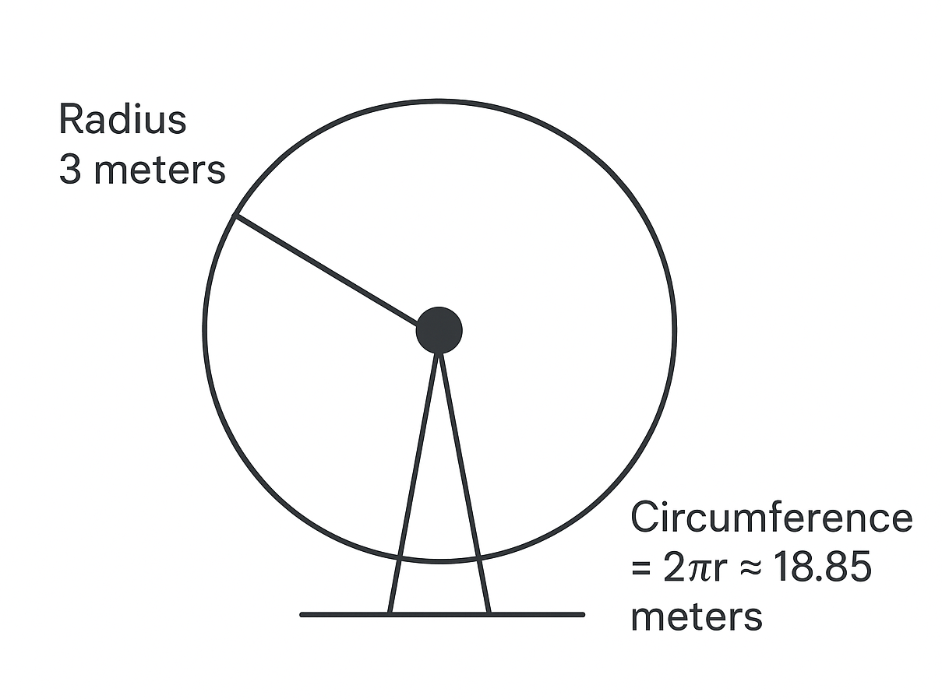
Ferris Wheel Design Project
π is irrational → cannot be written as a fraction.
Formula Reminder: Circumference 𝐶=2𝜋𝑟

Slide 21
Design & Calculate
Why is π irrational but still useful?
Task:
1. Sketch your Ferris wheel in groups.
2. Label radius and circumference.
3. Use C=2πr to calculate.

Slide 22
Peer Review & Reflection
Exchange sketches; check measurements and calculations.
Write one sentence:
How do irrational numbers help in design or engineering?

Slide 23
Homework:
Click on the link below and look for the lesson
“Rational vs. Irrational Numbers” to take your homework.
Middle School / Interactive Quiz | Innovate with Mr. Barbado

