Slide 1
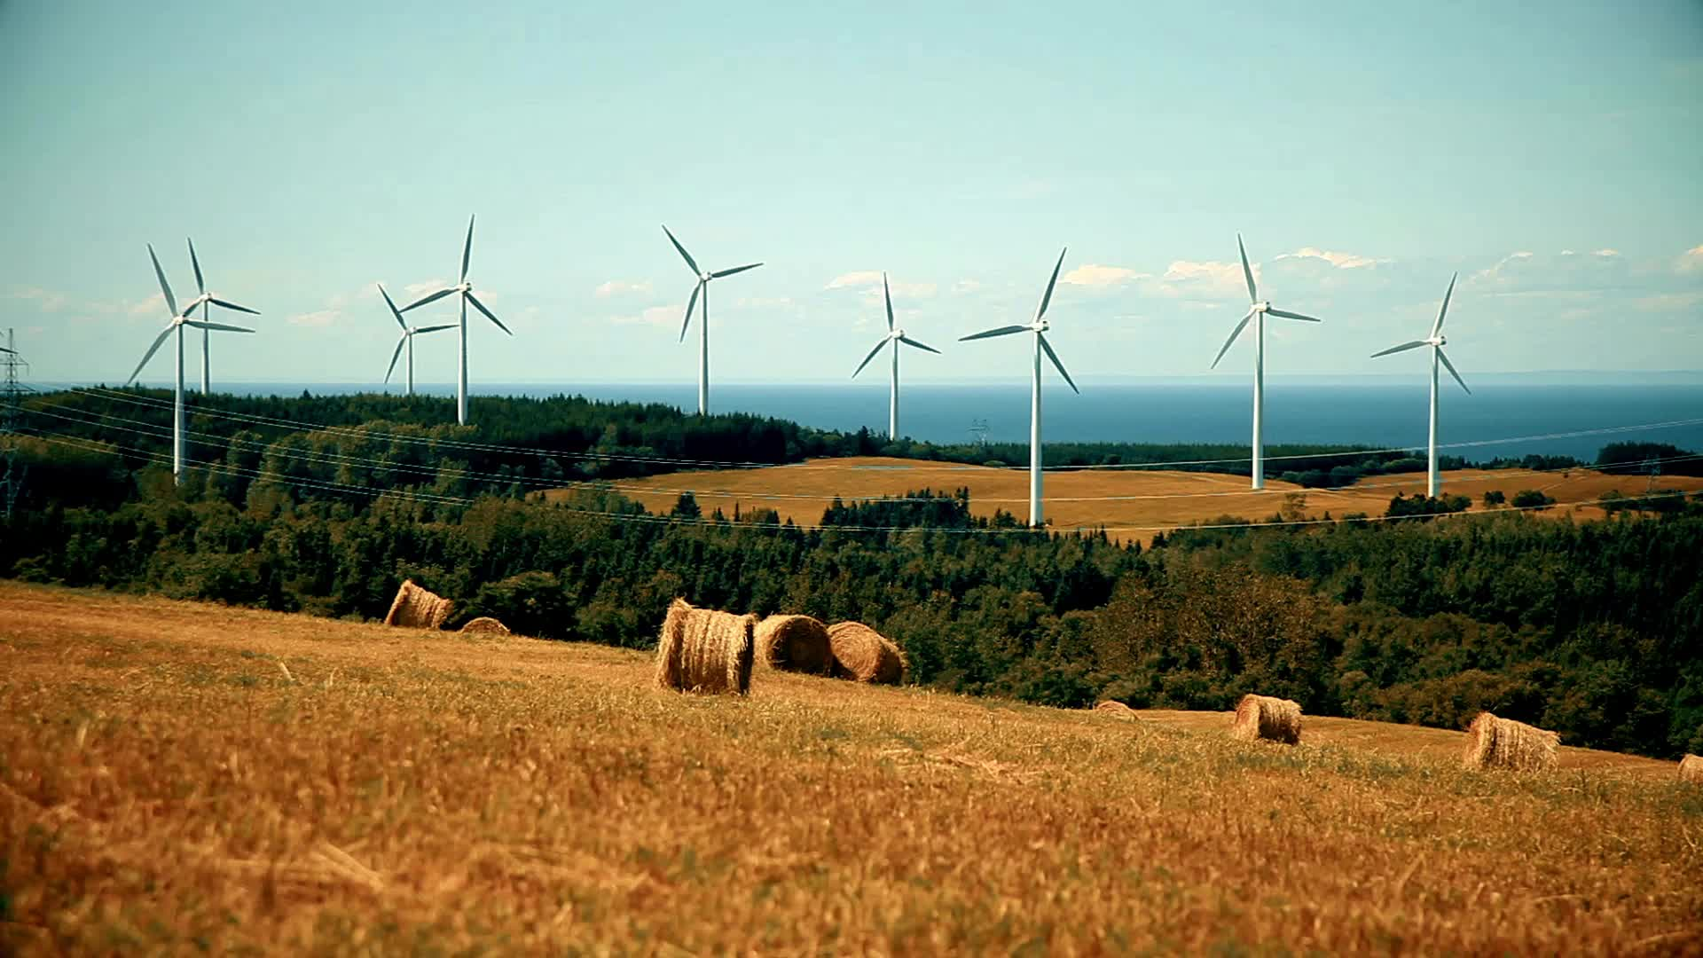
“Renewable and Nonrenewable Resources”
Learning the differences between renewable and nonrenewable resources, explore examples of each, and understand the importance of conservation.
Florida Benchmark: SC.5.E.7.4
NGSS: ESS3.A – Natural Resources

Slide 2

Essential Question
Wind Energy
How can we tell the difference between renewable and nonrenewable resources, and why does it matter?
Notes:
Renewable resources can be replaced naturally in a short time, like sunlight, wind, and water. Nonrenewable resources, such as coal and oil, take millions of years to form and can run out. Knowing the difference helps us make smarter choices to protect the planet and ensure resources for the future.

Slide 3
What are natural resources?
Natural resources are materials or things found in nature that people use to live, work, and survive.
These resources come from the Earth, sun, water, air, and plants.

Slide 4
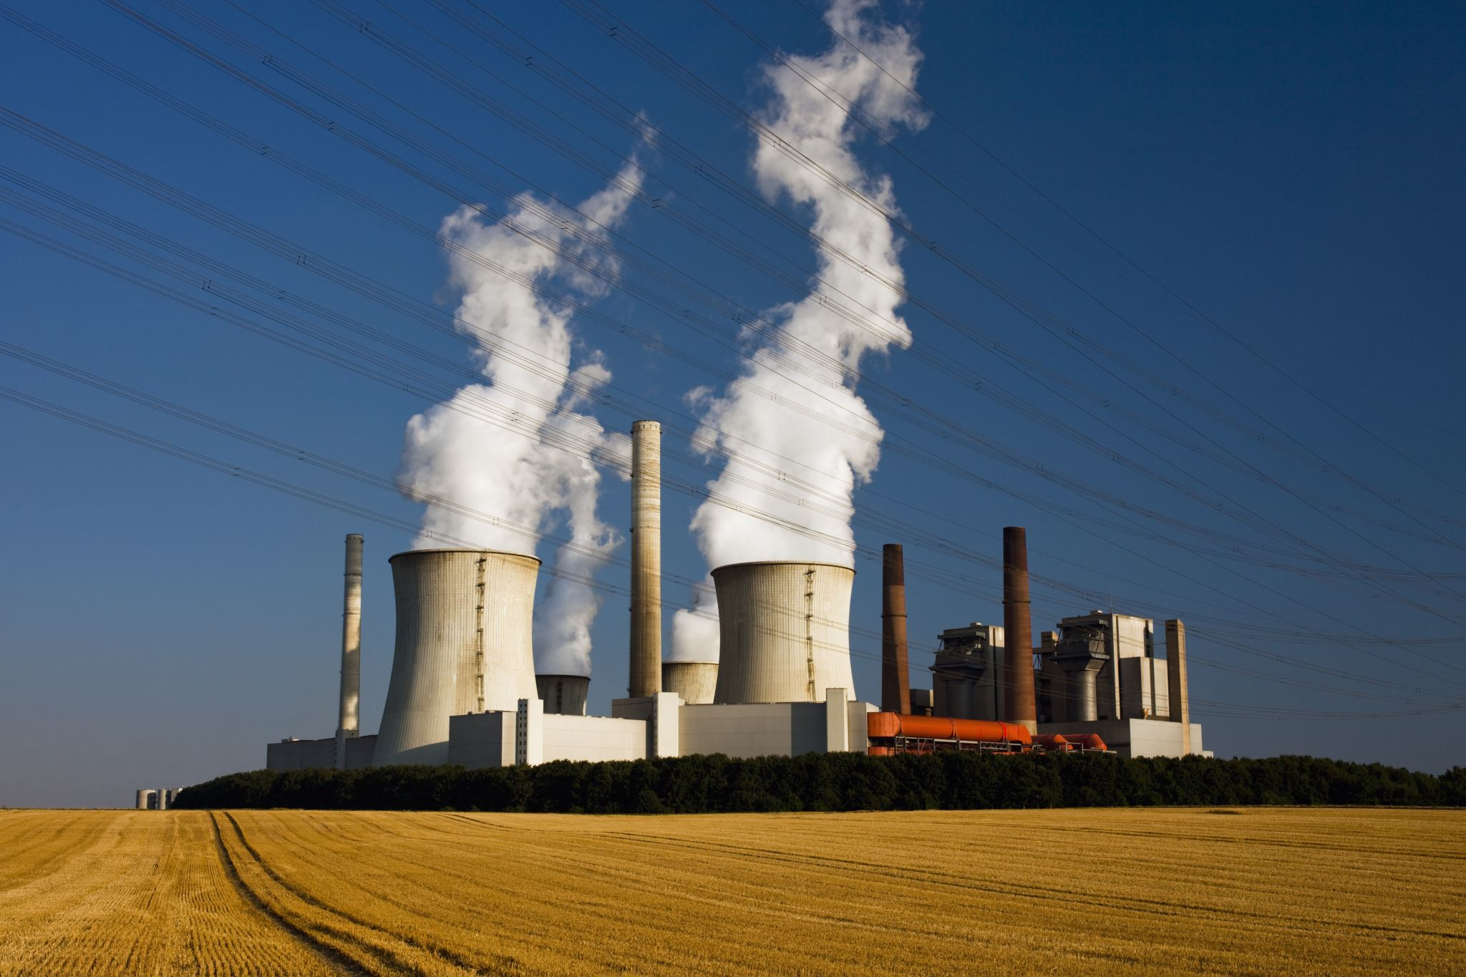
Two main types of Natural Resources
Nuclear Powerplant produces electrical energy from Uranium, a metal coming from the Earth’s Crust.
1. Renewable Resources
2. Non-renewable Resources

Slide 5

Renewable Resources
Is a natural resource that can be replaced or renewed by nature in a short amount of time. These resources will not run out as long as we use them wisely.
Sunlight – We can capture sunlight with solar panels to make electricity.
Wind – Wind turbines spin when the wind blows to make power.
Water – Moving water from rivers or dams can make hydroelectric energy.
Biomass like Trees – Trees can be cut down and replanted to grow again.
Geothermal Energy – Heat from deep inside the Earth that can be used for power.
Notes:
Renewable Resource – A resource that can be replaced naturally and used again and again.

Slide 6
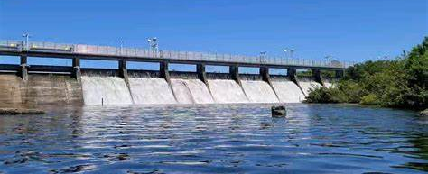
Source: Hillsborough River Dam in Tampa - Search
The Hillsborough River Dam in Tampa was originally built in 1897 to generate hydroelectric power for the city’s streetcar system but stopped producing electricity after flood damage in 1933. Today, the city is retrofitting the dam with turbines to generate about 839,000 kWh of electricity annually, enough to power around 76 homes. This energy is considered renewable because it relies on the continuous natural flow of the river.
Notes:
Resource:
The resource is water—specifically, moving or falling water (such as from rivers or dams).
Water is a renewable resource because the water cycle naturally replenishes it through rainfall, evaporation, and runoff.
🔸 Source:
The source of energy is the kinetic energy of the moving water.
This energy turns turbines to generate electricity.
It is renewable because as long as there is flowing water, the energy can be continuously harnessed.
🔍 Summary:
Resource: Water (renewable material we use)
Source: Kinetic energy of moving water (renewable energy source)

Slide 7
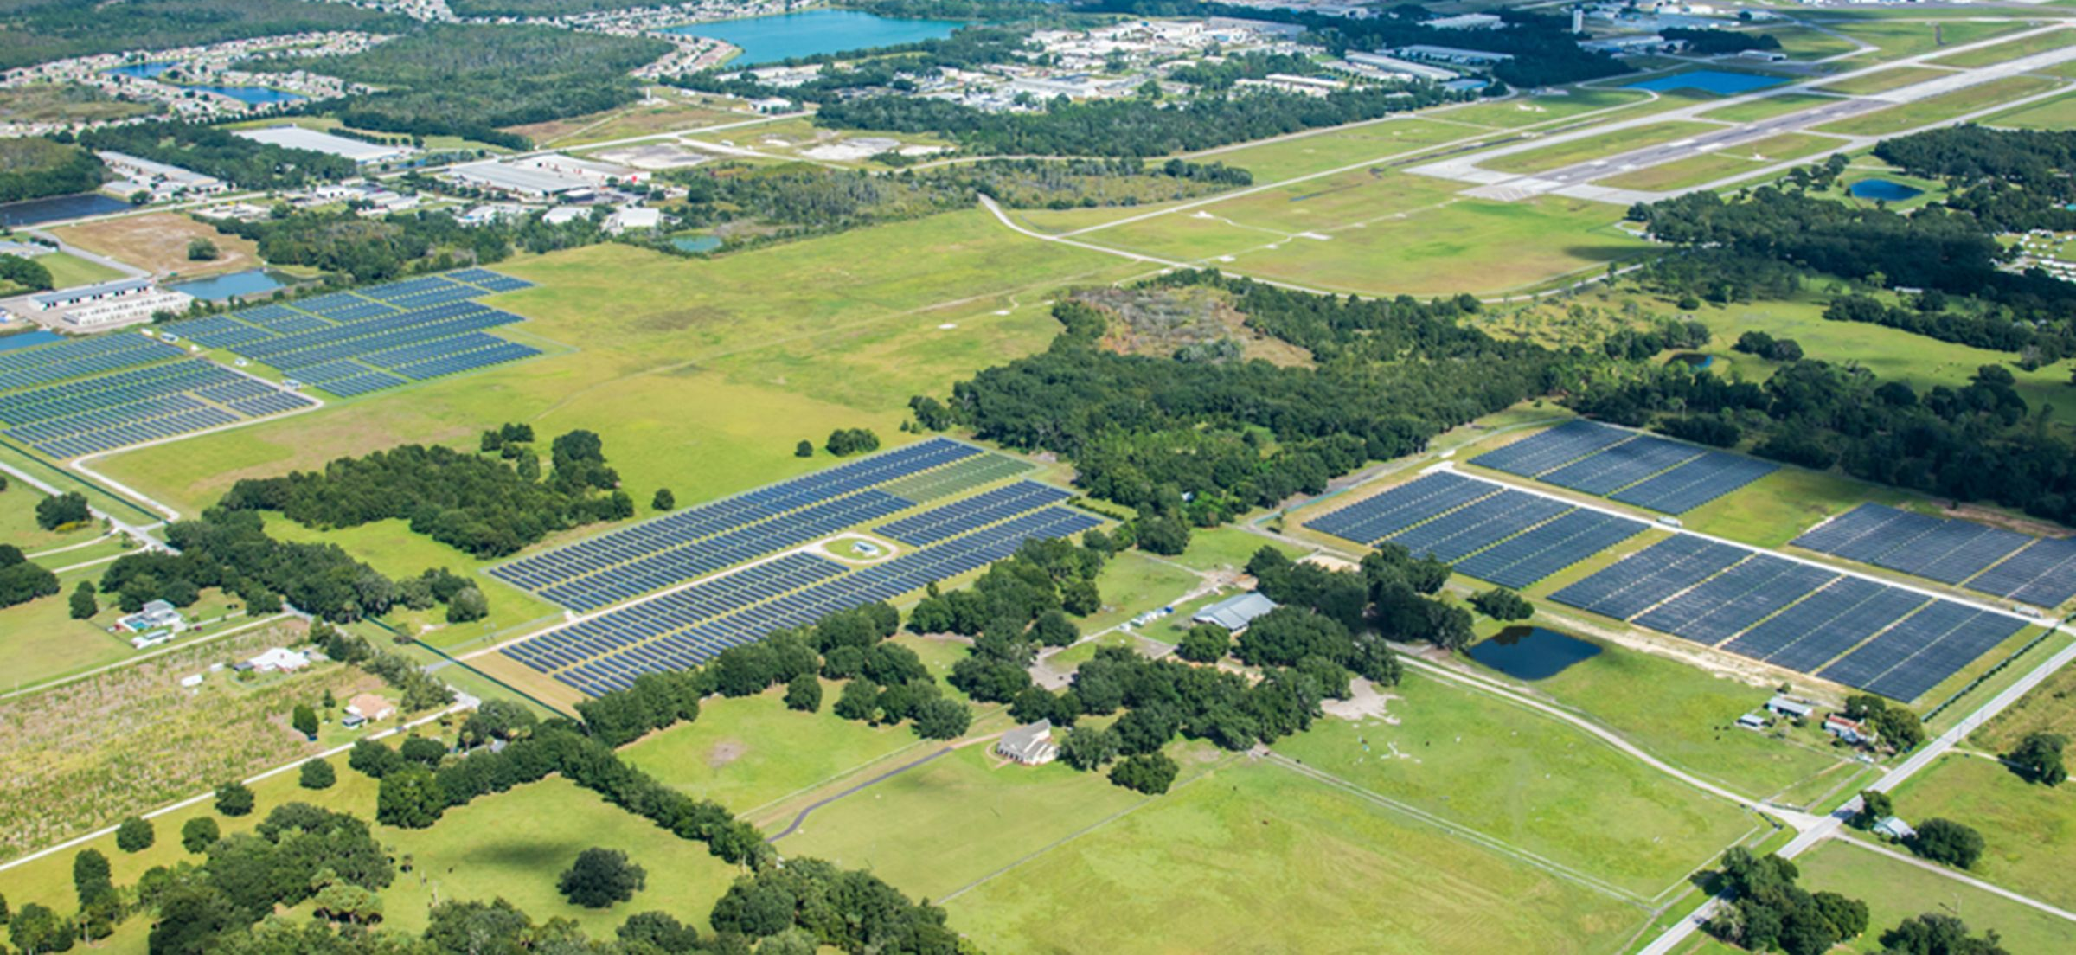
Lakeland Electric Airport I Solar Farm: A 2.3 MW photovoltaic solar facility commissioned in 2011, located near Lakeland Linder International Airport. It utilizes solar energy, which is a renewable resource, to generate electricity.
Source: desktopImage.jpg.thumb.1352.2400.jpg (2400×1352)
Notes:
1 Mega Watt = 1 Million Watts
Photovoltaic – a technology that converts solar energy to electricity
🔸 Resource:
The resource is sunlight (solar radiation).
It’s a renewable resource because the sun shines every day and is naturally replenished.
It’s used by solar panels to generate electricity.
🔸 Source:
The source of energy is the sun.
The sun provides light and heat, which solar technologies convert into usable energy.
It is a renewable source because it is expected to last billions of years.
🔍 Summary:
Resource: Sunlight (renewable material/energy used)
Source: The Sun (origin of energy)

Slide 8
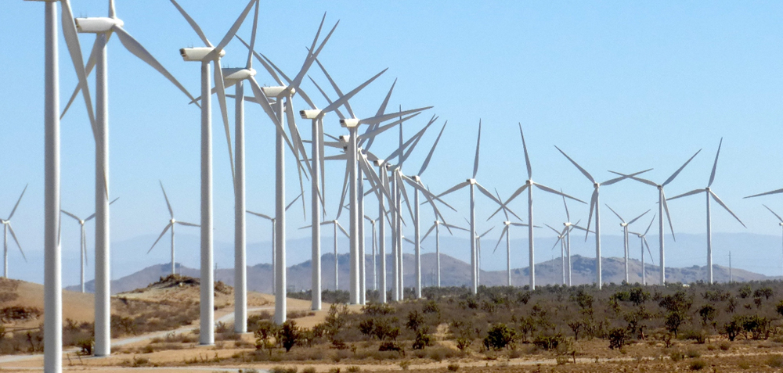
Source: Alta Wind Energy Center.jpg (1000×600)
The Alta Wind Energy Center in California is the largest wind farm in the U.S., with a capacity of 1,550 MW, enough to power over 400,000 homes. Wind energy is a renewable resource because it harnesses natural air currents, which are constantly replenished by the Earth's atmosphere, and does not deplete or produce harmful emissions.
Notes:
🔸 Resource:
The resource is the wind (moving air).
It is a renewable resource because it is naturally created by the Earth's rotation and the uneven heating of the atmosphere by the sun.
Wind is used to turn turbine blades, generating electricity.
🔸 Source:
The source of energy is the kinetic energy of the wind.
This kinetic energy is what moves the blades and drives the generator.
It’s renewable because wind is constantly produced in nature.
🔍 Summary:
Resource: Wind (the natural material used)
Source: Kinetic energy of wind (the energy being captured)

Slide 9
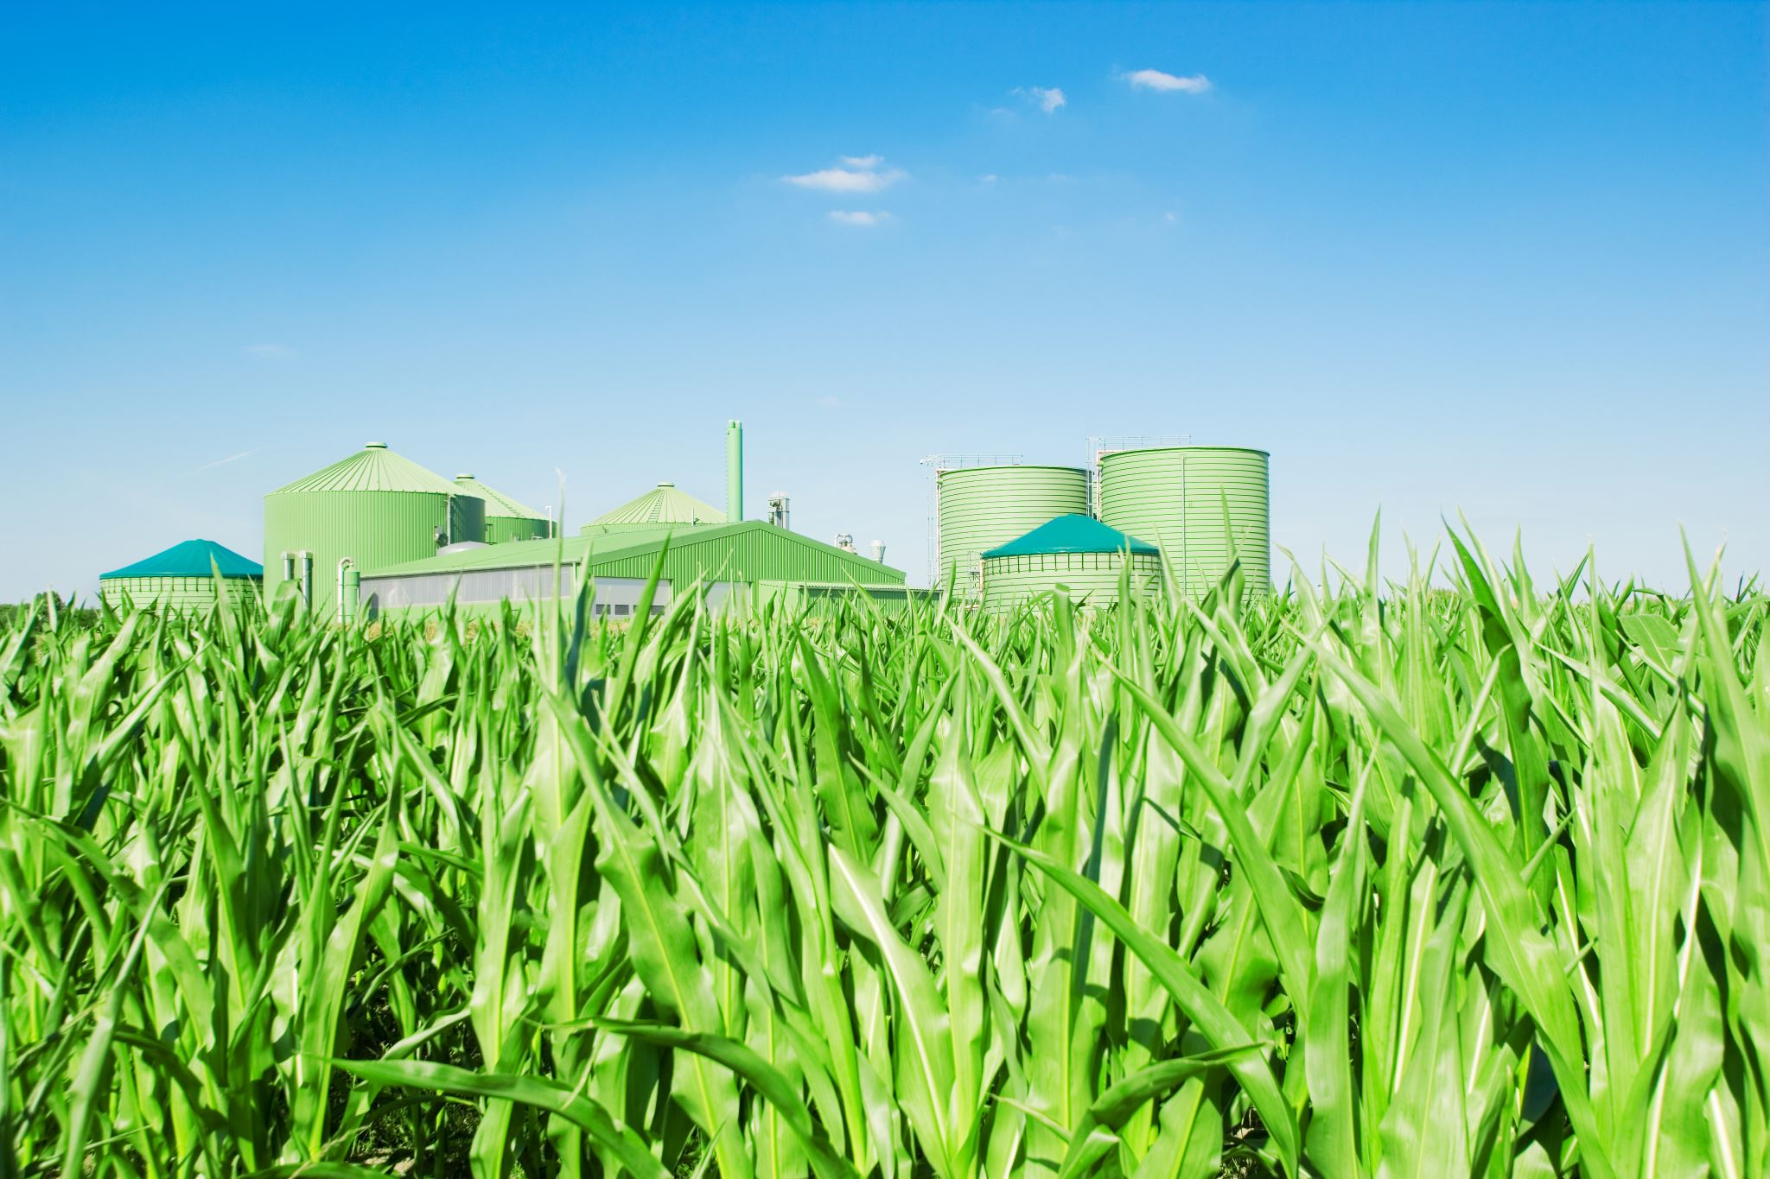
Biomass is any organic material that comes from plants or animals and can be used as a renewable energy source. Since plants grow back naturally and can be replanted, biomass is considered sustainable because it can be replenished without depleting resources. Biomass can be converted into energy in various ways, providing power for everyday use, such as electricity, heat, and biofuels.
Food: Plants, like grains, fruits, vegetables, and legumes, are renewable resources that provide food for people. They can be replanted and harvested repeatedly, ensuring a continuous and sustainable supply of nutrition.
Biofuels: Certain plants, like corn and sugarcane, can be turned into biofuels like ethanol and biodiesel. These biofuels provide a renewable alternative to fossil fuels and can be used to power vehicles and generate energy, reducing greenhouse gas emissions and supporting cleaner transportation.
Materials: Plants also provide renewable materials such as wood, fiber, and cotton. These materials are used for construction, textiles, and paper products. By responsibly managing plant harvests, these materials can be replenished without depleting natural resources.
Notes:
🔸 Resource:
The resource is biomass, which includes organic materials like wood, agricultural waste, food scraps, animal manure, and even sewage.
It is a renewable resource because plants and organic waste can be regrown or continuously produced.
These materials are burned or processed to produce energy.
🔸 Source:
The source of energy is the chemical energy stored in organic matter.
When biomass is burned or broken down (e.g., through fermentation or digestion), it releases heat or gas that can be converted into electricity or fuel.
This energy is renewable as long as the biomass supply is replenished sustainably.
🔍 Summary:
Resource: Biomass (organic materials we use)
Source: Chemical energy stored in biomass (the energy released during processing)

Slide 10
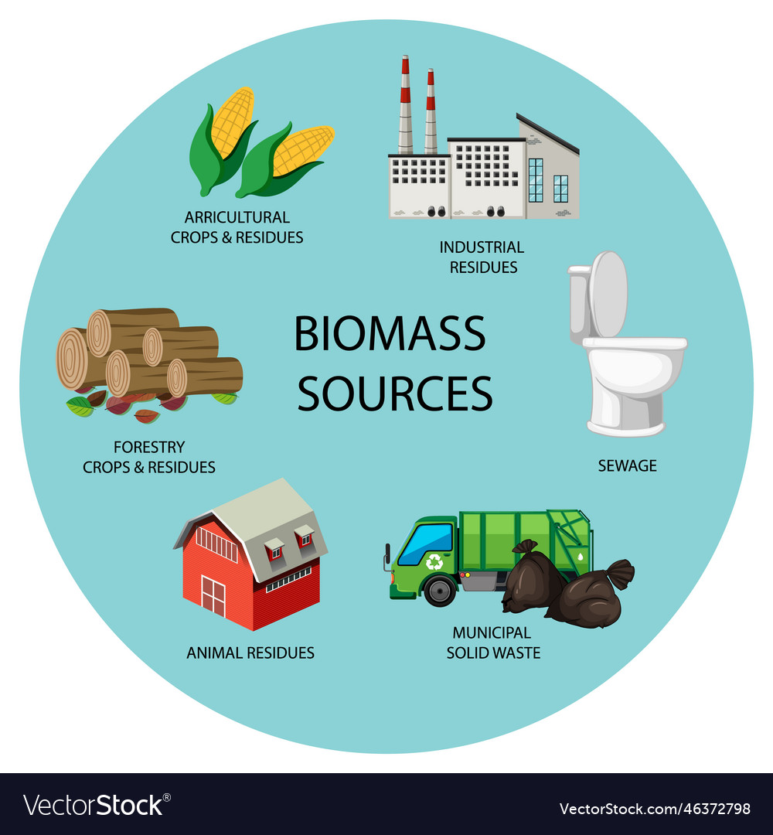
Biomass can come from various sources, including waste materials like sewage, garbage, decayed plants, and animal waste. These organic materials are often recycled or reprocessed to produce useful products like biofuels, electricity, or heat.
Sewage and Animal Waste: These can be used to produce biogas through anaerobic digestion, which can generate electricity and heat.
Garbage: Organic waste in garbage, such as food scraps or yard waste, can be processed into biofuels or burned to produce energy.
Decayed Plants: Plant waste like leaves, wood, and crop residues can be turned into biomass for energy generation through combustion or gasification.
Source: many-forms-of-biomass-energy-vector-46372798.jpg (1000×1080)
Notes:
biomass can come from various sources, including waste materials like sewage, garbage, decayed plants, and animal waste. These organic materials are often recycled or reprocessed to produce useful products like biofuels, electricity, or heat.
Here’s a breakdown:
Sewage and Animal Waste: These can be used to produce biogas through anaerobic digestion, which can generate electricity and heat.
Garbage: Organic waste in garbage, such as food scraps or yard waste, can be processed into biofuels or burned to produce energy.
Decayed Plants: Plant waste like leaves, wood, and crop residues can be turned into biomass for energy generation through combustion or gasification.

Slide 11
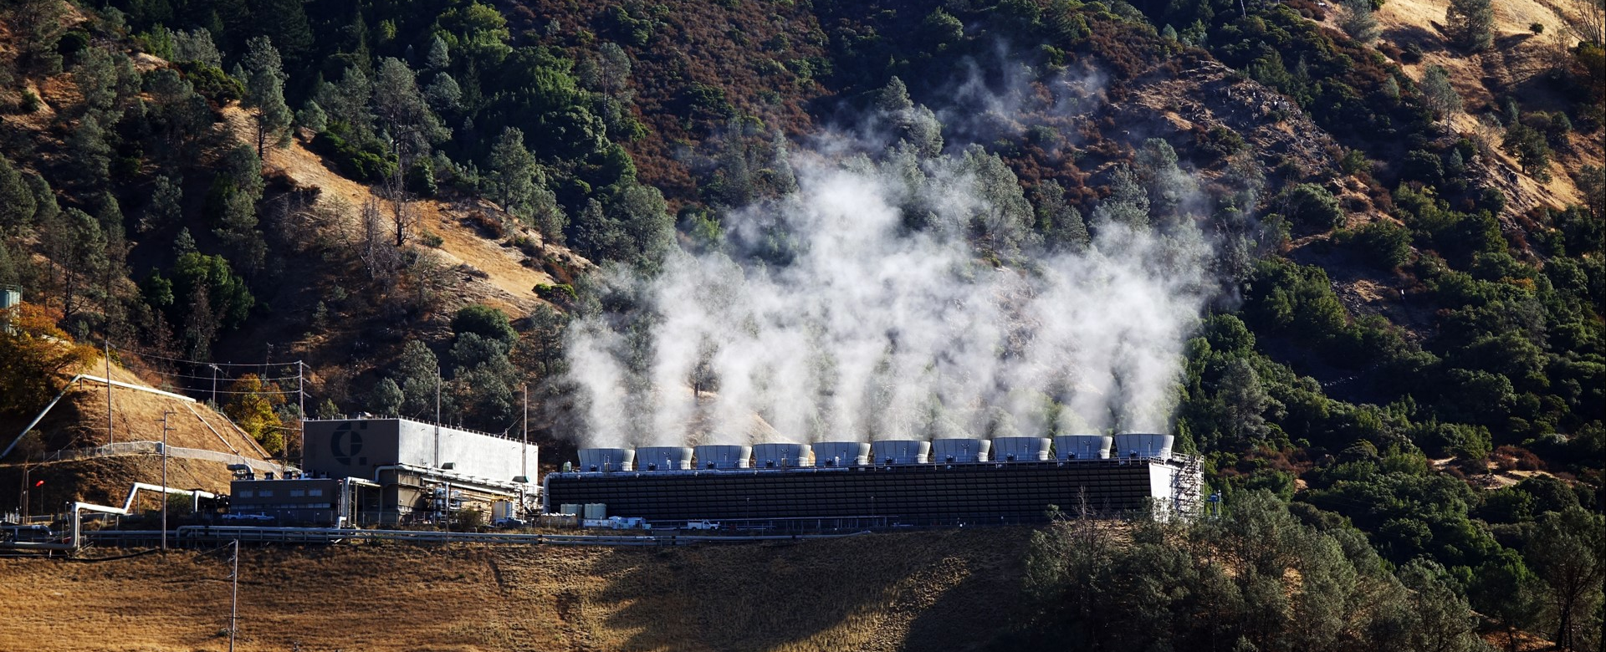
Source:341421465_3012028209104822_3193407651375948291_n.jpg (1920×1080)
The Geysers Geothermal Power Plant in California is the largest geothermal power plant in the world. Geothermal power plants obtain heat from the Earth's crust, where heat from the core rises to the surface, particularly in areas with volcanic activity or tectonic plate boundaries. Deep wells are drilled to access hot water or steam from underground reservoirs, which is then used to generate electricity by driving turbines. This heat source is renewable because the Earth continuously generates heat, making it a sustainable energy option.
Notes:
🔸 Resource:
The resource is geothermal water or steam found deep underground.
This is renewable because the Earth continually produces heat from its core, and with proper management, the hot water or steam can be replenished naturally.
🔸 Source:
The source of energy is the heat from the Earth’s interior, specifically from the mantle and crust.
This geothermal heat is captured by drilling deep wells and bringing hot water or steam to the surface to turn turbines and generate electricity.
It's a renewable source as the Earth's internal heat is essentially endless on a human time scale.
🔍 Summary:
Resource: Geothermal water or steam (used in the process)
Source: Earth’s internal heat (origin of the energy)

Slide 12
Non-renewable Resources
A nonrenewable resource is a natural resource that cannot be replaced quickly. It takes millions of years for these resources to form. Once they are used up, they are gone forever.
Fossil Fuels: Coal, oil, and natural gas, formed from
ancient plants and animals, take millions of years to form and cannot be replenished once used.
2. Minerals: Elements like gold, copper, and iron, extracted from the Earth, are finite and cannot be replaced quickly.
3. Nuclear Fuels: Uranium used in nuclear power plants is finite and cannot be replenished once used.
Notes:
Nonrenewable Resource – A resource that cannot be replaced quickly and may run out if used too much.

Slide 13
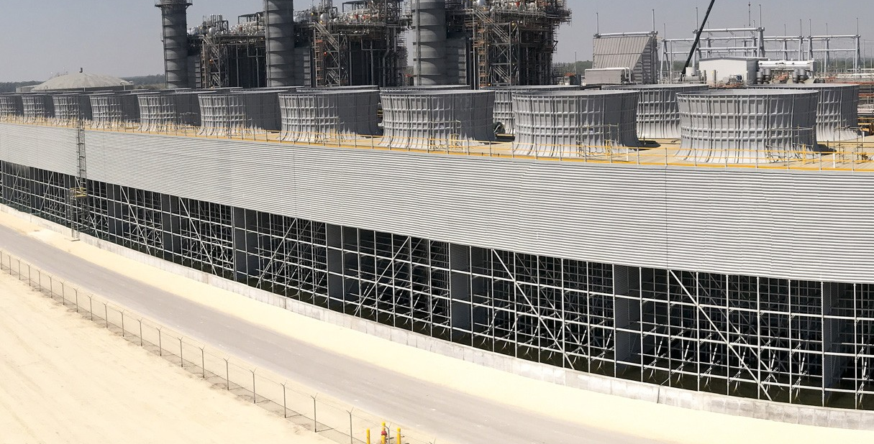
Natural Gas Power Plant
Source:okeechobee.jpeg (1215×759)
Okeechobee Clean Energy Center
Located in northeast Okeechobee County in Florida, this high-efficiency natural gas facility is one of the cleanest and most efficient of its kind in the world.
Notes:
🔋 Natural Gas Power Plants
Okeechobee Clean Energy Center
Located in northeast Okeechobee County, this high-efficiency natural gas facility is one of the cleanest and most efficient of its kind in the world.
Fort Myers Power Plant
Situated in Lee County, this facility combines natural gas and fuel oil to produce electricity, with an installed capacity of 2,608.9 MW, making it the third-largest power station in Florida.
Citrus Combined Cycle Station
Located at the 5,100-acre Crystal River Energy Complex on Florida's Gulf Coast, about 85 miles north of Tampa, this station is co-located with coal-fired units and a decommissioned nuclear plant.
🛢️ Oil Power Plants
Lauderdale Power Plant
Situated at 4300 SW 42nd Avenue in Fort Lauderdale, this facility operates as a combined-cycle unit using natural gas and oil as backup fuel.
⚒️ Coal Power Plants
Big Bend Power Station
Located in southeastern Hillsborough County on Tampa Bay, this station sits on nearly 1,500 acres on Big Bend Road in Apollo Beach.
Crystal River Energy Complex
Also in Citrus County, this complex includes operating and retired coal-fired units, along with a decommissioned nuclear plant.
🔸 Resource:
The resource is natural gas, a fossil fuel made mostly of methane and formed from the remains of ancient plants and animals buried for millions of years.
It is a nonrenewable resource because it takes millions of years to form and cannot be replaced quickly once used.
🔸 Source:
The source of energy is the chemical energy stored in the natural gas.
When the gas is burned, it releases heat energy that turns turbines to generate electricity.
Since it's based on limited underground deposits, it is nonrenewable.
🔍 Summary:
Resource: Natural gas (fossil fuel material used)
Source: Chemical energy from combustion of natural gas (used to make electricity)

Slide 14
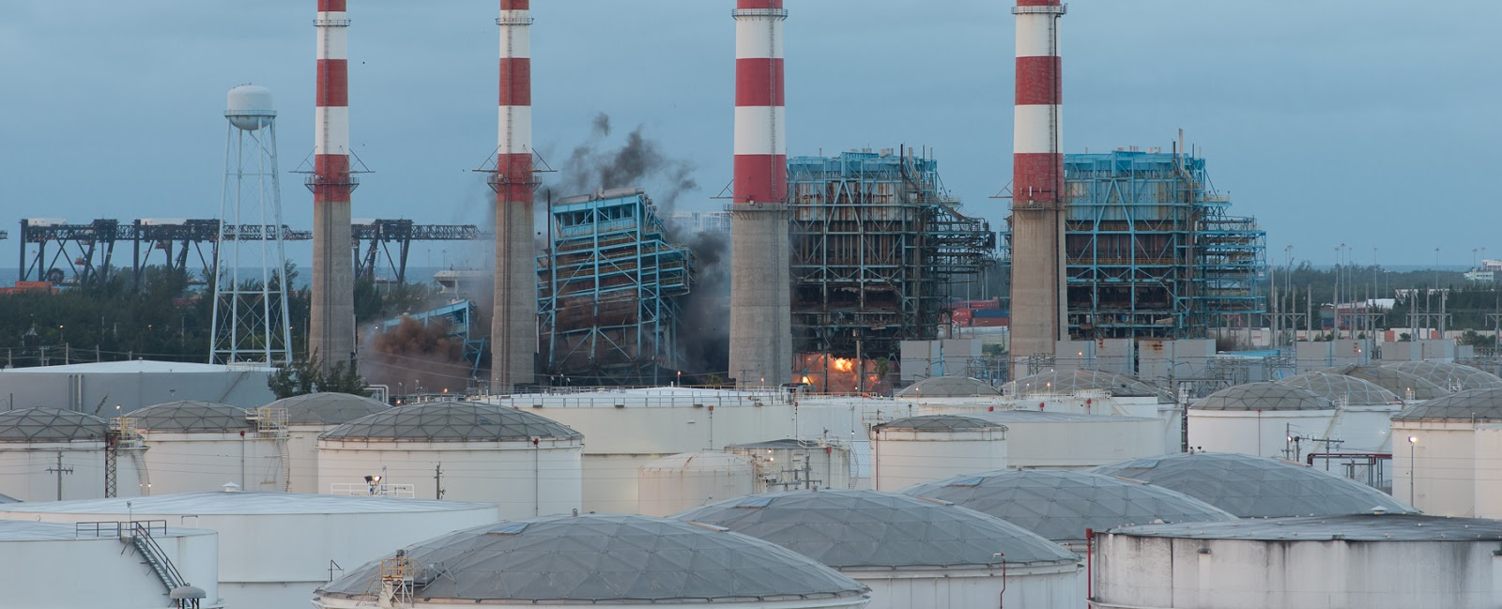
Oil Power Plant
Source: DSC_2924-1.jpg (1600×1068)
The Lauderdale Power Plant in Fort Lauderdale uses natural gas as its primary fuel and oil as a backup. Oil is nonrenewable because it forms over millions of years from the remains of ancient plants and animals under specific heat and pressure conditions deep within the Earth.
Notes:
🔸 Resource:
The resource is oil (also called petroleum), a nonrenewable fossil fuel formed from the buried remains of ancient marine organisms over millions of years.
Once extracted and refined, it can be burned to generate energy, but it cannot be replaced quickly, making it nonrenewable.
🔸 Source:
The source of energy is the chemical energy stored in the oil.
When burned, oil releases heat, which produces steam to turn turbines and create electricity.
This process releases carbon emissions, contributing to pollution and climate change.
🔍 Summary:
Resource: Oil (nonrenewable fossil fuel used)
Source: Chemical energy in oil (released during combustion to generate electricity)

Slide 15
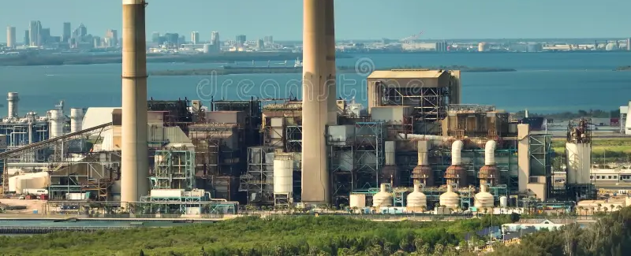
Coal Power Plant
Source: https://thumbs.dreamstime.com/b/aerial-view-big-bend-power-station-apollo-beach-near-tampa-florida-major-coal-fired-power-plant-producing-electricity-fossil-280694540.jpg
TECO (Tampa Electric Company) operates both nonrenewable and renewable power plants in the Tampa Bay area. Its main facility, the Big Bend Power Station in Apollo Beach, uses coal and natural gas, nonrenewable fossil fuels that take millions of years to form and cannot be quickly replaced. TECO is also investing in renewable energy, such as the Big Bend Solar Project, which uses sunlight to generate clean, sustainable electricity.
Notes:
🔸 Resource:
The resource is coal, a nonrenewable fossil fuel formed from the remains of plants and other organic materials over millions of years. It is mined from the earth and, once extracted, can be burned to generate energy. Coal is nonrenewable because it cannot be replenished on a human timescale.
🔸 Source:
The source of energy is the chemical energy stored in coal. When coal is burned, it releases heat, which produces steam. This steam drives turbines that generate electricity. However, this process also releases carbon dioxide and other pollutants, contributing to air pollution and climate change.
🔍 Summary:
Resource: Coal (nonrenewable fossil fuel used)
Source: Chemical energy in coal (released during combustion to generate electricity)

Slide 16
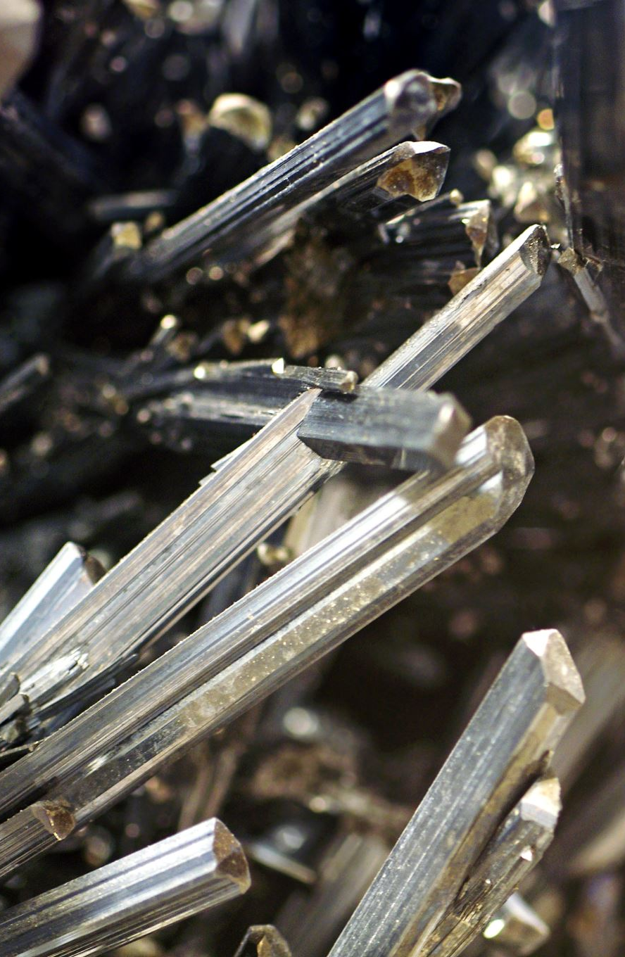
Minerals
Minerals like gold, copper, and iron are non-renewable because they take millions of years to form and cannot be replenished quickly. Florida has minerals like limestone and phosphate, used in construction and fertilizers. Once extracted, these resources cannot be replaced on a human timescale, making them finite and valuable.
Notes:
🔸 Resource:
The resource is minerals, naturally occurring inorganic substances found in the earth's crust. Minerals like iron, copper, gold, and aluminum are extracted through mining and are used in a variety of applications, from manufacturing to construction. Since minerals are finite and take millions of years to form, they are considered nonrenewable resources.
🔸 Source:
The source of energy or value in minerals comes from their chemical properties and their use in various industries. For example, metals like iron and copper are extracted and refined to produce materials used in construction, electronics, and transportation. Minerals themselves do not provide energy in the same way as fossil fuels, but their extraction and refinement are crucial for many technological and industrial processes.
🔍 Summary:
Resource: Minerals (nonrenewable resources extracted for industrial and technological use)
Source: The chemical properties of minerals (used in manufacturing, construction, and electronics)

Slide 17
Nuclear Fuels
Nuclear fuels, like uranium, are considered non-renewable because they are finite resources. Once uranium is used in nuclear power plants, it cannot be replenished on a human timescale. While nuclear energy can produce large amounts of electricity, the supply of uranium is limited, and once it’s depleted, we won’t be able to replace it easily.
Notes:
🔸 Resource:
The resource is uranium (specifically uranium-235), which is a nonrenewable mineral used as nuclear fuel.
It is mined from the Earth and cannot be replenished quickly, so it's a nonrenewable resource.
Uranium atoms are split in a process called nuclear fission, which releases a huge amount of energy.
🔸 Source:
The source of the energy is the nuclear energy stored in the nucleus of uranium atoms.
This energy is released during fission and is used to generate heat and produce electricity.
It is not replenishable like solar or wind energy.
🔍 Summary:
Resource: Uranium (nonrenewable material we use)
Source: Nuclear energy (stored in uranium atoms)

Slide 18
Why It Matters?
Renewable resources (e.g., solar, wind, hydropower) provide cleaner energy with minimal environmental impact.
They don’t produce harmful pollutants or greenhouse gases, helping protect the Earth.
Using renewable resources ensures access to energy for future generations without depleting the planet's resources.
Notes:
Depleting means using nature’s resources until there’s none left.
If we keep cutting down trees and don’t plant new ones, the trees can run out.
The same can happen with water, clean air, or oil if we don’t take care of them.
Wind and sunlight are renewable and we can’t run out of them — but sometimes we can’t use them fully because of certain issues:
Weather changes – If it's cloudy or nighttime, there's less sunlight. If the wind isn’t blowing, wind turbines don’t spin.
Location matters – Some places get more sun or wind than others, so energy supply can be uneven.
Too many buildings or pollution – These can block sunlight or change wind patterns, making it harder to collect energy.
So, while we can’t really “abuse” wind or sunlight the way we do oil or coal, poor planning or pollution can make it harder to use them well.

Slide 19
How You Can Help
• Turn off lights
• Recycle
• Use less water
• Walk or bike when possible
Notes:
Using less water helps conserve it for areas with limited access, protects ecosystems, and reduces the energy needed for water treatment and distribution.

Slide 20
Quick Review
Renewable resources can be replaced naturally and are unlimited on a human timescale, like sunlight and wind.
Nonrenewable resources are limited and can’t be replenished quickly, like fossil fuels and minerals.
Using energy wisely helps conserve resources, reduce waste, and minimize environmental harm.

Slide 21
Renewable Resources | Nonrenewable Resources
Solar Energy (energy from the sun) | Coal (used for electricity generation)
Wind Energy (energy from wind turbines) | Oil (petroleum used for gasoline, diesel, etc.)
Hydropower (energy from water flow) | Natural Gas (used for heating and electricity)
Geothermal Energy (heat from Earth’s core) | Nuclear Energy (from uranium)
Biomass (organic matter like wood, crops) | Minerals (like gold, copper, iron, etc.)
Biofuels (e.g., ethanol, biodiesel) | Phosphate (used in fertilizers)

Slide 22
Generalization
How can we tell the difference between renewable and nonrenewable resources?
Why is it important to use more renewable energy in the future?
Click this link to take the quiz for the lesson on renewable and nonrenewable resources15598804

Slide 23
It’s time to make the project!

Slide 24
Sources and References:
• U.S. Energy Information Administration (EIA). Energy Kids
• Florida Department of Education. Science Standards – SC.5.E.7.4
• National Renewable Energy Laboratory (NREL). https://www.nrel.gov
• National Geographic Kids. https://kids.nationalgeographic.com
• BrainPOP. Renewable and Nonrenewable Resources Video Lesson

