Slide 1

Proportional Relationships & Functions: Introduction to Tables & Vocabulary
Day 1
John Mark L. Barbado, M.Ed.
STEM Teacher
www.innovatewithmrbarbado.com
Notes:
Good morning, class! Welcome to our unit on Proportional Relationships & Functions. I’m [Your Name], and today we will focus on understanding key vocabulary and how to identify proportional relationships in tables. Let’s get started!

Slide 2

Ratio & Rate
Day 1
Ratio: A comparison of two quantities. Ratios tell us how much of one thing exists compared to another.
Example: 2 pencils cost $1 → ratio = 2:1
Rate: A ratio comparing two quantities with different units. Rates are useful for understanding speed, cost per unit, or other “per” situations.
Example: Car travels 60 miles in 1 hour → rate = 60 miles/hour
www.innovatewithmrbarbado.com
Notes:
First, we learn ratio and rate. A ratio compares two quantities, like 2 pencils for $1. A rate is a ratio comparing quantities with different units, like a car traveling 60 miles in 1 hour. Can anyone give another example of a ratio or rate?

Slide 3

Unit Rate & Constant of Proportionality
Day 1
Constant of Proportionality (k): The number you get when dividing y by x (y ÷ x). K tells us how much y changes for each 1 x. If k is constant, the relationship is proportional.
Example Table:
Unit Rate: Rate for 1 unit. Unit rate shows the value for a single item, making comparisons easier.
Example: $0.50 per pencil
Pencils (x) | Cost (y) | y ÷ x = k
2 | 1 | 0.5
4 | 2 | 0.5
10 | 5 | 0.5
www.innovatewithmrbarbado.com
Notes:
Now, the unit rate is the cost for one item—in this case, $0.50 per pencil. The constant of proportionality, k, is calculated by dividing y by x. Notice that for all rows, k = 0.5, which means this is a proportional relationship.

Slide 4
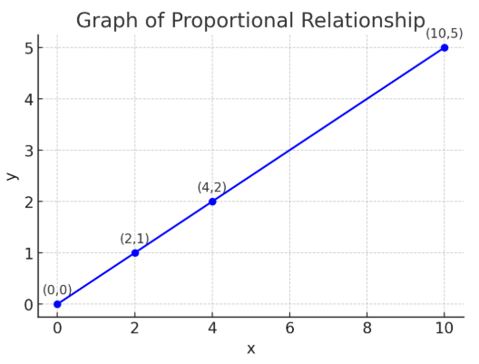
Proportional Relationships & Functions
Day 1
Proportional vs. Non-Proportional (Relationships on Graphs)
Proportional Relationship: A relationship where y ÷ x is constant. If you double x, y doubles too. The table or graph shows a consistent pattern.
Function: A rule where each input has exactly one output.
Every proportional relationship is a function because each x-value corresponds to only one y-value.
Pencils (x) | Cost (y) | y ÷ x = k
2 | 1 | 0.5
4 | 2 | 0.5
10 | 5 | 0.5
www.innovatewithmrbarbado.com
Notes:
A proportional relationship has a constant k. For example, doubling the number of pencils doubles the cost. A function gives exactly one output for each input. In this table, every number of pencils has one total cost, so it’s a function.

Slide 5
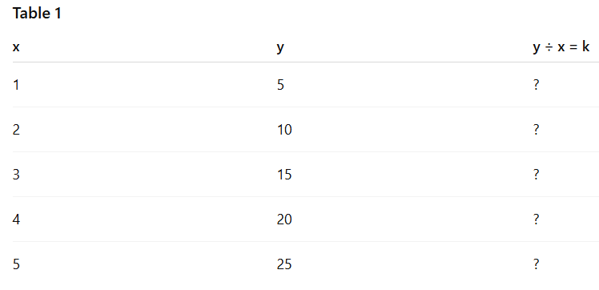
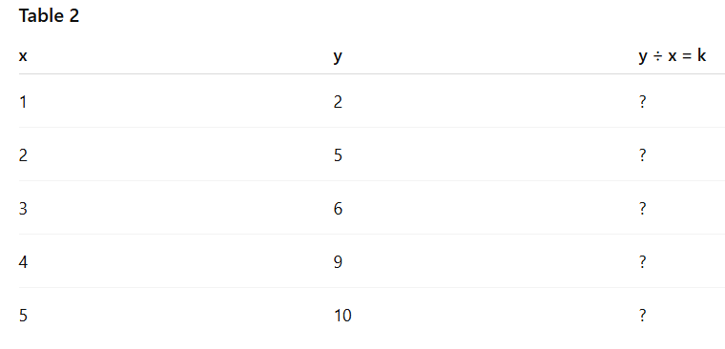
Find k and Classify
Instructions: For each table of values below, calculate 𝑘=𝑦/x for each ordered pair. Decide if the relationship is proportional. Determine if it is a function (does each x have exactly one y?). Write your reasoning.
Day 1
Discussion Questions:
Which table is proportional? Why?
Which table is non-proportional? Why?
Are both tables functions? Explain your answer.
www.innovatewithmrbarbado.com
Notes:
Class, calculate k for each ordered pair in both tables. Look for consistency: if k is the same for all pairs, it’s proportional. Next, check the function rule: does each x have exactly one y? Table 1 should be proportional and a function. Table 2 is a function but not proportional because k changes. Discuss your answers with your partner, then we’ll review as a class.

Slide 6

Graphing Proportional Relationships: Proportional Relationships and Slope
How to Plot Points a Coordinate Plane | Positive and Negative Coordinates | Math with Mr. J
Day 2
www.innovatewithmrbarbado.com
Notes:
Good morning class! Today we will continue learning about proportional relationships, but this time, we will graph them on the coordinate plane. By the end of this lesson, you will be able to plot points from a table, draw a line through the origin, and identify the constant of proportionality, k.

Slide 7
How to Graph a Proportional Relationship
Day 2
Take a table of values (x, y).
Plot each point on the coordinate plane.
Draw a straight line through the origin (0,0).
The slope of the line = k (constant of proportionality).
Hours (x) | Pay (y)
1 | 15
2 | 30
3 | 45
www.innovatewithmrbarbado.com
Notes:
Here’s a table showing hours worked and pay. First, plot the points (1,15), (2,30), and (3,45) on the graph. Then, draw a straight line through the origin. Notice that the slope, or k, is 15. This means each hour earns $15. If the line passes through the origin and the points are aligned, the relationship is proportional.

Slide 8
Guided Practice Activity:
Instructions: Graph the following table. Draw a line through the origin. Identify the constant of proportionality K. Is the relationship proportional?
Day 2
Questions:
Plot the points.
Draw a line through the origin.
Find k.
Proportional or not?
Pounds of Apples (x) | Cost (y)
1 | 3
2 | 6
5 | 15
www.innovatewithmrbarbado.com
Notes:
Now it’s your turn! Use this table of apples and their cost to plot points on the graph, draw a line through the origin, and find k. Discuss with your partner: Does this relationship look proportional?

Slide 9
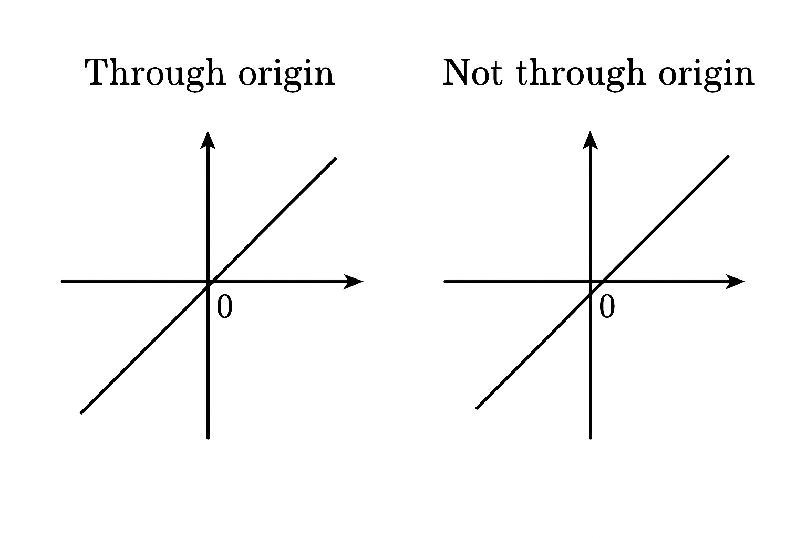
Comparing Proportional & Non-Proportional Relationships:
Day 3
Distinguish between proportional and non-proportional relationships by comparing tables, graphs, and equations, and explain their reasoning.
www.innovatewithmrbarbado.com
Notes:
Today, we will take our knowledge of proportional and non-proportional relationships further. By the end of class, you’ll be able to look at a table, a graph, or an equation and tell me whether the relationship is proportional or not—and explain why.

Slide 10
How to Compare Relationships
Day 3
Tables:
Proportional → constant ratio (k = y/x is the same).
Non-Proportional → ratio changes or doesn’t work.
Example:
  (2, 4), (3, 6), (4, 8) → k = 2 → Proportional
  (2, 5), (3, 8), (4, 11) → k changes → Non-Proportional
Graphs:
Proportional → straight line through the origin (0,0).
Non-Proportional → line not through origin or not straight.
Equations:
Proportional → in the form
y = kx.
Non-Proportional → in the form y = kx + b (with b ≠ 0).
www.innovatewithmrbarbado.com
Notes:
When we compare relationships, we use three tools: tables, graphs, and equations. Remember: a proportional relationship always has the same constant of proportionality. On graphs, it’s a straight line through the origin. And in equations, it looks like y = kx with no extra number added.

Slide 11
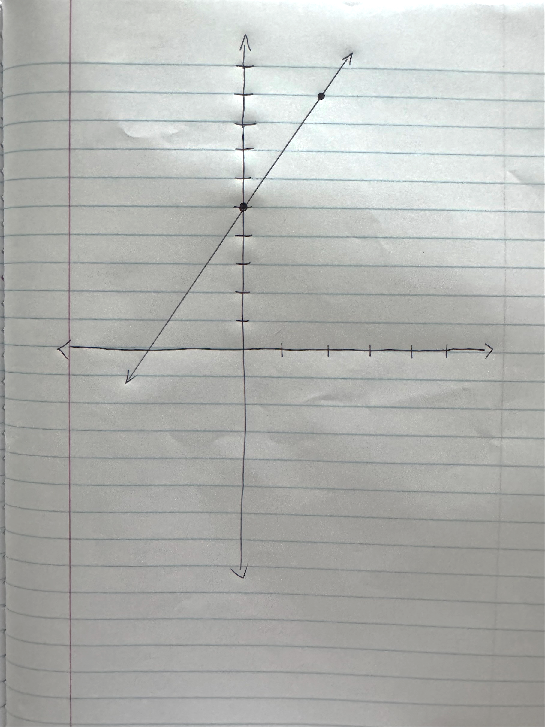
Guided Practice: Is It Proportional or Non-Proportional?
1. Solve for k (if possible).
2. Decide: Proportional or Non-Proportional?
3. Explain why.
Day 3
x | y
1 | 3
2 | 6
3 | 9
4 | 12
Equation: y = 4x + 2
www.innovatewithmrbarbado.com
Notes:
Let’s test what we’ve learned. Work with your partner: look at each representation—table, graph, and equation. First, solve for k if you can. Then decide: is it proportional or non-proportional? And most importantly, explain why.

Slide 12
Functions & Non-Proportional Relationships: Proportional Relationships & Functions
Day 4
www.innovatewithmrbarbado.com
Notes:
Good morning, class! Today, we will learn how to distinguish proportional functions from non-proportional functions. Remember, every proportional relationship is a function, but not every function is proportional. Let’s explore what makes them different

Slide 13
Understanding Functions & Relationships
Day 4
Proportional Function – A straight line passing through the origin. Equation: y = kx. Example: y = 3x → Each input has exactly one output.
Non-Proportional Function – A straight line not passing through the origin. Equation: y = kx + b (b ≠ 0). Example: y = 2x + 5.
Not a Function – An input (x) has more than one output (y). Example: {(2,3), (2,5)} → 2 maps to 3 and 5.
www.innovatewithmrbarbado.com
Notes:
Notice that proportional functions always pass through the origin. Non-proportional functions have a y-intercept. And if one x gives more than one y, it’s not a function.

Slide 14
Classify the Relationships
Day 4
Instructions: Solve for k if possible. Decide if each relationship is: Proportional Function Non-Proportional Function Not a Function
x | y
1 | 2
2 | 4
3 | 6
x | y
1 | 3
2 | 7
3 | 11
x | y
1 | 2
1 | 3
2 | 4
www.innovatewithmrbarbado.com

Slide 15

Proportional Relationships & Functions: Real-World Application
Day 5
Objective: Students will apply proportional relationships to solve multi-step real-world problems and present solutions.
www.innovatewithmrbarbado.com
Notes:
Good morning class! Today we are going to use everything we learned this week about proportional relationships and functions. Our goal is to apply tables, graphs, equations, and functions to real-world scenarios. By the end of the lesson, you should be able to solve problems and explain your reasoning

Slide 16
Group Project – Real-World Application
Day 5
Instructions:
Choose a scenario: recipes, travel, shopping, or wages.
Table of values
Graph (coordinate plane)
Equation (y = kx or f(x) = kx)
Function representation
Present your results to the class.
Identify if it is proportional or non-proportional.
Create:
www.innovatewithmrbarbado.com
Notes:
Work with your group to pick a scenario. Make a table first, then plot your graph, write your equation, and show how it works as a function. Decide if it is proportional or not. Be ready to present and explain why it is proportional or non-proportional.

Slide 17

Homework available at:
Middle School / Interactive Quiz | Innovate with Mr. Barbado
Day 5

