Slide 1
Forces, Motion, and Friction
Investigate and describe the influence of friction on motion.
Florida Benchmark: SC.5.P.13.2 – Investigate and describe the influence of friction on motion.
NGSS Standard: 3-PS2-2 – Make observations and/or measurements of an object’s motion to provide evidence that a pattern can be used to predict future motion.
John Mark L. Barbado, M.Ed.
STEM Educator

Slide 2
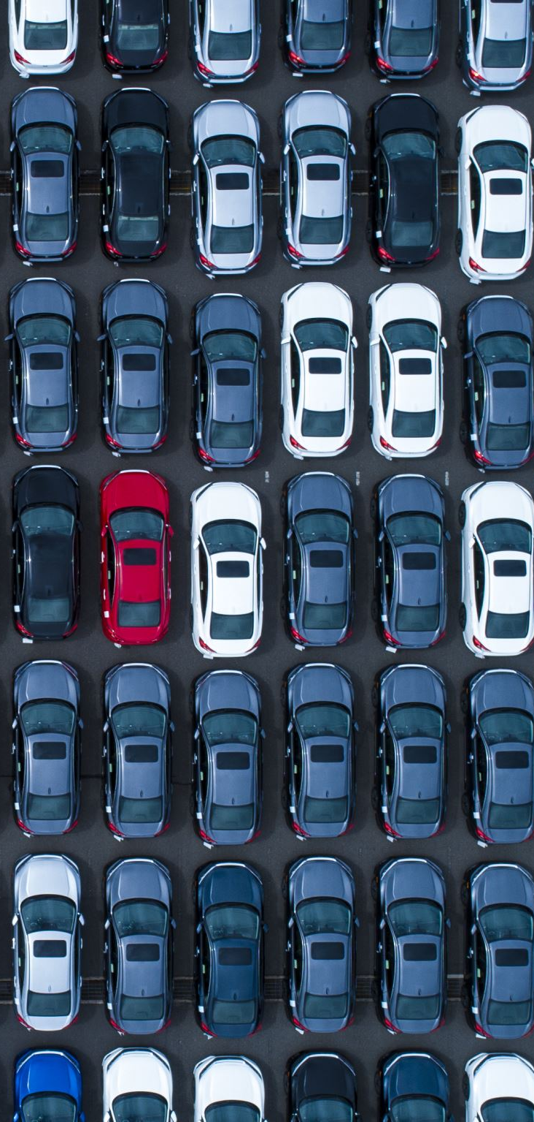
Essential Question/s:
What makes a car stop when you stop pushing it? or Why do you slow down when running on grass compared to tile?

Slide 3
What is a Force?
• A force is a push or pull on an object.
• Forces can start or stop motion or change direction.
• Examples: Kicking a ball, lifting a book, pulling a door open.

Slide 4
Types of Forces
Contact Force
Non-contact Force

Slide 5
Contact Forces
Applied Force (Fₐ)
  A force that’s pushed or pulled by a person or object.
  Example: You pushing a box.
Frictional Force (Ff)
  Opposes motion between two surfaces in contact.
  Includes static, sliding, rolling, and fluid friction.
Normal Force (Fn)
  The support force from a surface, acts perpendicular to the surface.
  Example: A book resting on a table is supported by the normal force.
Tension Force (Ft)
  Force through a string, rope, or cable when pulled tight.
  Example: Tug-of-war rope tension.
Spring Force (Fs)
  Force from a compressed or stretched spring.
  Example: A slingshot or trampoline.
Air Resistance (a type of fluid friction)
  Force that opposes motion through air.
  Example: A parachute slowing down a fall.

Slide 6
Non-contact Forces (act at a distance)
1. Gravitational Force (Fg)
  The force of attraction between objects with mass (like Earth pulling us down).
  Example: An apple falling from a tree.
2. Electromagnetic Force
  Acts between charged particles.
  Includes both electric (static electricity) and magnetic forces.
  Example: Magnets attracting or repelling, lightning.
3. Nuclear Forces
  Only act inside atoms:
    Strong Nuclear Force: Holds the nucleus of an atom together.
    Weak Nuclear Force: Responsible for certain types of radioactive decay.

Slide 7
What is Motion?
• Motion is a change in an object's position over time.
• Described by speed, direction, and distance.
• Examples: A bike moving, a ball rolling, a bird flying.

Slide 8
What is Friction?
• Friction is a force that slows or stops motion.
• It happens when two surfaces rub against each other.
• Rough surfaces = more friction. Smooth surfaces = less friction.

Slide 9
Types of Friction
Static friction – keeps objects still.
➔ Example: A heavy box resting on the floor that you have to push hard to start moving.
Sliding (Kinetic) friction – between sliding surfaces.
➔ Example: A book sliding across a table when you give it a push.
Rolling friction – between rolling objects and surfaces.
➔ Example: A skateboard rolling on the sidewalk.
Fluid friction – through air or liquid.
➔ Example: A swimmer moving through the water or an airplane flying through the air.
Notes:
There are four main types of friction, each depending on the situation and type of motion:
Static Friction
Acts on objects at rest.
Prevents motion from starting.
Example: A book that doesn’t move when you push it lightly.
Sliding (Kinetic) Friction
Acts on objects that are sliding over a surface.
Always opposes the direction of motion.
Example: Pushing a book across a table.
Rolling Friction
Occurs when an object rolls over a surface.
Less than sliding friction.
Example: A soccer ball rolling on the grass.
Fluid Friction (or Drag)
Happens when an object moves through a fluid (liquid or gas).
Depends on the object's speed, shape, and the fluid’s density.
Example: Air resistance on a moving car or water resistance on a swimmer.

Slide 10
Everyday Examples
• Walking (friction helps grip the ground).
• Driving (tires use friction to stop).
• Writing (friction between pencil and paper).
• Using brakes on a bicycle.

Slide 11
Summary
• Forces make objects move or stop.
• Motion is how objects change position.
• Friction resists motion and slows things down.
• These concepts help explain how things work in real life.

Slide 12
References:
Florida Department of Education. (2023). Standard SC.5.P.13.2: Investigate and describe the influence of friction on motion.
National Science Teaching Association (NSTA). (2022). Force and Motion: Elementary Science Practices. https://www.nsta.org
NASA Space Place. (2021). What Is Force? https://spaceplace.nasa.gov/what-is-force
Khan Academy Kids. (2023). Understanding Motion and Friction. https://www.khanacademy.org

