Slide 1

Introduction to Triangle Congruence & Postulates
Benchmark: MA.8.GR.1.6 – Use properties of congruent triangles
John Mark L. Barbado, M.Ed.
STEM Teacher
www.innovatewithmrbarbado.com
Notes:
Good morning, class! Today we are starting an exciting unit on triangle congruence. By the end of this unit, you will be able to identify congruent triangles using specific postulates and apply important properties to solve problems. Let’s get started!

Slide 2
Why Learn About Congruent Triangles?
www.innovatewithmrbarbado.com
Congruent triangles have equal sides and angles.
Used in real-life construction, design, and engineering.
Essential for solving geometry problems efficiently.
Notes:
Congruent triangles are like twins—they are exactly the same in shape and size. If we know a triangle’s sides or angles, we can find others without measuring everything. Engineers and architects use this idea all the time to make sure structures are precise.

Slide 3
Important Tools & Properties to Identify Congruent Triangles
1. Perpendicular Lines – form right angles (90°). Right angles are congruent.
2. Midpoint – divides a segment into two equal parts.
3. Reflexive Property – a side or angle is equal to itself.
4. Vertical Angles – angles opposite each other when two lines intersect are congruent.
5. Angle Bisector – divides an angle into two equal parts.
6. Segment Bisector – divides a segment into two equal parts; trisector divides into three equal parts.
7. Supplementary Angles of Congruent Angles are Congruent – if two angles are equal, their supplements are also equal.
www.innovatewithmrbarbado.com
Notes:
These tools are like the detective kit for finding congruent triangles. If you know these, you can spot congruent triangles faster. For example, if a line cuts a segment in half, you know each part is equal. If two angles are vertical angles, they are automatically equal!

Slide 4
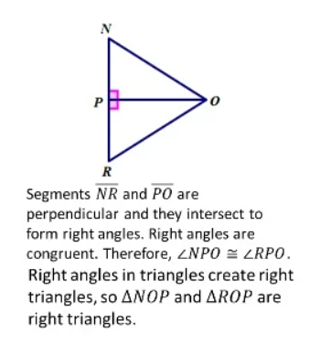
Perpendicular Lines – form right angles (90°). Right angles are congruent.
www.innovatewithmrbarbado.com

Slide 5
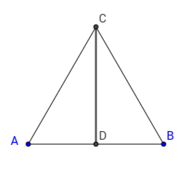
Midpoint – divides a segment into two equal parts.
Reflexive Property – a side or angle is equal to itself.
www.innovatewithmrbarbado.com
Line segments CD≅CD

Slide 6
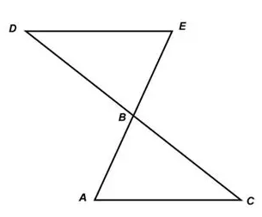
Vertical Angles – angles opposite each other when two lines intersect are congruent.
www.innovatewithmrbarbado.com
<BED ≅ <BAC

Slide 7
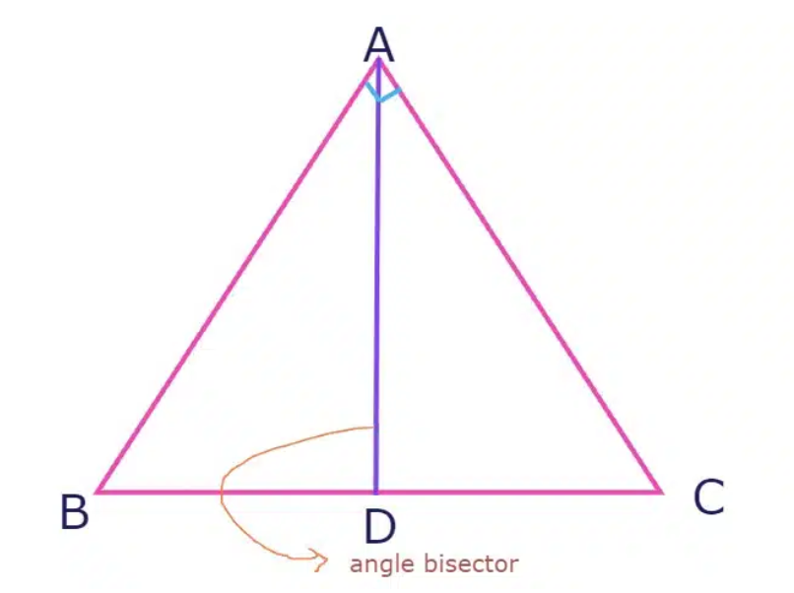
An angle bisector is a line or ray that divides an angle into two equal parts. The angle bisector passes through the vertex of the angle and divides it into two smaller angles, each of which has the same measure. The angle bisector is sometimes also called the angle tri-sector because it divides the angle into three equal parts.
www.innovatewithmrbarbado.com
For example, consider a triangle ABC, where angle A is bisected by the angle bisector line AD.
Therefore:
Line segments AD≅AD

Slide 8
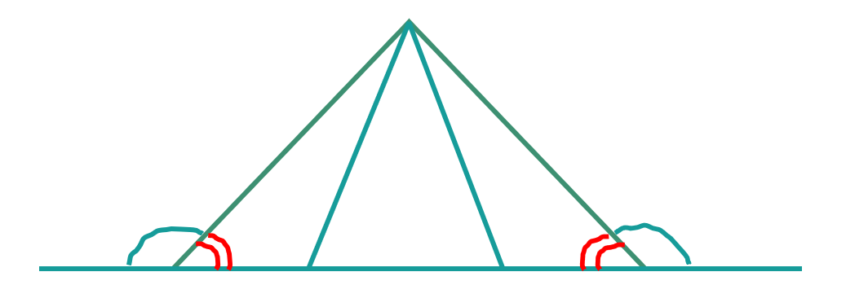
Supplementary Angles of Congruent Angles are Congruent – if two angles are equal, their supplements are also equal.
<1
<2
<3
<4
<1 ≅ <4
Therefore: <2 ≅ <3
www.innovatewithmrbarbado.com

Slide 9
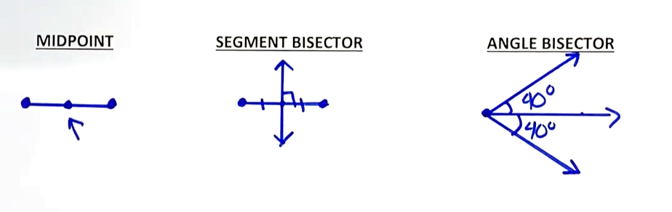
Differentiation
www.innovatewithmrbarbado.com

Slide 10
Tips to Identify Congruent Triangles
www.innovatewithmrbarbado.com
Look for shared sides (use reflexive property).
1
Identify vertical angles.
2
Check for given midpoints or bisectors.
3
Mark equal sides/angles on diagrams.
4
Use process of elimination with known postulates (SSS, SAS, ASA, AAS).
5
Notes:
When solving problems, marking equal sides and angles helps you see which postulate to use. Start with what’s given and then check for these clues. Remember, diagrams are your friend—draw and label carefully!

Slide 11
Triangle congruence postulates are rules that determine when two triangles are congruent, meaning they have the same shape and size. The main postulates are SSS, SAS, ASA, AAS, and HL.
www.innovatewithmrbarbado.com
SSS (Side-Side-Side) – if all three sides of one triangle are congruent to another triangle, they are congruent.
SAS (Side-Angle-Side) – if two sides and the included angle of one triangle are congruent to another, the triangles are congruent.
ASA (Angle-Side-Angle) – if two angles and the included side of one triangle are congruent to another, the triangles are congruent.
AAS (Angle-Angle-Side) – if two angles and a non-included side are congruent to another triangle, the triangles are congruent.
Notes:
These are the rules that will help us determine if two triangles are congruent. Each has a slightly different way of checking sides and angles. Tomorrow we’ll start practicing the first two postulates.

Slide 12
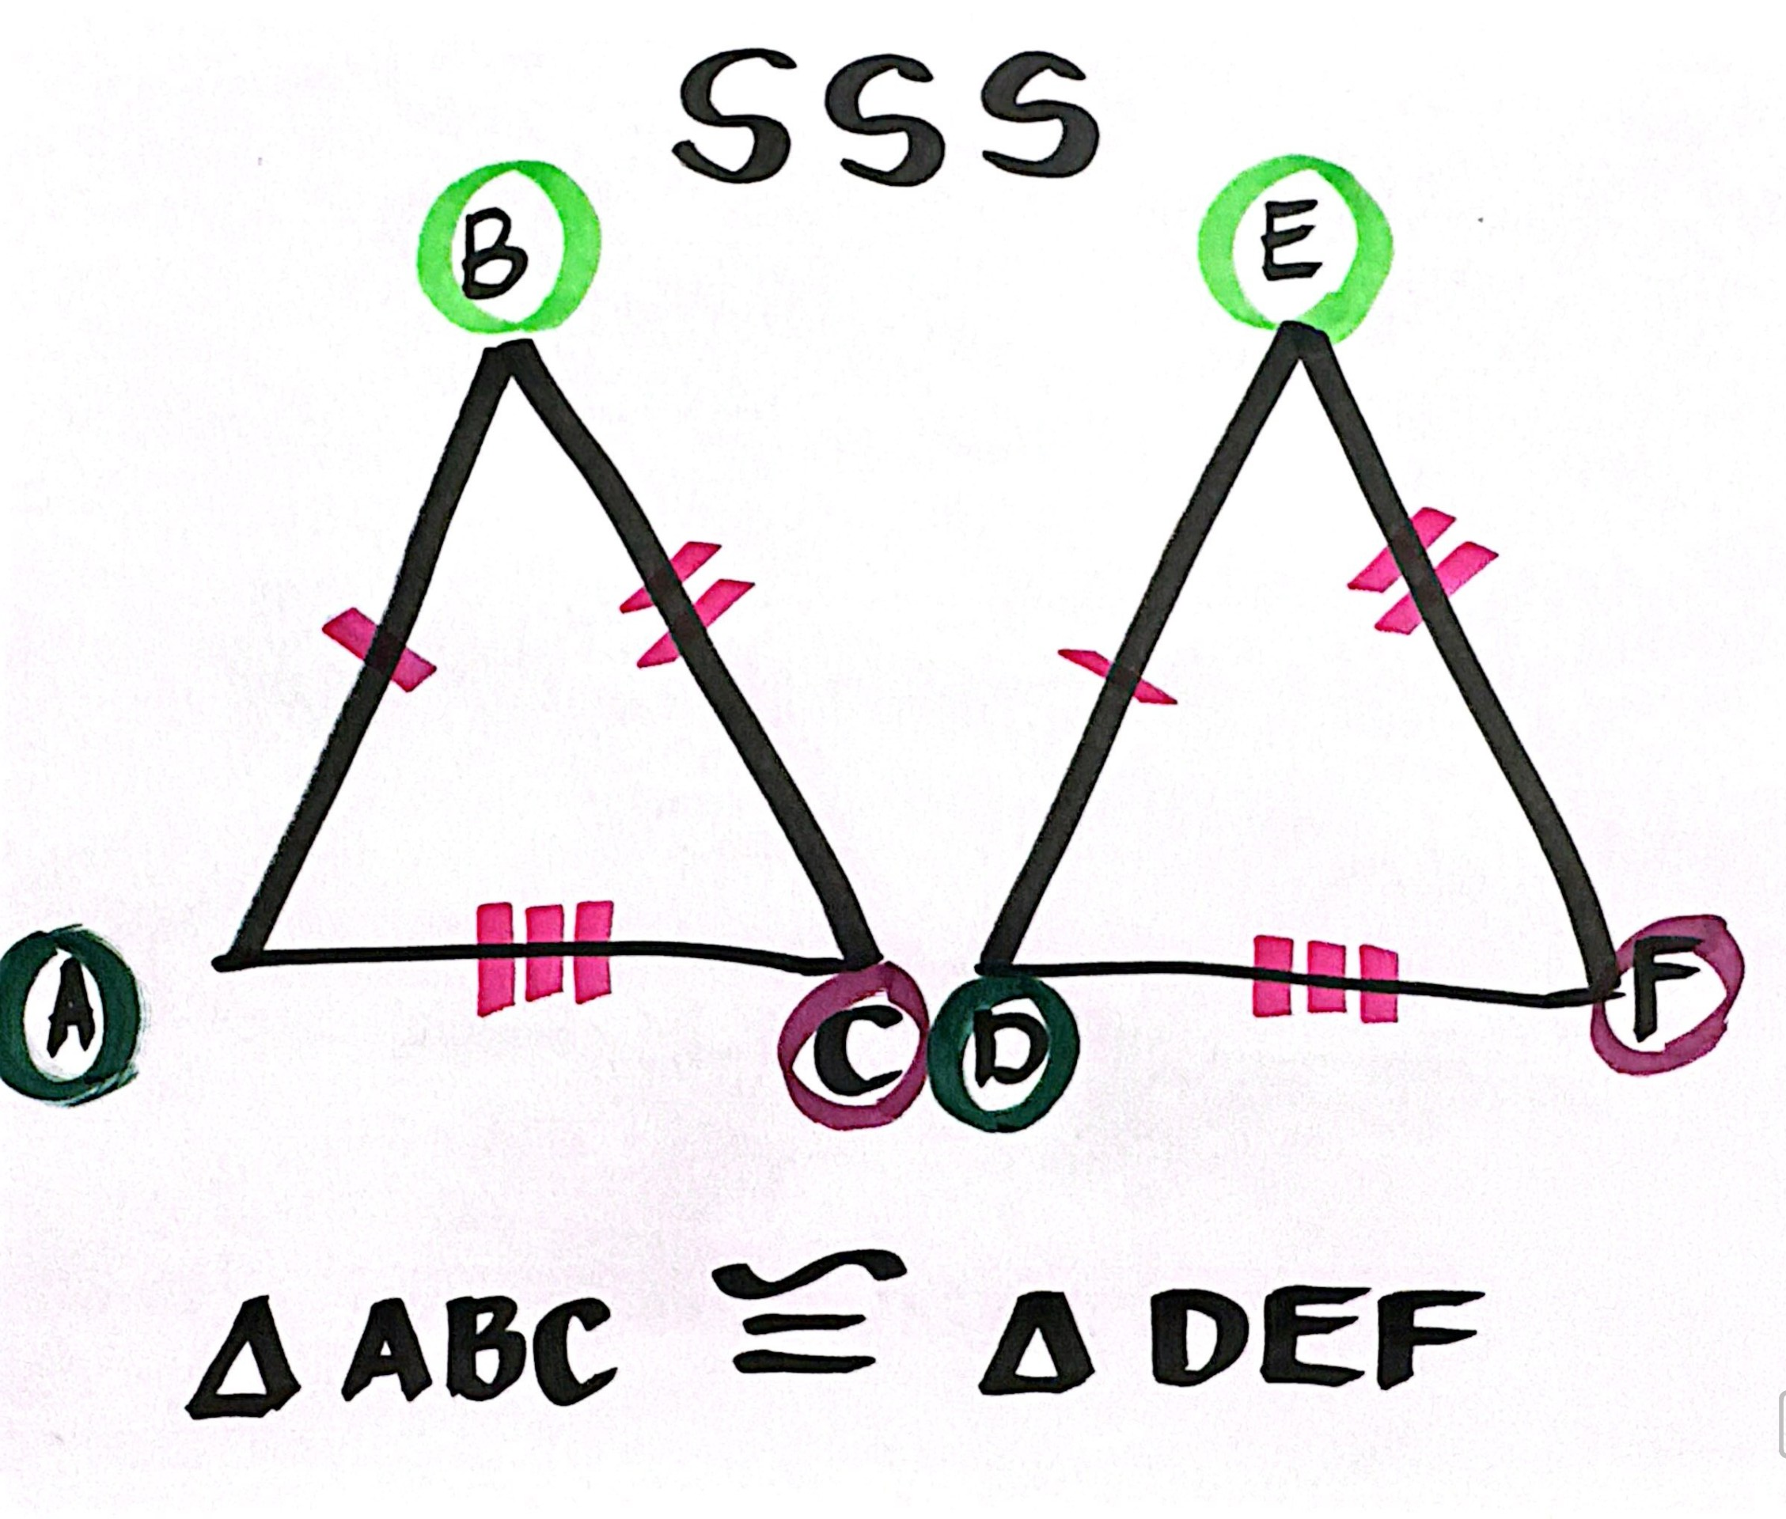
SSS (Side-Side-Side) – if all three sides of one triangle are congruent to another triangle, they are congruent.
www.innovatewithmrbarbado.com

Slide 13
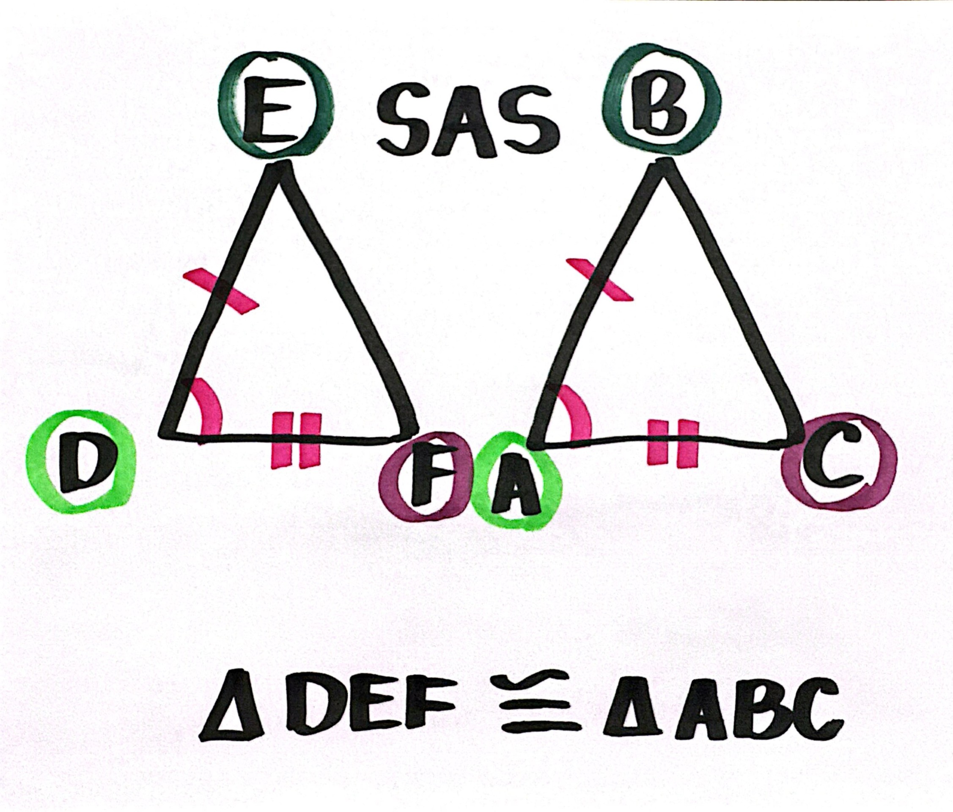
SAS (Side-Angle-Side) – if two sides and the included angle of one triangle are congruent to another, the triangles are congruent.
www.innovatewithmrbarbado.com

Slide 14
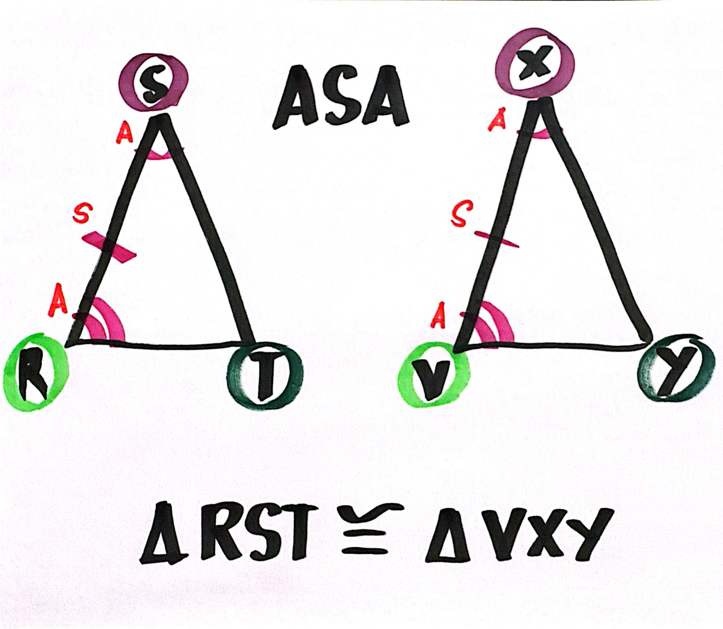
ASA (Angle-Side-Angle) – if two angles and the included side of one triangle are congruent to another, the triangles are congruent.
www.innovatewithmrbarbado.com

Slide 15
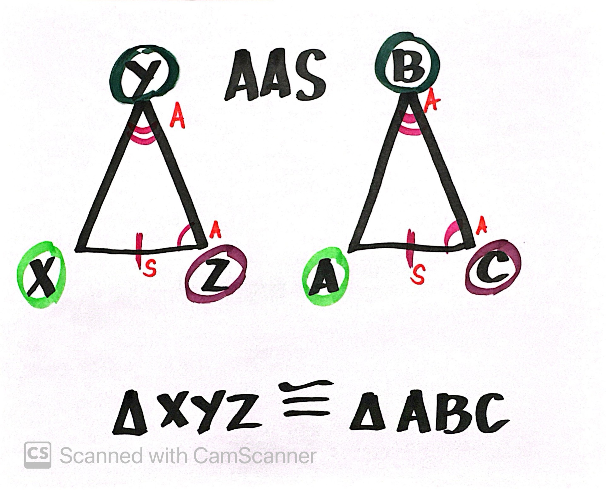
AAS (Angle-Angle-Side) – if two angles and a non-included side are congruent to another triangle, the triangles are congruent.
www.innovatewithmrbarbado.com

Slide 16

Triangle Congruence Postulates: ASA & AAS
MA.8.GR.1.6 – Use properties of congruent triangles.
Objectives:
Explain ASA and AAS postulates.
Tell the difference between ASA and AAS.
Identify triangle congruence using these postulates.

Slide 17
SSS (Side-Side-Side) – if all three sides of one triangle are congruent to another triangle, they are congruent.
www.innovatewithmrbarbado.com

Slide 18
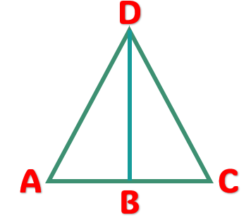
Side-Side-Side (SSS) Postulate
www.innovatewithmrbarbado.com
Statements | Reasons
1. Segment AD ≅ Segment CD | Given
2. B is midpoint of segment AC | Given
3. Segment AB ≅ Segment BC | Def. of midpoint
4. Segment BD ≅ Segment BD | Reflexive property of equality
5. Δ ABD ≅ Δ CBD | SSS Postulate (1,2,4)
Given:
Segment AD ≅ Segment CD
B is midpoint of segment AC
Prove: Δ ABD ≅ Δ CBD

Slide 19
SAS (Side-Angle-Side) – if two sides and the included angle of one triangle are congruent to another, the triangles are congruent.
www.innovatewithmrbarbado.com

Slide 20
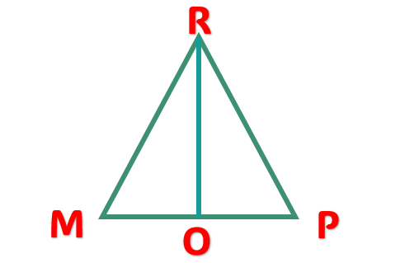
Side-Angle-Side (SAS) Postulate
www.innovatewithmrbarbado.com
Statements | Reasons
1. Segment RO Segment MP | Given
2. Segment MO ≅ Segment OP | Given
3. <MOR ≅ <POR | lines form right angles
4. Segment RO ≅ Segment RO | Reflexive property of equality
5. Δ MRO ≅ Δ PRO | SAS Postulate (2,3,4)
Given:
Segment RO Segment MP
Segment MO ≅ Segment OP
Prove: Δ MRO ≅ Δ PRO

Slide 21
If two angles and the included side of one triangle are congruent to another, the triangles are congruent.
www.innovatewithmrbarbado.com
Angle-Side-Angle (ASA) Postulate

Slide 22
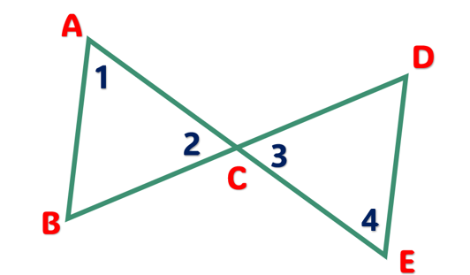
Angle-Side-Angle (ASA) Postulate
www.innovatewithmrbarbado.com
Statements | Reasons
1. <1 ≅ <4 | Given
2. Segment AC ≅ Segment EC | Given
3. <2 ≅ <3 | Vertical angles are congruent angles
4. Δ ABC ≅ Δ EDC | ASA Postulate (1,2,3)
Given:
<1 ≅ <4
Segment AC ≅ Segment EC
Prove: Δ ABC ≅ Δ EDC

Slide 23
AAS (Angle-Angle-Side) – if two angles and a non-included side are congruent to another triangle, the triangles are congruent.
www.innovatewithmrbarbado.com

Slide 24
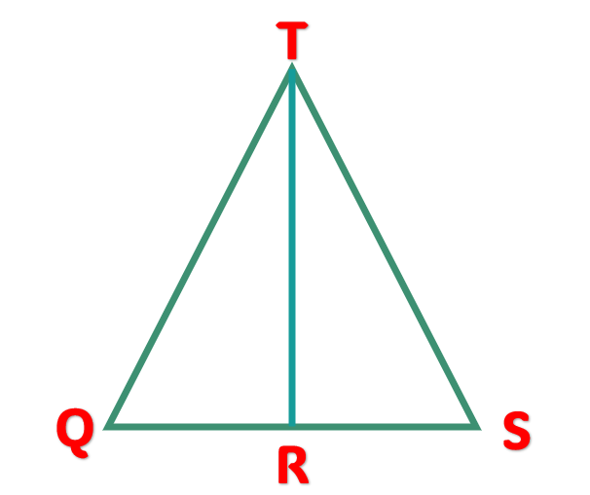
Angle-Angle-Side (AAS) Postulate
www.innovatewithmrbarbado.com
Statements | Reasons
1. <TQR ≅ <TSR | Given
2. Ray TR bisects <QTS | Given
3. <QTR ≅ <STR | Def. of angle bisector
4. Segment TR ≅ Segment TR | Reflexive property of equality
5. Δ QTR ≅ Δ STR | AAS Postulate (1,3,4)
Given:
<TQR ≅ <TSR
Ray TR bisects <QTS
Prove: Δ QTR ≅ Δ STR

Slide 25

Additional interactive activity at:
Middle School / Interactive Quiz | Innovate with Mr. Barbado

