Slide 1
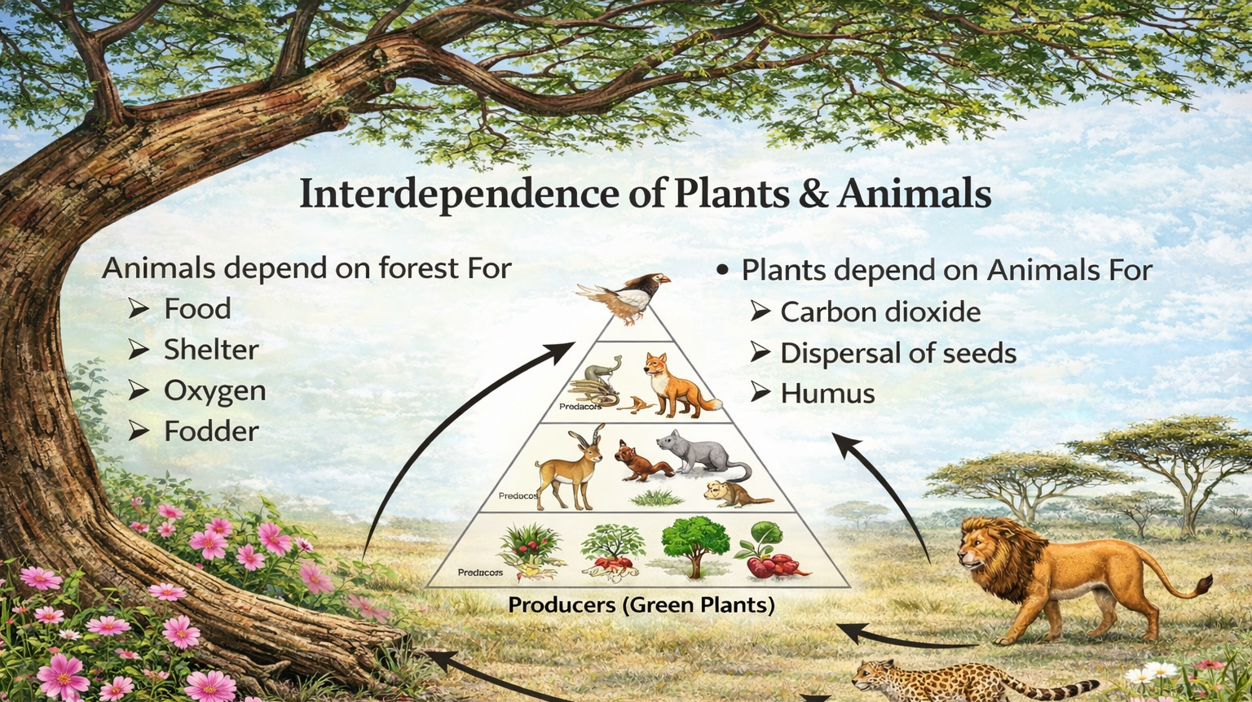
Interdependence in Ecosystems
“Think Like a Scientist: Predict. Analyze. Explain.”
Notes:
Today, you are not just a student—you are a scientist.
Your job is to analyze systems and predict what happens when something changes.

Slide 2
LEARNING TARGET
Analyze relationships in ecosystems
1
Predict chain reactions
2
Explain cause and effect
3
Justify reasoning
4

Slide 3
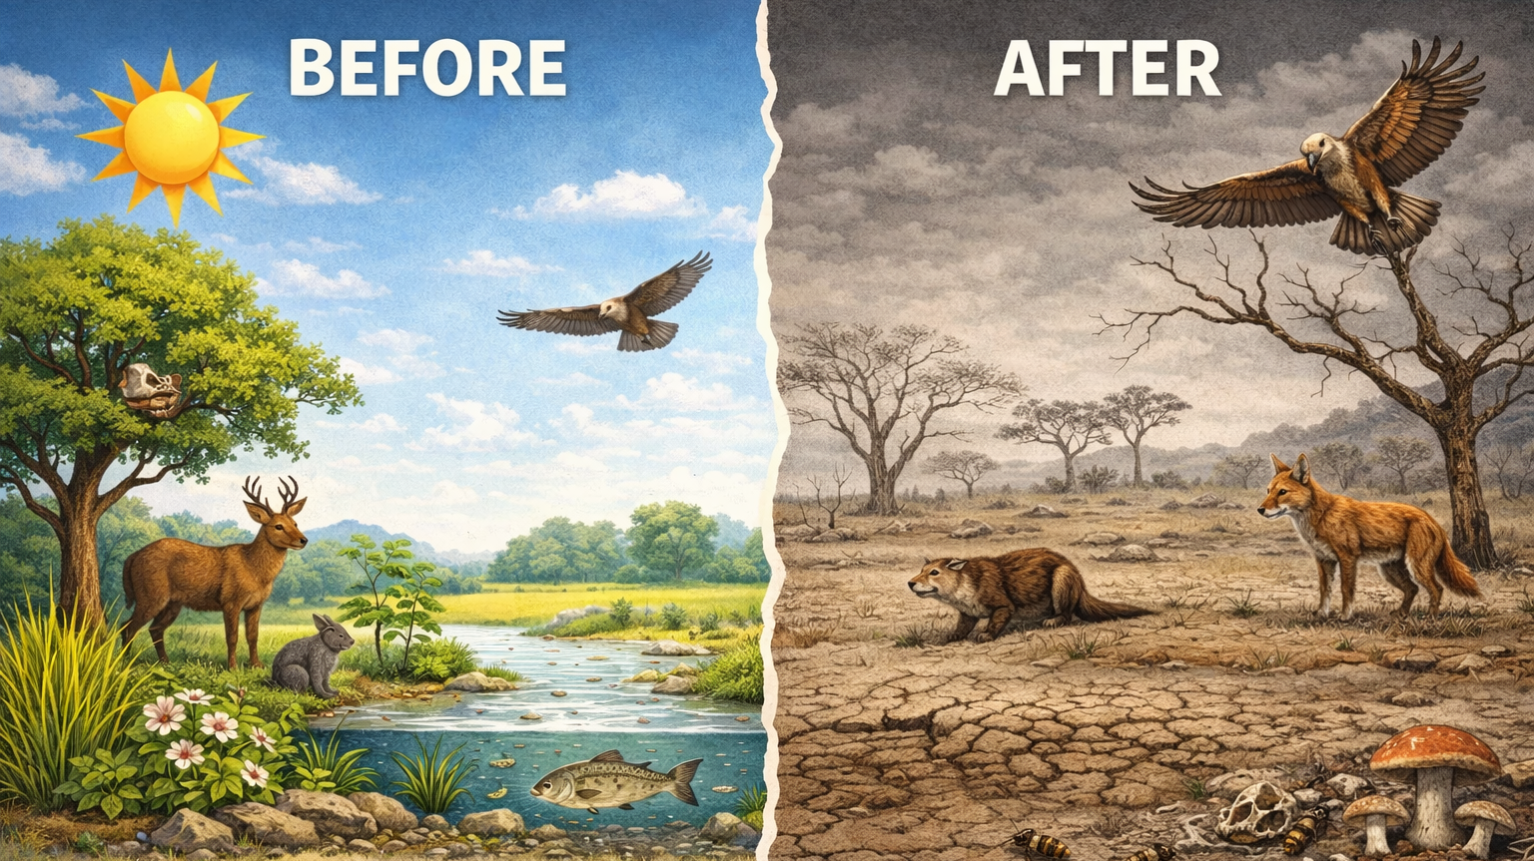
What happens if plants suddenly disappear?
Notes:
Level 1:
“What happens to herbivores?”
✅ They decrease
Level 2:
“What happens to predators after that?”
✅ They also decrease
Level 3 (Gifted):
“Which group is affected first, and why?”
✅ Herbivores (they directly lose food)
👉 Push deeper:
“Is this a direct or indirect effect?”
✅ Answer:
Herbivores = direct
Predators = indirect

Slide 4
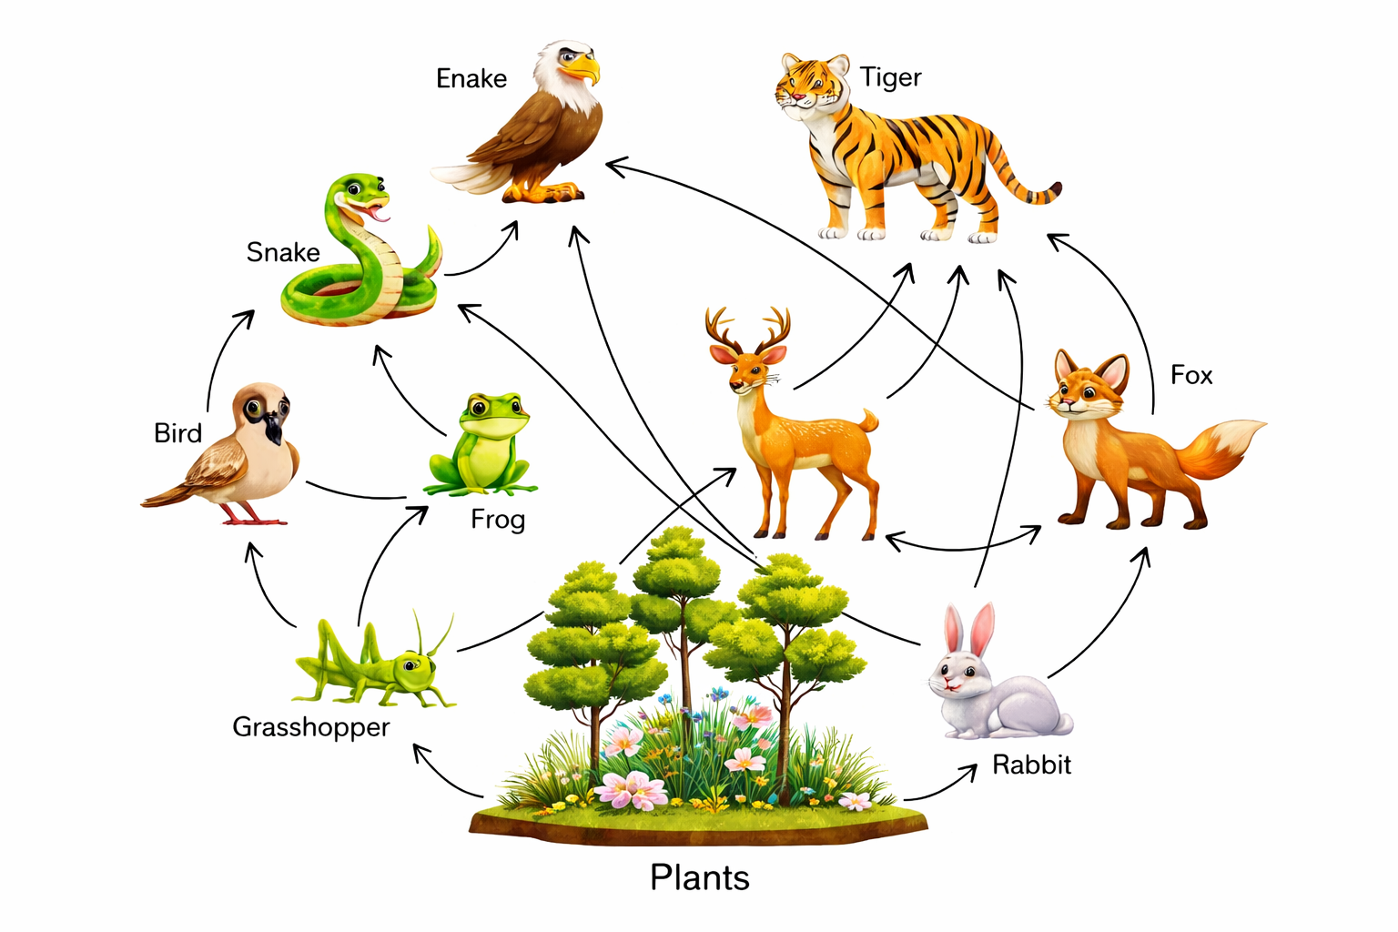
FOOD WEB ANALYSIS
Ecosystems are systems—not chains, but networks.
Notes:
This is a system with multiple interactions happening at the same time.
❓ Tiered Questions:
Level 1:
“What is the difference between a chain and a web?”
✅ One path vs many
Level 2:
“Why is a web more stable than a chain?”
✅ More connections = backup food sources
Level 3 (Evaluation):
“Which ecosystem is more vulnerable: one with few connections or many? Why?”
✅ Few connections → less stable → easier to collapse

Slide 5
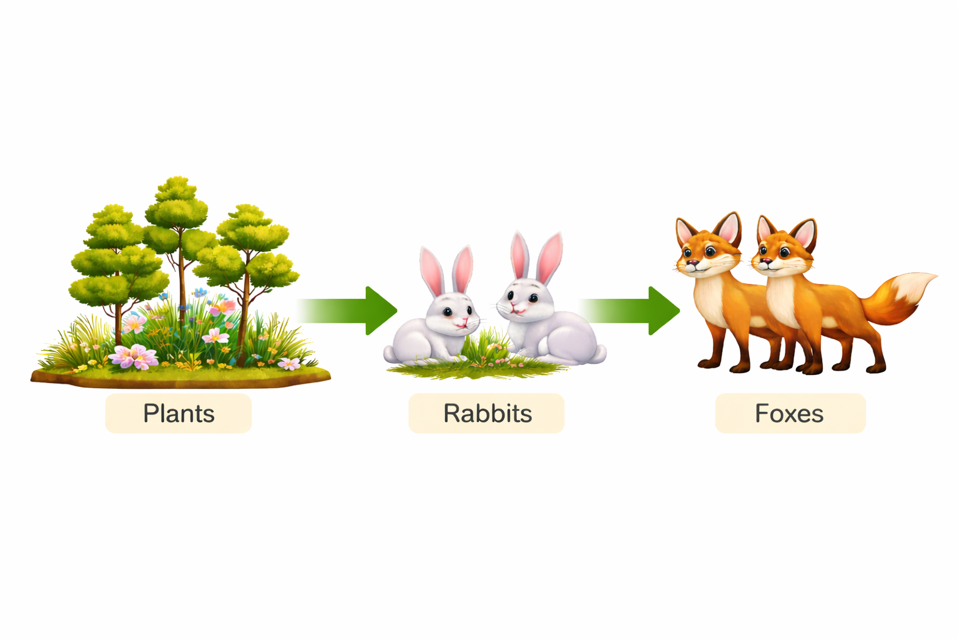
INTERDEPENDENCE
is the mutual reliance of organisms on each other and their environment to survive, reproduce, and maintain ecosystem stability.
Notes:
Let’s trace a system step-by-step.
Scenario:
Plants → Rabbits → Foxes
❓ Tiered Questions:
Level 1:
“If rabbits disappear, what happens to foxes?”
✅ Decrease
Level 2:
“What happens to plants?”
✅ Increase
Level 3 (Analysis):
“Which change happens faster—plants increasing or foxes decreasing? Why?”
✅ Answer:
Foxes decrease faster (immediate loss of food)
Plants increase slower (growth takes time)

Slide 6
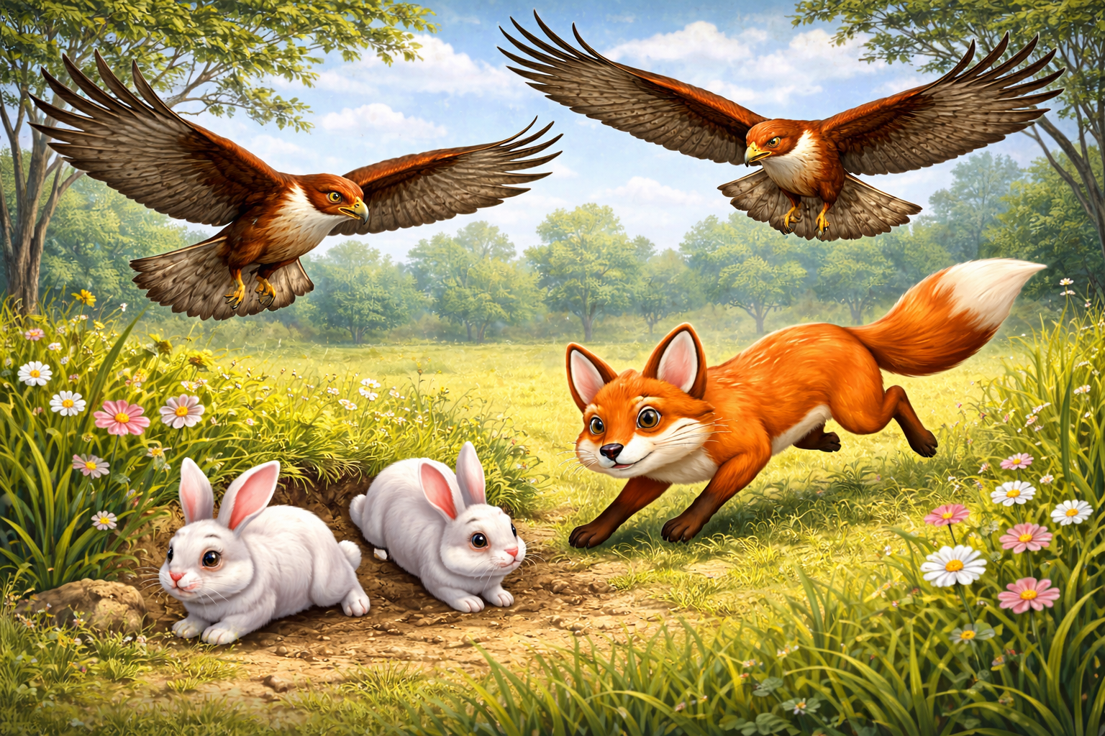
MULTIPLE RELATIONSHIPS (SIMULTANEOUS INTERACTIONS)
Multiple relationships happen at once.
Notes:
This is not one interaction—it’s layered.
❓ Tiered Questions:
Level 1:
“What relationships are present?”
✅ Competition + Predation
Level 2:
“Which population is under the most pressure?”
✅ Rabbits
Level 3 (Evaluation):
“Which factor affects rabbit survival more—competition among predators or predation itself?”
✅ Answer:
Predation (direct removal of rabbits)
Level 4 (Advanced Reasoning):
“If predator competition increases, how might predator populations change?”
✅ Answer:
Some predators may decrease due to limited food

Slide 7
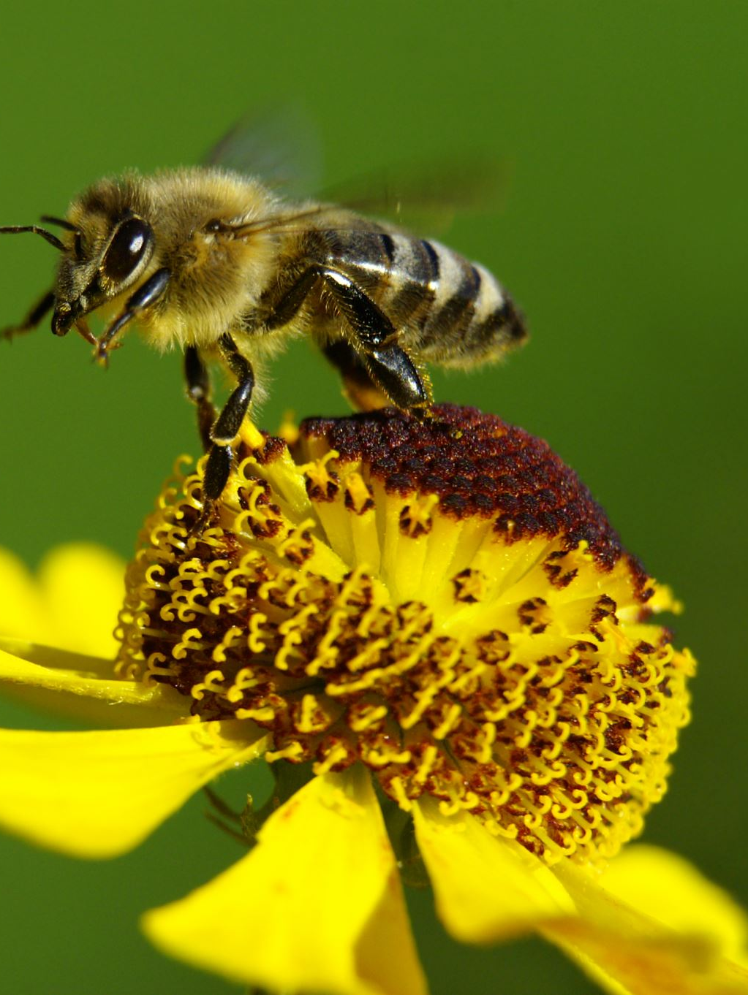
SYMBIOSIS (SYSTEM IMPACT)
Symbioses (symbiotic relationships) are close, long-term interactions between different species. The three main types are:
Mutualism: Both species benefit (+ / +) Example: Bees get nectar from flowers, and flowers get pollinated.
Commensalism: One species benefits, the other is neither helped nor harmed (+ / 0) Example: Barnacles living on whales—barnacles gain transport, the whale is unaffected.
Parasitism: One species benefits, the other is harmed (+ / –) Example: Ticks feeding on mammals.
Notes:
Some relationships involve long-term interactions.
❓ Tiered Questions:
Level 1:
“What is symbiosis?”
✅ Living together
Level 2:
“Does symbiosis always benefit both organisms?”
✅ No
Level 3 (Analysis):
“How does parasitism affect population health?”
✅ Answer:
Weakens organisms
Reduces reproduction
Lowers survival
Level 4 (Evaluation):
“Could parasitism indirectly affect predators? How?”
✅ Answer:
Yes, weaker prey → less food quality → predator impact

Slide 8
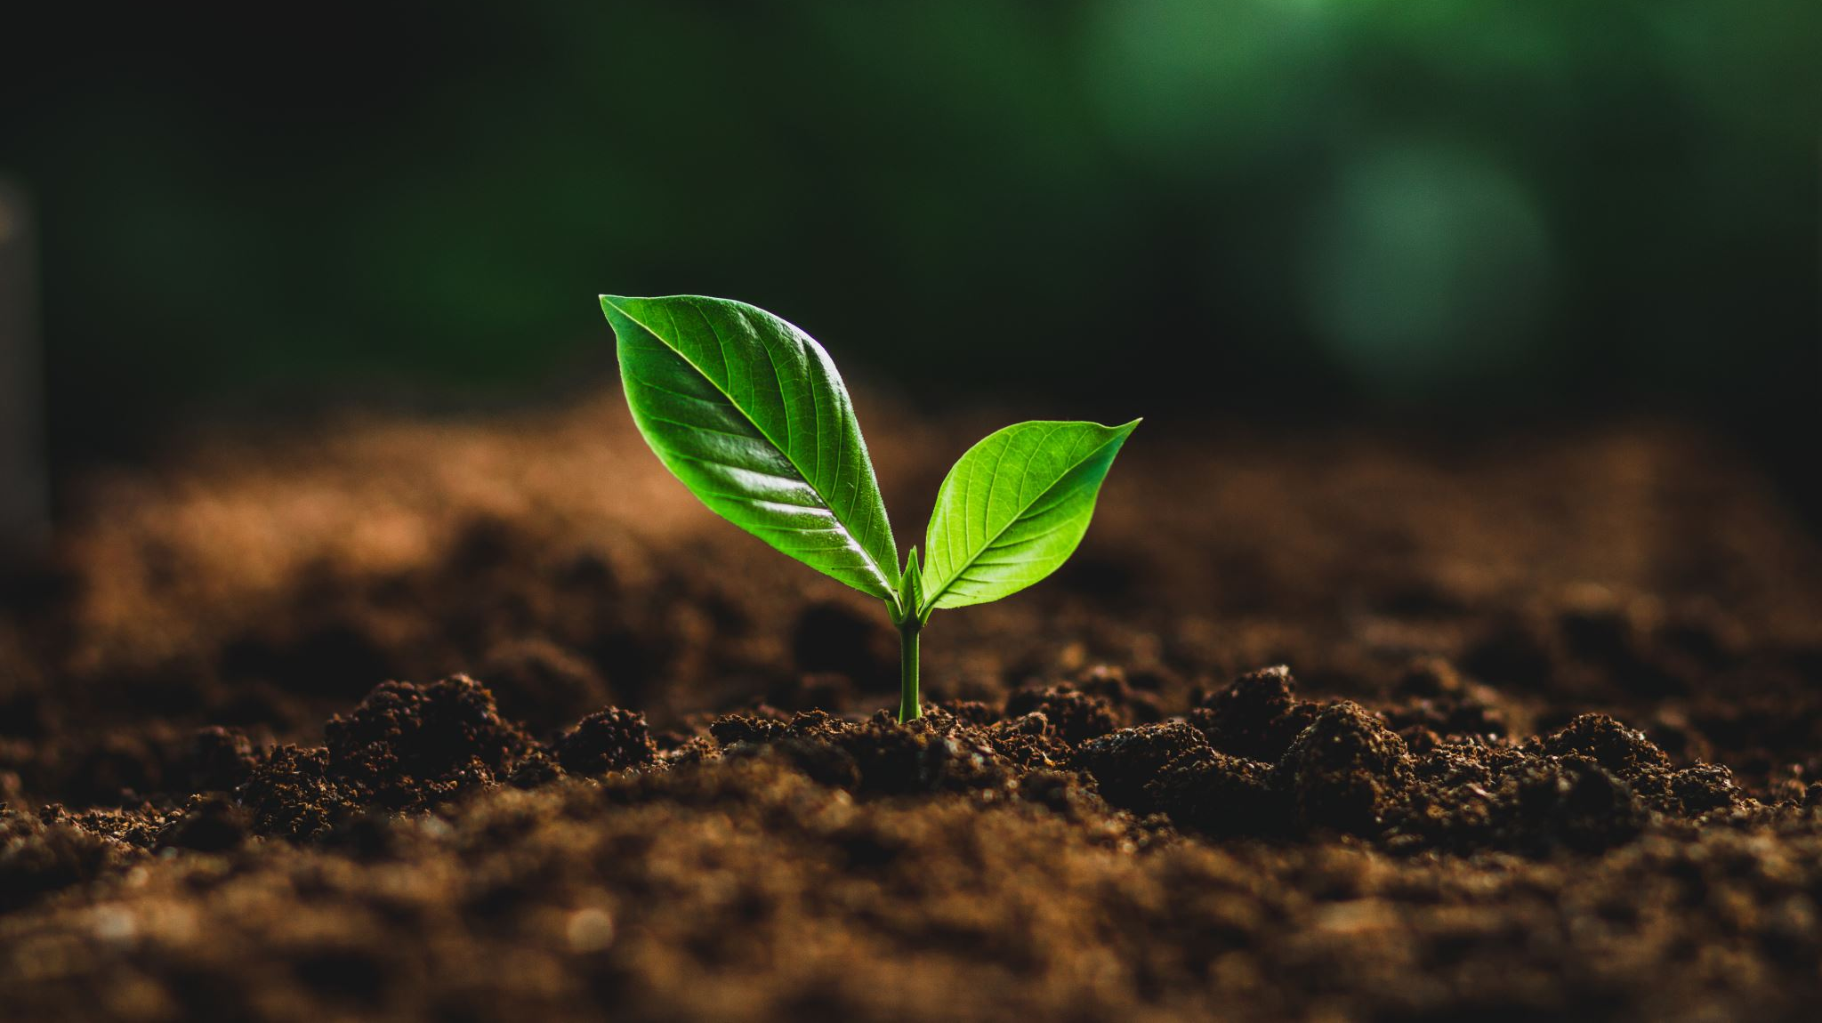
ENVIRONMENTAL FACTORS (SYSTEM DISRUPTION)
Environmental changes affect ALL relationships.
Notes:
Now we analyze a disturbance.

Slide 9
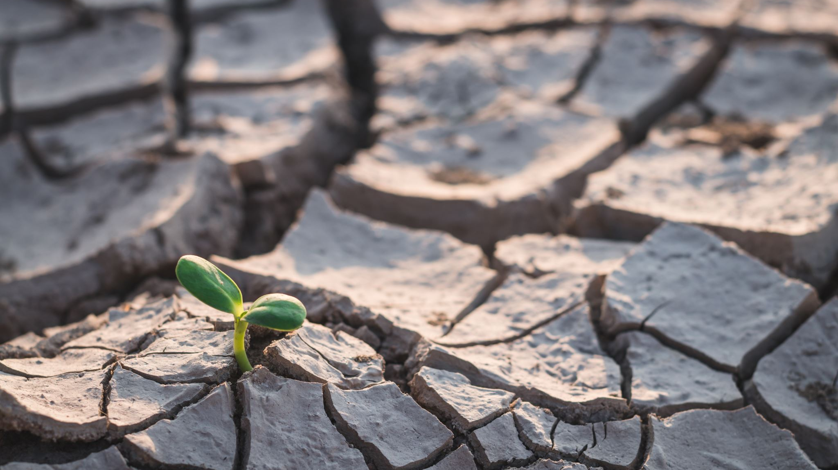
CASE STUDY – DROUGHT
Drought = Less water → System disruption
Notes:
❓ Tiered Questions:
Level 1:
“What happens to plants?”
✅ Decrease
Level 2:
“What happens to herbivores?”
✅ Decrease
Level 3:
“What happens to predators?”
✅ Decrease
Level 4 (Analysis):
“Why does competition increase?”
✅ Answer:
Fewer resources → more organisms competing
Level 5 (Synthesis):
“Describe the FULL chain reaction starting from drought.”
✅ Answer:
Drought → plants ↓ → herbivores ↓ → predators ↓ → competition ↑ → ecosystem imbalance

Slide 10
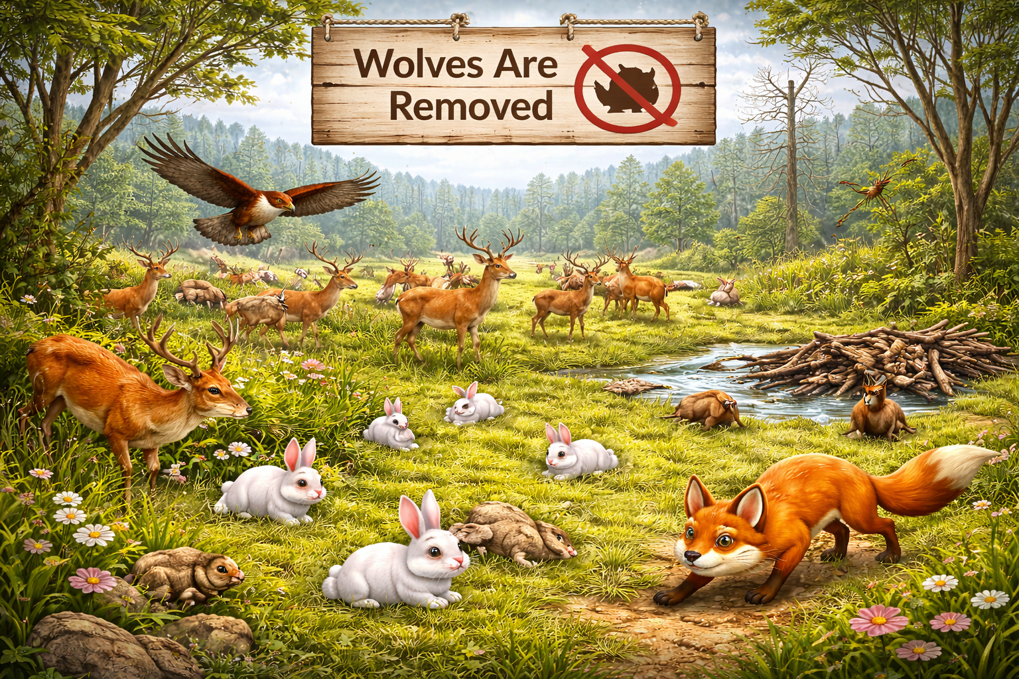
GUIDED PRACTICE (DEEP ANALYSIS)
Scenario :
“Wolves are removed”
Notes:
Level 1: Deer? → ✅ Increase
Level 2: Plants? → ✅ Decrease
Level 3 (Analysis):
“Why do plants decrease?”
✅ Answer:
More deer eating them
Level 4 (Evaluation):
“Is removing wolves helpful or harmful to the ecosystem? Why?”
✅ Answer:
Harmful (causes imbalance)

Slide 11
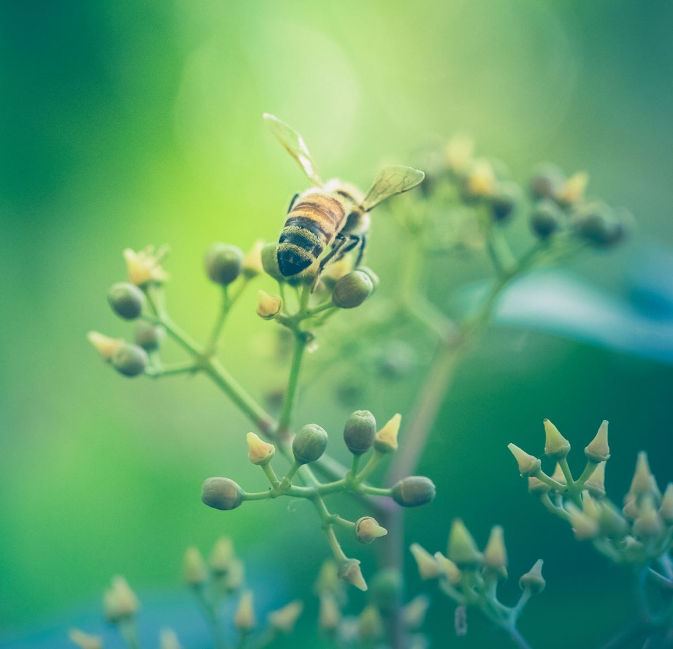
What if pollinators disappeared?
Notes:
❓ Tiered Questions:
Level 1:
“What happens to plants?”
✅ Decrease
Level 2:
“What happens to herbivores?”
✅ Decrease
Level 3 (Analysis):
“How does this affect the entire food web?”
✅ Answer:
Multiple populations decline
Level 4 (Synthesis):
“Explain the chain reaction from pollinator loss.”
✅ Answer:
Pollinators ↓ → plants ↓ → herbivores ↓ → predators ↓ → ecosystem collapse

Slide 12

Why is it important to understand interdependence?
Notes:
Today, you analyzed an ecosystem as a system—not just parts.
✅ Answer:
Helps predict changes
Helps protect ecosystems
Shows how everything is connected

