Slide 1

STEM SCHOLARS HUB
EXPLORE • LEARN • INNOVATE • INSPIRE
Energy Changes, Cold Pack Engineering
Physical & Chemical Changes
SCIENCE
DATA
ENGINEERING
REVIEW
PHYSICAL & CHEMICAL CHANGES
www.stemscholarshub.net

Slide 2
STEM SCHOLARS HUB
WEEK OVERVIEW
EXPLORE • LEARN • INNOVATE • INSPIRE
Our Week at a Glance
LEARNING TARGET: Connect chemical energy changes to an engineering application and precision control.
MONDAY
Endothermic & Exothermic Reactions — temperature investigation.
TUESDAY
Energy Transfer & Instant Cold Packs — explain why cold packs become cold.
WEDNESDAY
Cold Pack Design Challenge — define, plan, criteria and constraints.
THURSDAY
Cold Pack Test & Improve — collect data, evaluate, redesign.
NOTE: Keep returning to evidence: What did we measure? What does the data support?
FRIDAY
Drone Program — hovering accuracy and directional control.
PHYSICAL & CHEMICAL CHANGES
www.stemscholarshub.net

Slide 3
STEM SCHOLARS HUB
MONDAY
EXPLORE • LEARN • INNOVATE • INSPIRE
Endothermic vs. Exothermic
LEARNING TARGET: Use temperature data to determine whether thermal energy was absorbed or released.
“If a cup gets colder during a reaction, where did the thermal energy go?”
EXO = energy exits the system → surroundings warm. ENDO = energy enters the system → surroundings cool.
INVESTIGATE
A: baking soda + vinegar. B: 3% hydrogen peroxide + yeast. Measure initial and final temperatures.
ANALYZE
Calculate ΔT = final temperature − initial temperature. Use the sign and observed trend as evidence.
PHYSICAL & CHEMICAL CHANGES
www.stemscholarshub.net

Slide 4
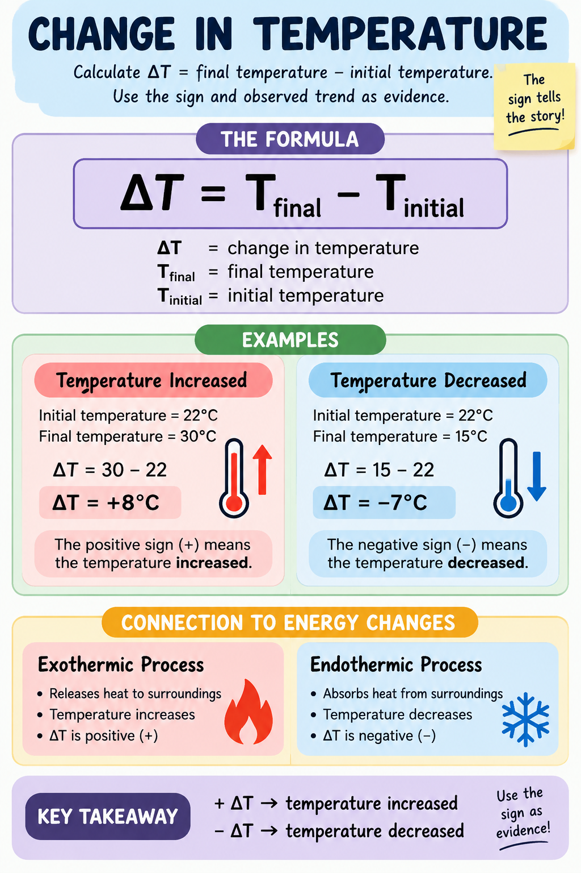

Slide 5
STEM SCHOLARS HUB
MONDAY
EXPLORE • LEARN • INNOVATE • INSPIRE
Experiment Guidance & Expected Thinking
LEARNING TARGET: Collect reliable temperature evidence and explain the result.
BEFORE
Students predict which mixture will increase or decrease in temperature.
DURING
Use thermometers; record actual classroom data. Do not substitute expected values for measurements.
EXPECTED
Baking soda + vinegar typically cools; peroxide + yeast typically warms.
DISCUSS
A temperature change is evidence of energy transfer; connect it with other evidence of chemical change.
NOTE: Use 3% household hydrogen peroxide, eye protection, small quantities, and no tasting.
PHYSICAL & CHEMICAL CHANGES
www.stemscholarshub.net

Slide 6
STEM SCHOLARS HUB
TUESDAY
EXPLORE • LEARN • INNOVATE • INSPIRE
Energy Transfer & Instant Cold Packs
LEARNING TARGET: Explain how an endothermic process cools its surroundings.
REVIEW
Draw arrows: surroundings → system for endothermic; system → surroundings for exothermic.
PHENOMENON
An instant cold pack begins at room temperature but becomes cold after activation.
REASON
The process inside absorbs thermal energy from the pack and nearby surroundings.
CONNECT
Ask: “If the pack is on your arm, in which direction is thermal energy moving?”
NOTE: thermal energy moves from the warmer surroundings/arm toward the endothermic system.
PHYSICAL & CHEMICAL CHANGES
www.stemscholarshub.net

Slide 7
STEM SCHOLARS HUB
TUESDAY
EXPLORE • LEARN • INNOVATE • INSPIRE
Cold Pack Data Analysis
LEARNING TARGET: Use quantitative evidence to identify the most effective cooling process.
COMPARE
Give teams sample or Monday data sets with different starting and minimum temperatures.
CALCULATE
Determine ΔT for each trial and rank the cooling effect.
EVIDENCE
Students cite measured temperature change rather than saying only “it felt cold.”
EXIT
Which data would convince an engineer that a process is useful for a cold pack? Why?
PHYSICAL & CHEMICAL CHANGES
www.stemscholarshub.net

Slide 8
STEM SCHOLARS HUB
WEDNESDAY
EXPLORE • LEARN • INNOVATE • INSPIRE
Cold Pack Design Challenge — Plan
LEARNING TARGET: Define an engineering problem and develop a cold-pack design using criteria and constraints.
PROBLEM
Design a model cold pack that produces a measurable decrease in temperature.
CRITERIA
It should cool effectively and allow temperature change to be measured.
CONSTRAINTS
Use only teacher-approved materials, amounts, time, and container system.
PLAN
Teams sketch the design, identify variables, predict results, and create a testing procedure.
PHYSICAL & CHEMICAL CHANGES
www.stemscholarshub.net

Slide 9
STEM SCHOLARS HUB
WEDNESDAY
EXPLORE • LEARN • INNOVATE • INSPIRE
Teacher Conference Questions
LEARNING TARGET: Defend a design plan using scientific reasoning before testing.
WHY?
Why did your team choose this process or material combination?
ENERGY
Where do you predict thermal energy will move?
MEASURE
What measurements will show whether your design worked?
FAIR TEST
What variables must remain controlled so your comparison is meaningful?
PHYSICAL & CHEMICAL CHANGES
www.stemscholarshub.net

Slide 10
STEM SCHOLARS HUB
THURSDAY
EXPLORE • LEARN • INNOVATE • INSPIRE
Cold Pack Design Challenge — Test
LEARNING TARGET: Test a design, collect temperature data, and evaluate performance.
BASELINE
Record initial temperature before activating the model.
TEST
Activate the design and measure temperature at consistent intervals.
DATA
Record minimum temperature, ΔT, observations, and test duration.
EVALUATE
Did the design meet the criteria? Support the answer with numerical evidence.
PHYSICAL & CHEMICAL CHANGES
www.stemscholarshub.net

Slide 11
STEM SCHOLARS HUB
THURSDAY
EXPLORE • LEARN • INNOVATE • INSPIRE
Improve & Redesign
LEARNING TARGET: Use test evidence to propose a justified improvement.
IDENTIFY
What part of the design worked best? What limited its performance?
EVIDENCE
Point to a specific measurement or observation from the test.
REDESIGN
Change one meaningful feature while keeping the purpose the same.
DEFEND
“We would change ___ because our data showed ___.”
PHYSICAL & CHEMICAL CHANGES
www.stemscholarshub.net

Slide 12
STEM SCHOLARS HUB
FRIDAY
EXPLORE • LEARN • INNOVATE • INSPIRE
Drone Program — Hovering Accuracy
LEARNING TARGET: Use measurement and controlled adjustments to improve hovering precision.
GOAL
Maintain a stable hover within a designated target area.
MEASURE
Track time in target, drift, or number of corrections.
CONTROL
Make small adjustments rather than large repeated corrections.
ITERATE
Test → observe → adjust → retest.
NOTE: Follow your school's drone safety procedures and establish a clear flight zone before operation.
PHYSICAL & CHEMICAL CHANGES
www.stemscholarshub.net

Slide 13
STEM SCHOLARS HUB
FRIDAY
EXPLORE • LEARN • INNOVATE • INSPIRE
Directional Control & Engineering Reflection
LEARNING TARGET: Apply precision, feedback, and iteration to controlled drone movement.
TASK
Move forward, backward, left, and right while maintaining controlled altitude.
CHALLENGE
Navigate a simple marked path or target sequence with accuracy.
DATA
Record errors, corrections, completion time, or target accuracy.
REFLECT
How is improving drone control similar to redesigning the cold pack?
NOTE: Expected connection: both use testing, data/feedback, controlled changes, and iteration.
PHYSICAL & CHEMICAL CHANGES
www.stemscholarshub.net

Slide 14
STEM SCHOLARS HUB
FRIDAY
EXPLORE • LEARN • INNOVATE • INSPIRE
Synthesize the Week
LEARNING TARGET: Connect scientific evidence, energy transfer, and engineering design.
SCIENCE
Endothermic processes absorb thermal energy; exothermic processes release it.
EVIDENCE
Temperature measurements provide quantitative evidence of energy transfer.
ENGINEERING
Data help engineers evaluate whether a design meets criteria.
ITERATION
Both cold-pack design and drone control improve through testing and adjustment.
TEACHER NOTE: Final prompt: “How did evidence change or strengthen one decision you made this week?”
PHYSICAL & CHEMICAL CHANGES
www.stemscholarshub.net

