Slide 1
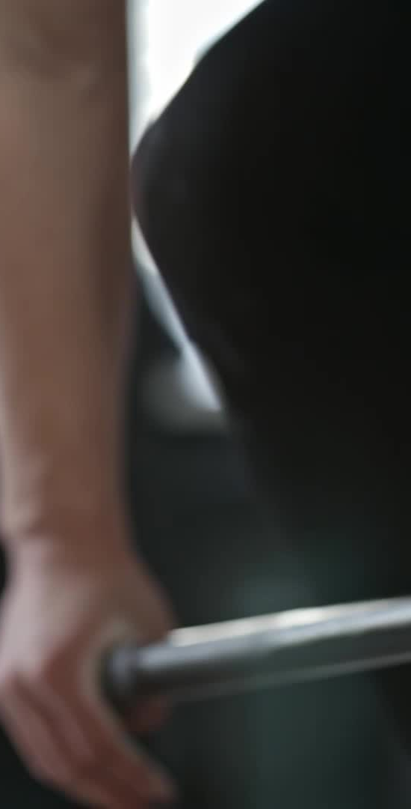
Understanding the Muscular System
The Importance of Muscles in Our Body
Florida Benchmark: SC.6.L.14.5
NGSS Standard: MS-LS1-3
John Mark L. Barbado, M.Ed.
STEM Educator

Slide 2

Essential Question
How do muscles in the human body work together to help us move and maintain homeostasis?

Slide 3
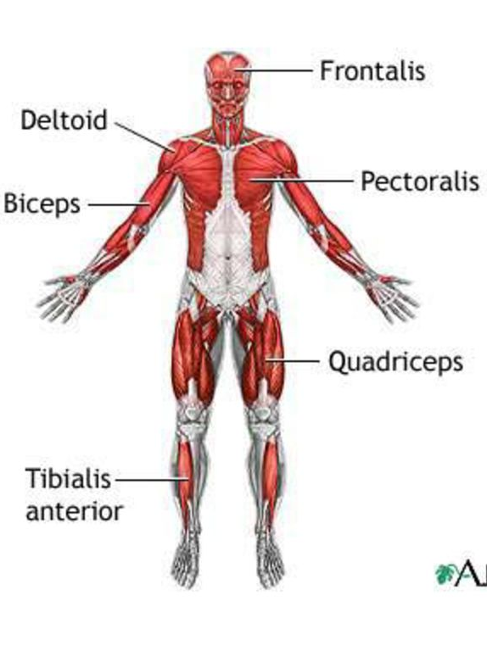
What is the Muscular System?
The muscular system helps us move, breathe, and carry out everyday tasks.
It includes three main types of muscles: skeletal, smooth, and cardiac.
slide_4.jpg (1024×768)

Slide 4
Types of Muscles in the Human Body
• Skeletal Muscles: Voluntary, attached to bones, help in movement (e.g., biceps, quadriceps).
• Smooth Muscles: Involuntary, found in organs (e.g., stomach, intestines).
• Cardiac Muscles: Involuntary, make up the heart and pump blood.

Slide 5
How Do Muscles Work Together?
Muscles work in pairs: One contracts, and the other relaxes to produce movement.
Example: Biceps and Triceps work together to bend and straighten the arm.

Slide 6
Why are Muscles Important for Your Health?
Muscles help with movement, posture, organ protection, and breathing.
Regular exercise keeps muscles strong and healthy.

Slide 7
How to Keep Your Muscles Healthy
• Exercise regularly: Running, swimming, or weightlifting.
• Eat a balanced diet: Protein and vitamins help muscles recover.
• Rest: Sleep and recovery are crucial for muscle health.

Slide 8
The Muscular System is Key to Movement and Health
Muscles are essential for everything from moving to breathing.
Keep your muscles strong and healthy through exercise, good nutrition, and rest.

Slide 9
References
• American Heart Association. (2020). How your heart works.
• National Institute of Arthritis and Musculoskeletal and Skin Diseases (NIAMS). (2019). Muscle structure and function.
• Mayo Clinic. (2022). Muscle cramps: Causes, treatment, and prevention.

