Slide 1
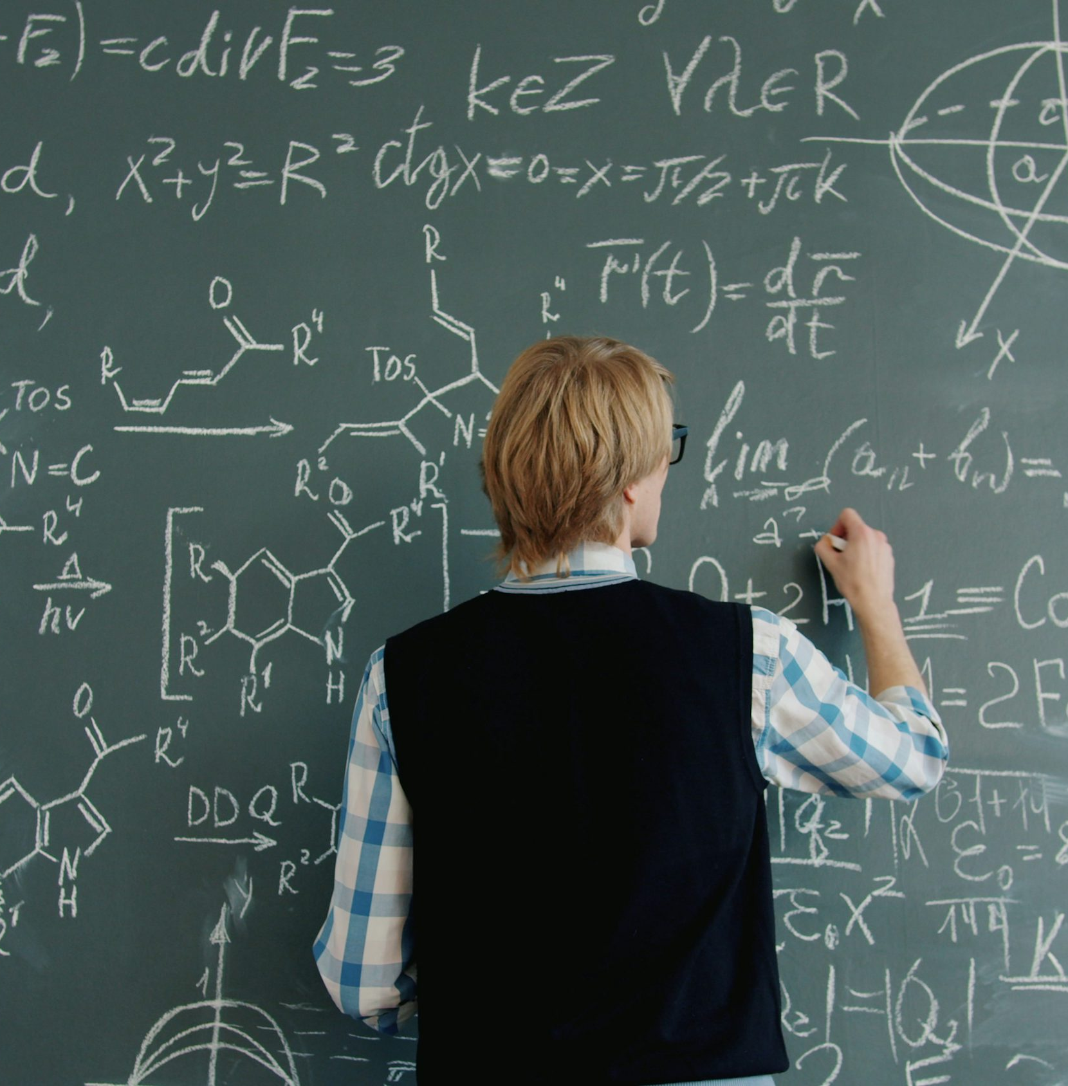
Understanding
Place Value
MA.7.NSO.2.1
Understand place value for whole numbers, decimals, and fractions.
Student goal: “I can tell what a digit is worth in a whole number, decimal, or fraction.”
5
0.5
1/10
Place value helps us compare, read, and explain numbers.
Notes:
[Sources]
- Photo on right: Unsplash, Vitaly Gariev, “Teacher writing math equations on a chalkboard” (https://unsplash.com/photos/teacher-writing-math-equations-on-a-chalkboard-zHXST3gGIdI).

Slide 2
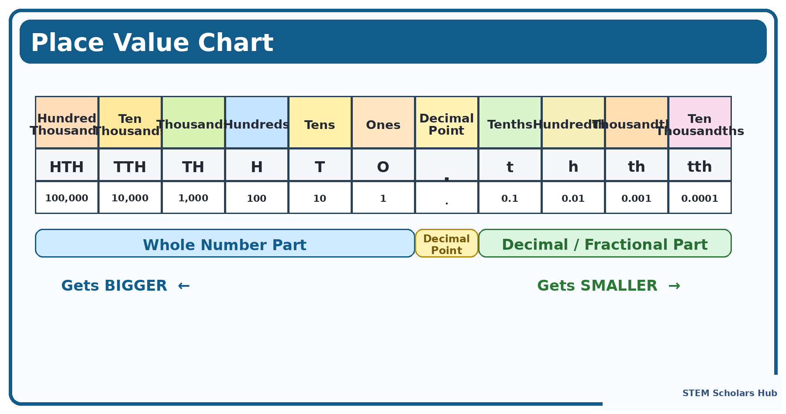

Slide 3
Whole Numbers: the place tells the value
Use one example and say each digit out loud.
Example: 3,672
Quick picture clue
Thousands
Hundreds
Tens
Ones
Left is larger in whole numbers.
3
6
7
2
3,000
600
70
2
6 hundreds
3 thousands
Expanded form: 3,000 + 600 + 70 + 2
7 tens
2 ones
“The 6 is not just 6. It is 600 because it is in the hundreds place.”

Slide 4
Decimals: each step right gets smaller
Connect decimals to money and to fractions.
Example: 0.45
Compare the pictures
4 tenths = 0.4
0.8 = 8 tenths
A strip with 4 out of 10 parts shaded
5 hundredths = 0.05
0.08 = 8 hundredths
0.8 is bigger because tenths are larger pieces.
Money example:
$0.50 > $0.05
A 10×10 grid with 5 tiny boxes shaded

Slide 5
Fractions: the denominator tells the size of the parts
Smaller denominator → larger pieces when the whole is the same.
Compare 1/5 and 1/10
Quick compare routine
Look at the denominator.
“How many pieces is the whole cut into?”
Fewer pieces means each piece is larger.
If needed, change the fraction to a decimal.
1/5 = 1 part out of 5
1/10 = 1 part out of 10
The 1/5 piece is wider, so 1/5 is greater.
Decimal connection:
Question to ask the student:
“Would you rather get 1 piece from 5 slices or 1 piece from 10 slices?”
1/10 = 0.1
1/5 = 0.2
“More pieces means smaller pieces.”

Slide 6
Question 1: whole numbers
Guide the student to name the place first.
What is the value of 6 in 3,672?
Thousands
Hundreds
Tens
Ones
3,672
3
6
7
2
3,000
?
70
2
“What place is the 6 in?”
Hint ladder
Thousands
Hundreds
Tens
Ones
Student job: point to the correct box before answering.

Slide 7
Answer 1
Say the place and the value in one sentence.
The 6 is in the hundreds place, so its value is 600
Thousands
Hundreds
Tens
Ones
Sentence frame:
“The digit 6 is in the hundreds place, so it is worth 600.”
3
6
7
2
3,000
600
70
2
Have the student repeat the sentence one time.

Slide 8
Question 2: decimals
Ask the student to compare tenths and hundredths.
Which is greater: 0.8 or 0.08?
Which picture covers more of the whole?
0.8 = 8 tenths
Bigger pieces
0.08 = 8 hundredths
Smaller pieces

Slide 9
Answer 2
Use both words and pictures to justify the answer.
0.8 is greater
Reason: 8 tenths is more than 8 hundredths.
0.8 = 8 tenths
0.08 = 8 hundredths
“0.8 is greater because tenths are bigger than hundredths.”

Slide 10
Question 3 and answer: fractions
Use the picture first, then say the answer.
Which is greater: 1/5 or 1/10?
Answer: 1/5 is greater.
Why? The whole was cut into fewer pieces, so each piece is bigger.
1/5
Decimal check:
1/5 = 0.2
1/10 = 0.1
1/10
“Would you rather have 1 piece from 5 slices or 1 piece from 10 slices?”

Slide 11

Wrap-up
Finish with one final check and one sentence summary.
Remember:
Whole numbers
Left is larger
Decimals
Right is smaller
Fractions
Bottom tells size
Exit ticket
Which is greater: 0.3 or 0.03?
Explain using place value.
Target answer: 0.3 is greater because 3 tenths is more than 3 hundredths.
Notes:
[Sources]
- Photo on right: Unsplash, Jakub Żerdzicki, “Hand writing in notebook with calculator and cash” (https://unsplash.com/photos/hand-writing-in-notebook-with-calculator-and-cash-leLj_06wjJQ).

